Slide 1
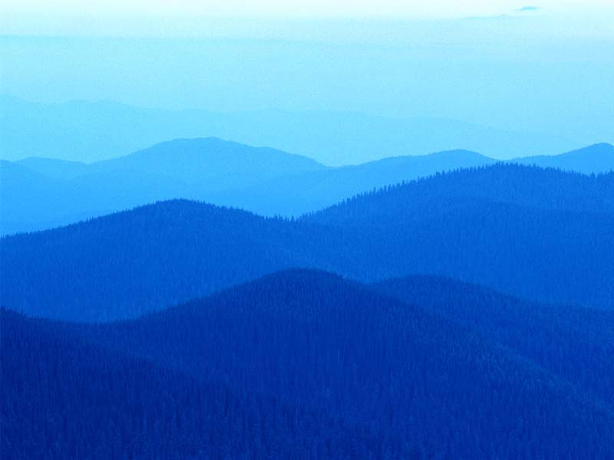

I Love the Mountains
Traditional folk song
Performance track

Slide 2
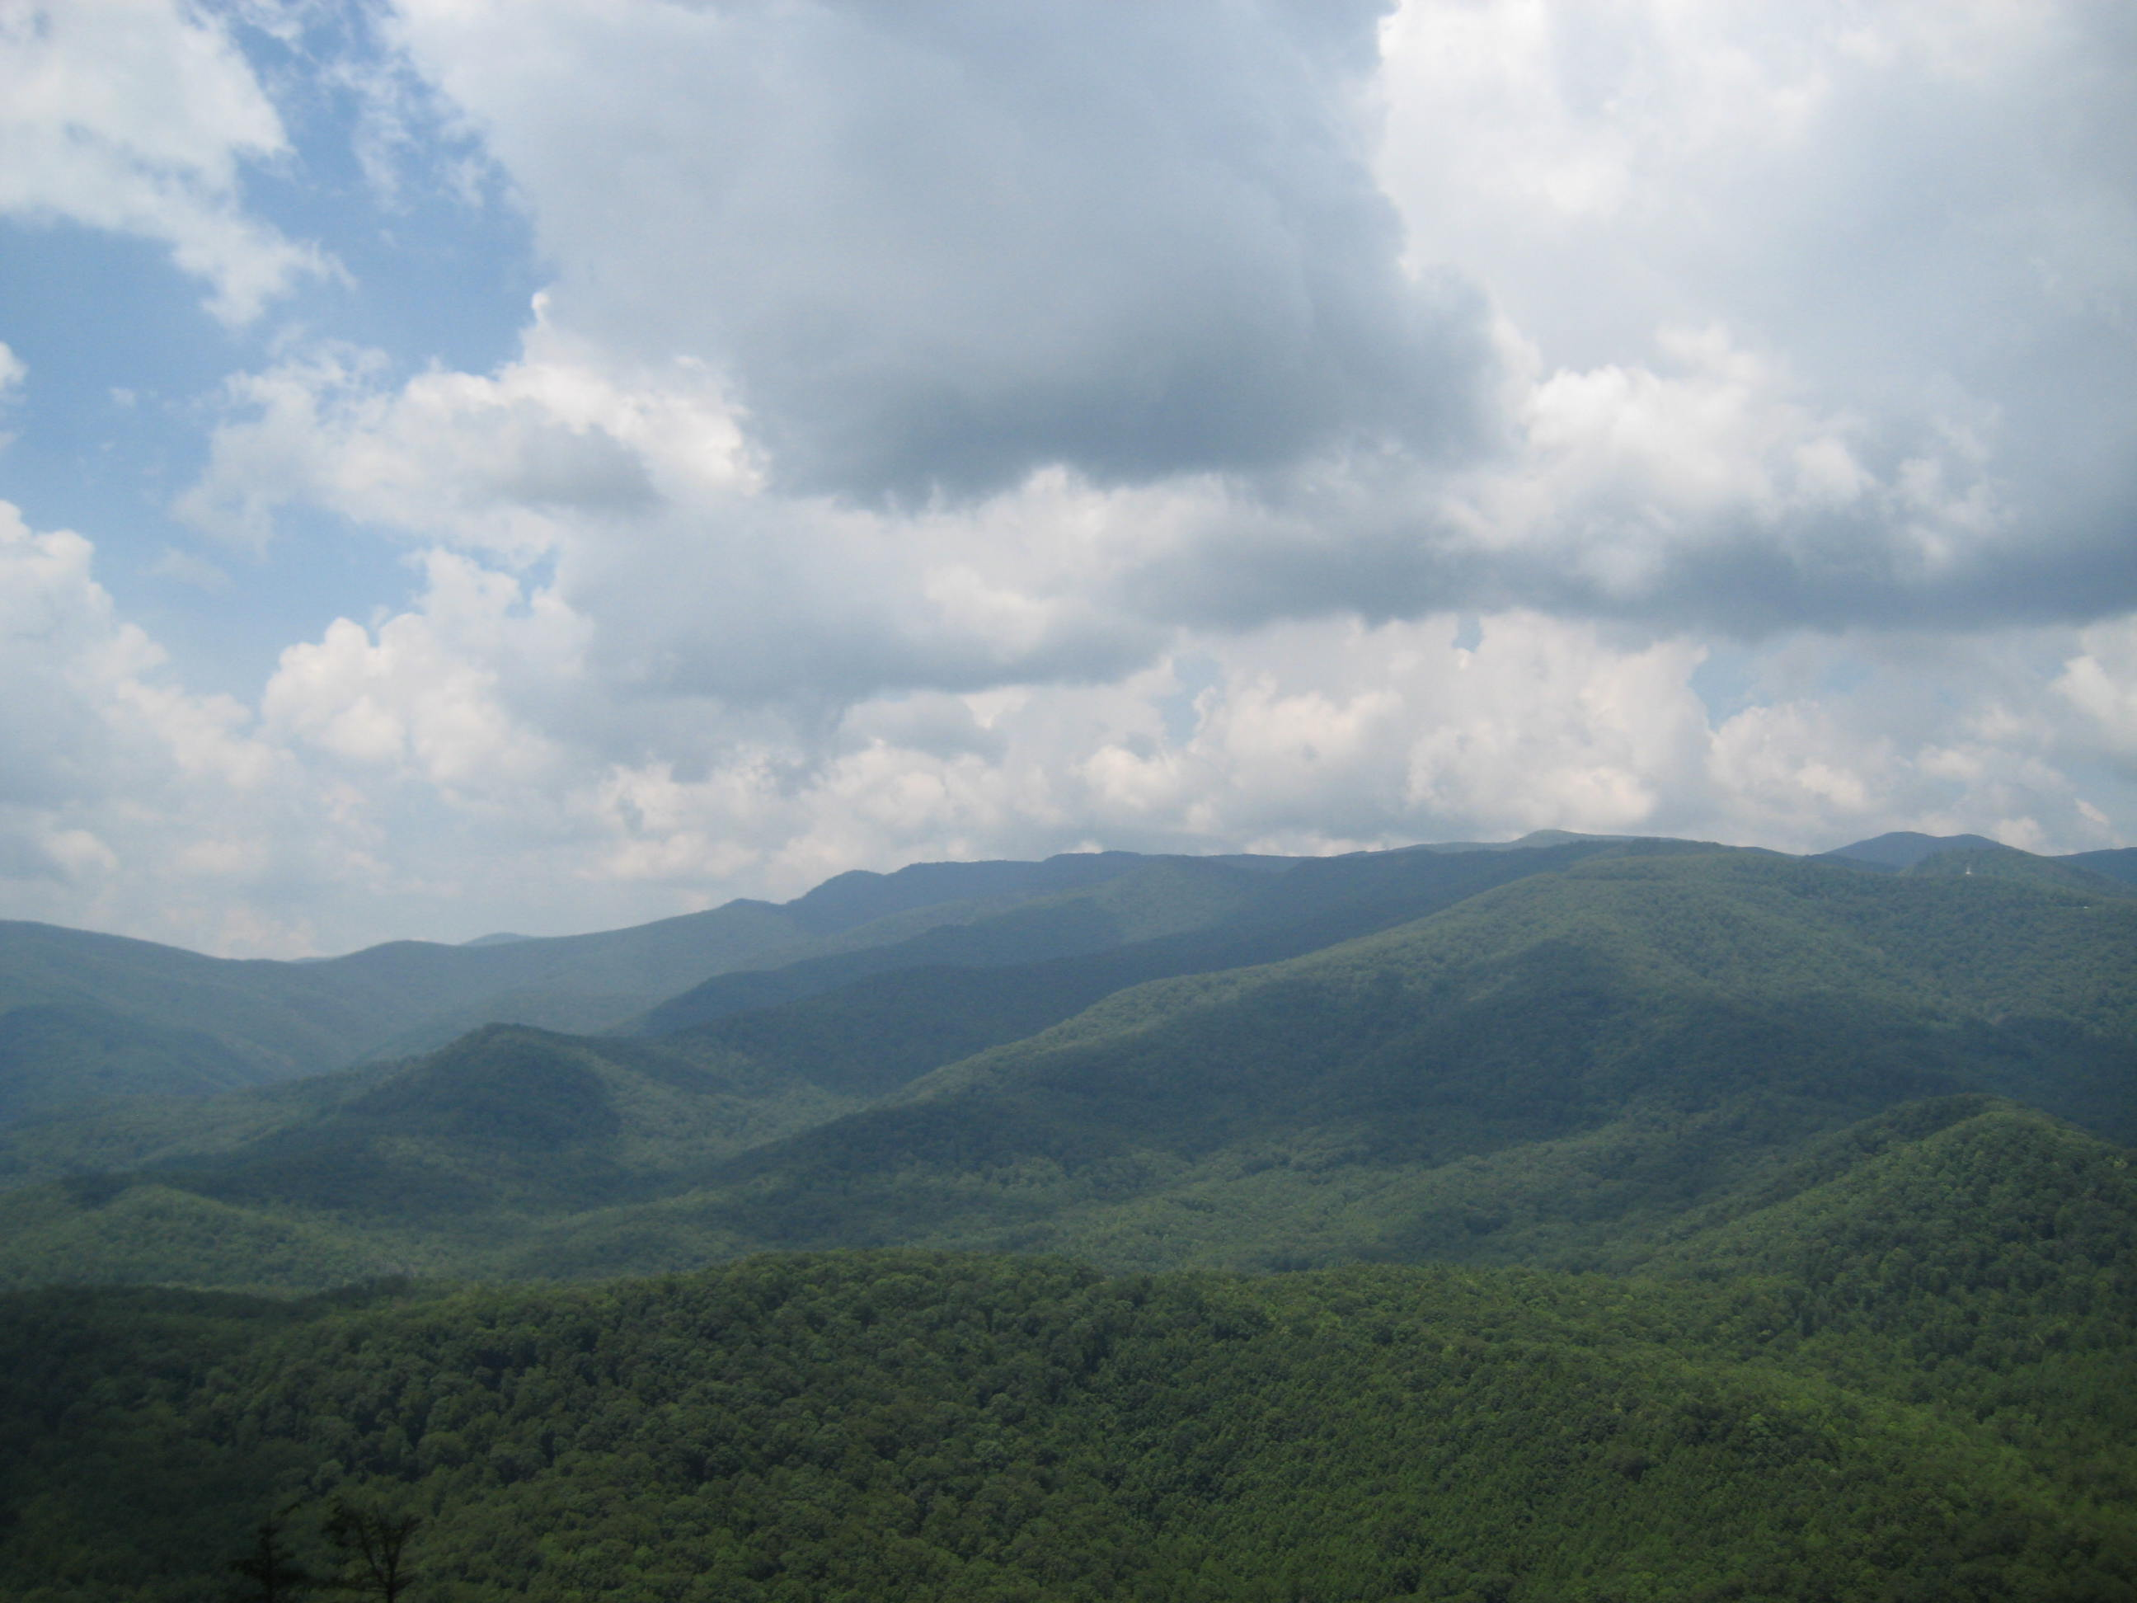
I love the mountains
I love the rolling hills

Slide 3
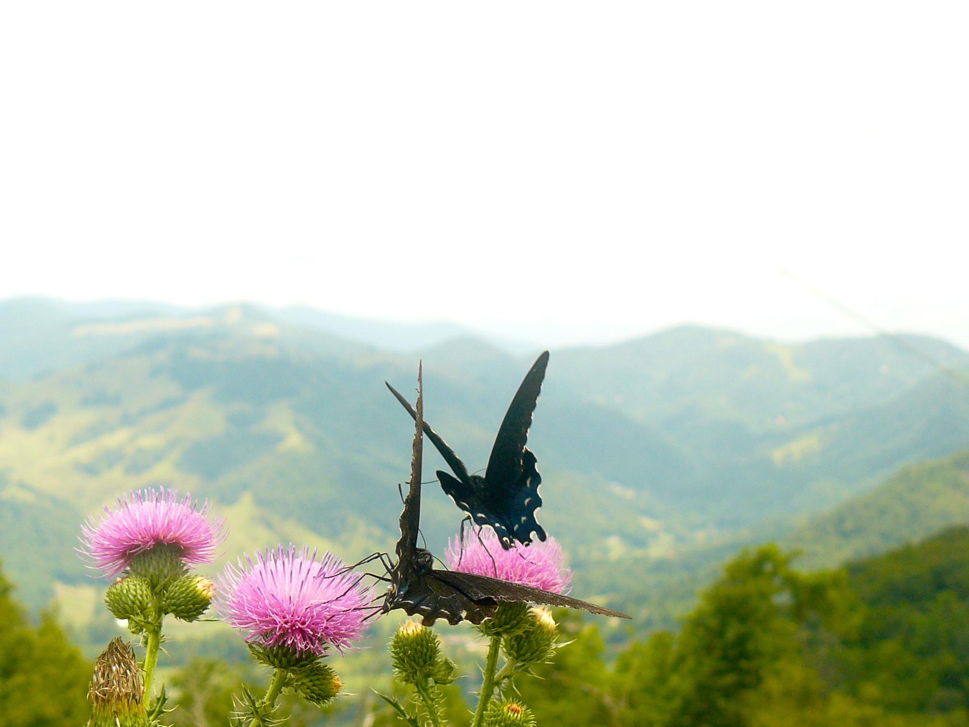
I love the flowers
I love the daffodils

Slide 4
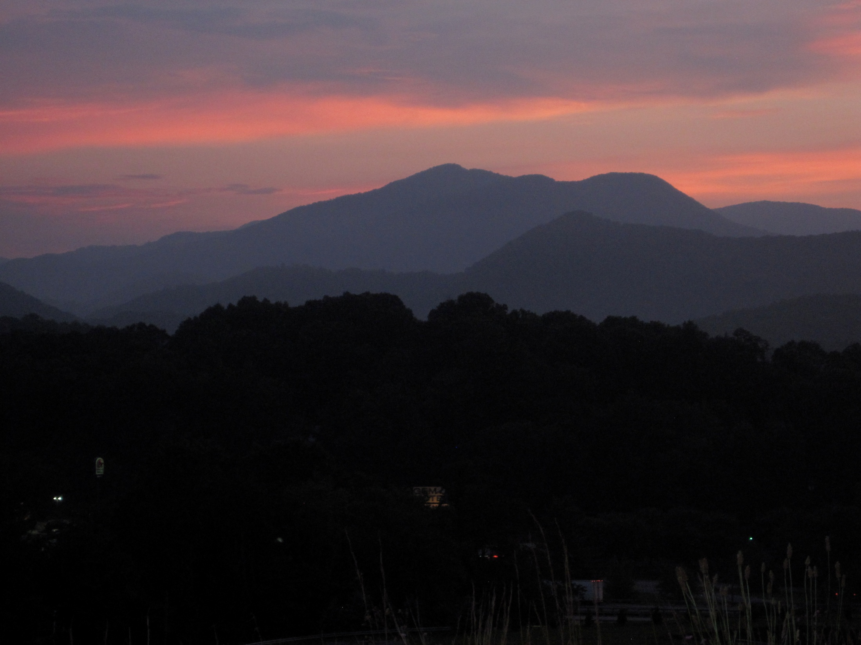
I love the fireside
When all the lights are low

Slide 5
Boom-de-ah-da,
Boom-de-ah-da,
Boom-de-ah-da

Slide 7
I love the mountains
I love the rolling hills

Slide 8

I love the flowers
I love the daffodils

Slide 9
I love the fireside
When all the lights are low

Slide 10
Boom-de-ah-da,
Boom-de-ah-da,
Boom-de-ah-da
Boom! Boom!
Boom! Boom!

Slide 11
Learning Goal
Student will understand that melody can move by step, skip or repeat.
4 | Sings musically with correct hand signs.
3 | Sings with correct hand signs every time.
2 | Sings with correct hand signs when teacher helps.
1 | Does not sing with hand signs.
0 | Does not know what melody means.

Slide 12
Music Grades
Music Grades
O = outstanding – mostly 4s, some 3s
S = satisfactory – mostly 3s, some 2s
N = needs improvement – mostly 2s
U = unsatisfactory – mostly 1s

Slide 13
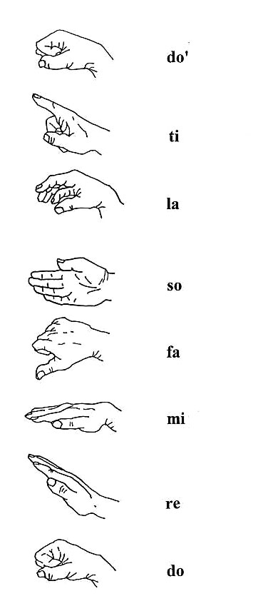
Step?
Skip?
Repeat?

Slide 14
Step!

Slide 17
Step?
Skip?
Repeat?

Slide 18
Repeat!

Slide 20
Step?
Skip?
Repeat?

Slide 21
Skip!

Slide 22
Line notes or space notes?

Slide 23
space notes!

Slide 26
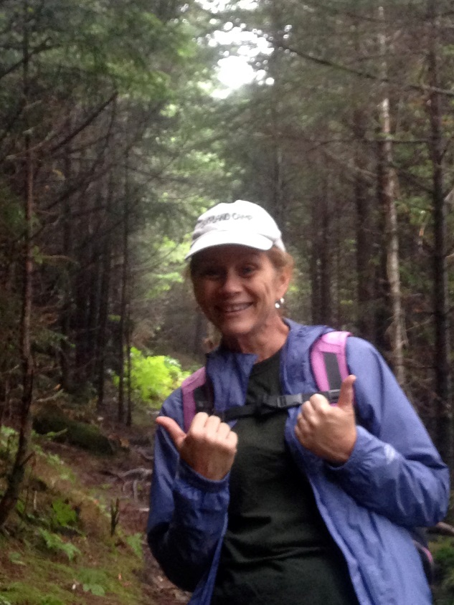
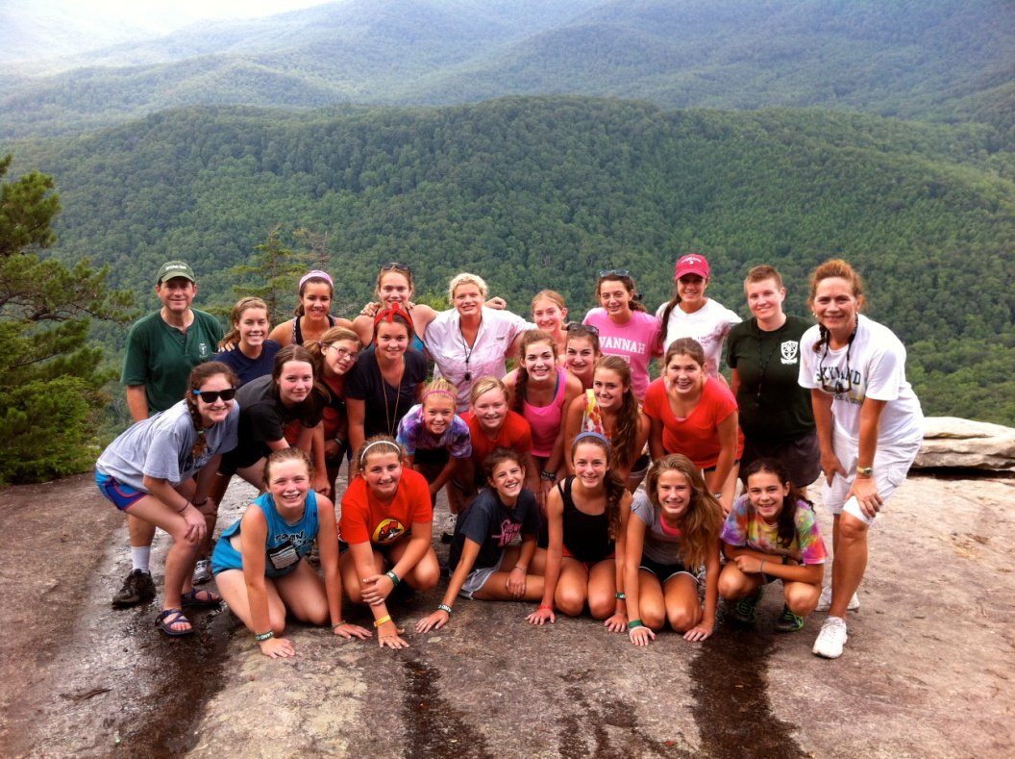

Slide 27
Learning Goal
Student will understand ostinato, then read music and perform ostinato
4 | Can read the music and perform ostinato musically, without help
3 | Can read the music and perform ostinato with help.
2 | Can read the music and perform ostinato with a few mistakes.
1 | Can hear and label ostinato in song
0 | Does not have any knowledge of ostinato or reading music

