Slide 2
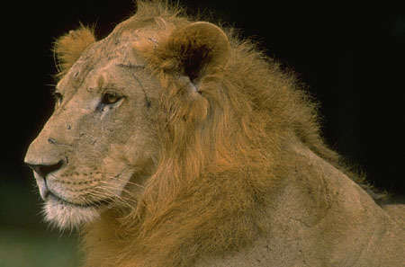

The Lion Sleeps Tonight
Written by George David Weiss, Hugo Peretti, and Luigi Creatore
Originally a Zulu hunting song, this was first recorded in South Africa. Pete Seeger brought the song to the United States in the 1950s when he recorded it with his band “The Weavers”.

Slide 3
Wimoweh, wimoweh, wimoweh, wimoweh (repeat)

Slide 4
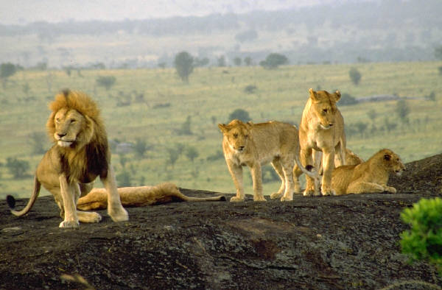
In the jungle, the mighty jungle
The lion sleeps tonight
In the jungle, the quiet jungle
The lion sleeps tonight

Slide 5
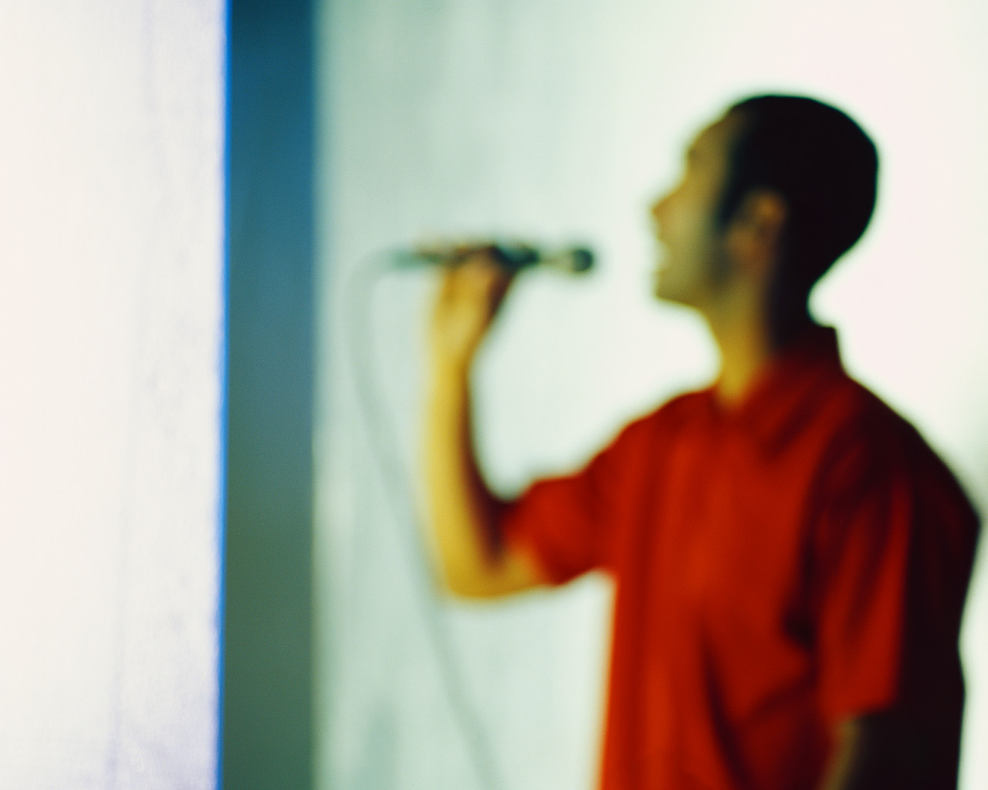
eeeeeeeeee eeeee
eeee eeee
um um away
oo
Wimoweh . . . Wimoweh . . . Wimoweh . . . wimoweh

Slide 6
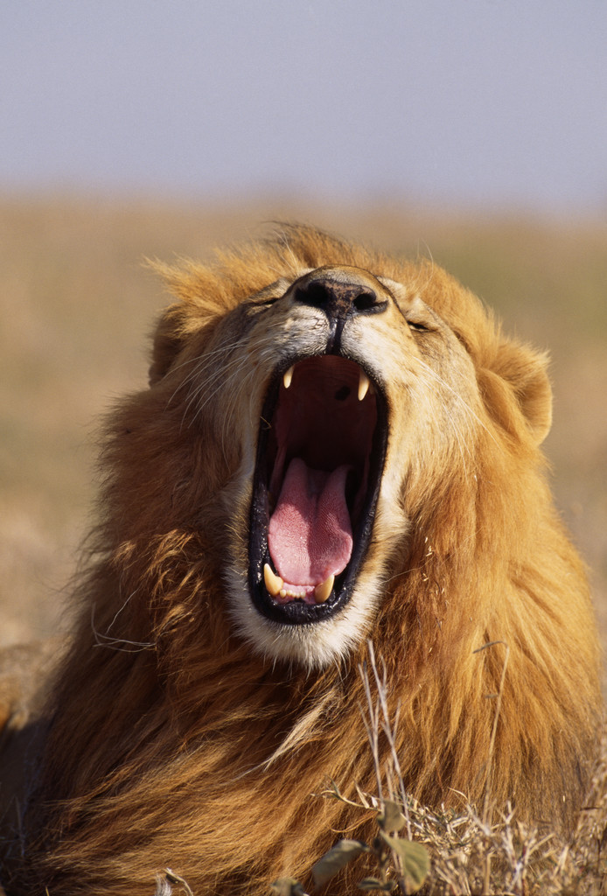
Near the village, the peaceful village
The lion sleeps tonight
Near the village, the quiet village
The lion sleeps tonight

Slide 7

eeeeeeeeee eeeee
eeee eeee
um um away
oo
Wimoweh . . . Wimoweh . . . Wimoweh . . . wimoweh

Slide 8
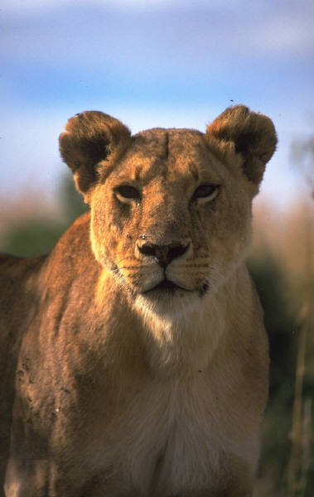
Hush, my darling, don't fear, my darling
The lion sleeps tonight
Hush, my darling, don't fear, my darling
The lion sleeps tonight

Slide 9
eeeeeeeeee eeeee
eeee eeee
um um away
oo
Wimoweh . . . Wimoweh . . . Wimoweh . . . wimoweh

Slide 10
MU.5.H.2.2
Describe how technology has changed the way
audiences experience music.
Jimmy Fallon and Billy Joel
Ladysmith Black Mambazo

Slide 11
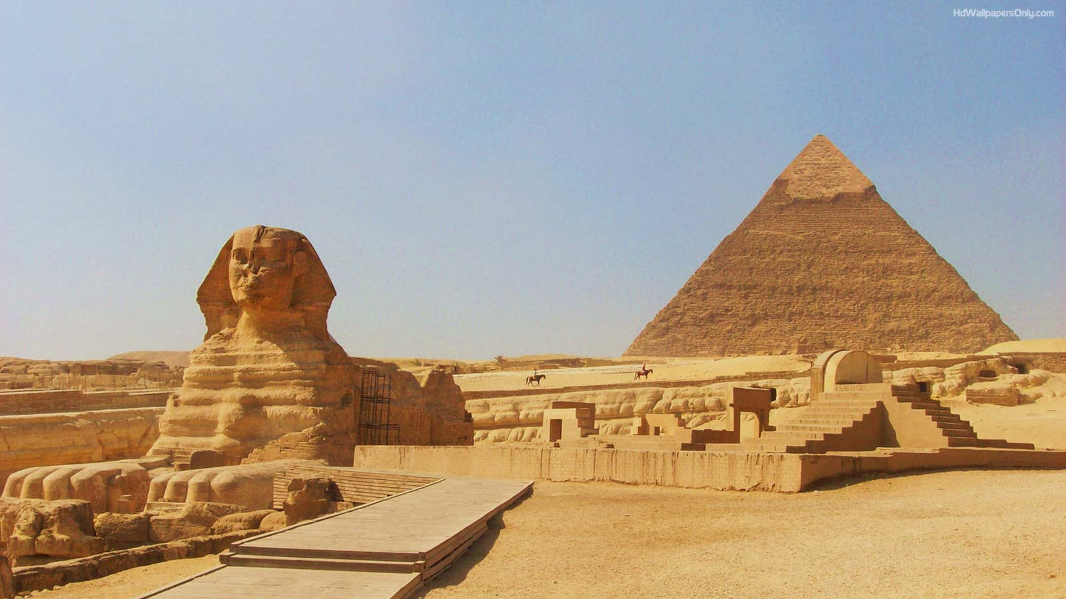
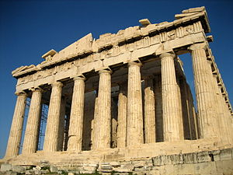
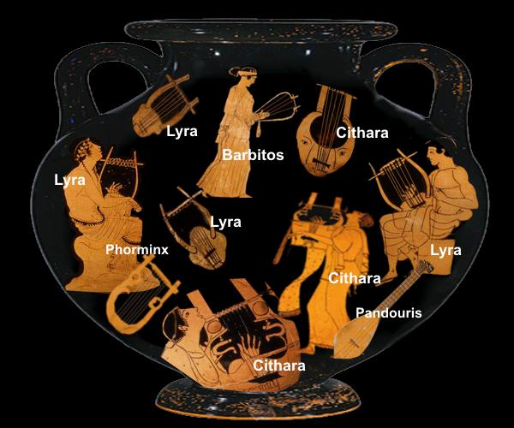
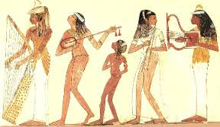
Was there music before recorded music?
Ancient Egypt
3150 BC
Ancient Greece
8th Century BC
They had music, but we don’t know what it sounded like. They didn’t write it down, they didn’t record it.

Slide 12
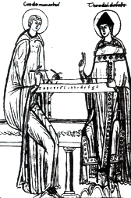
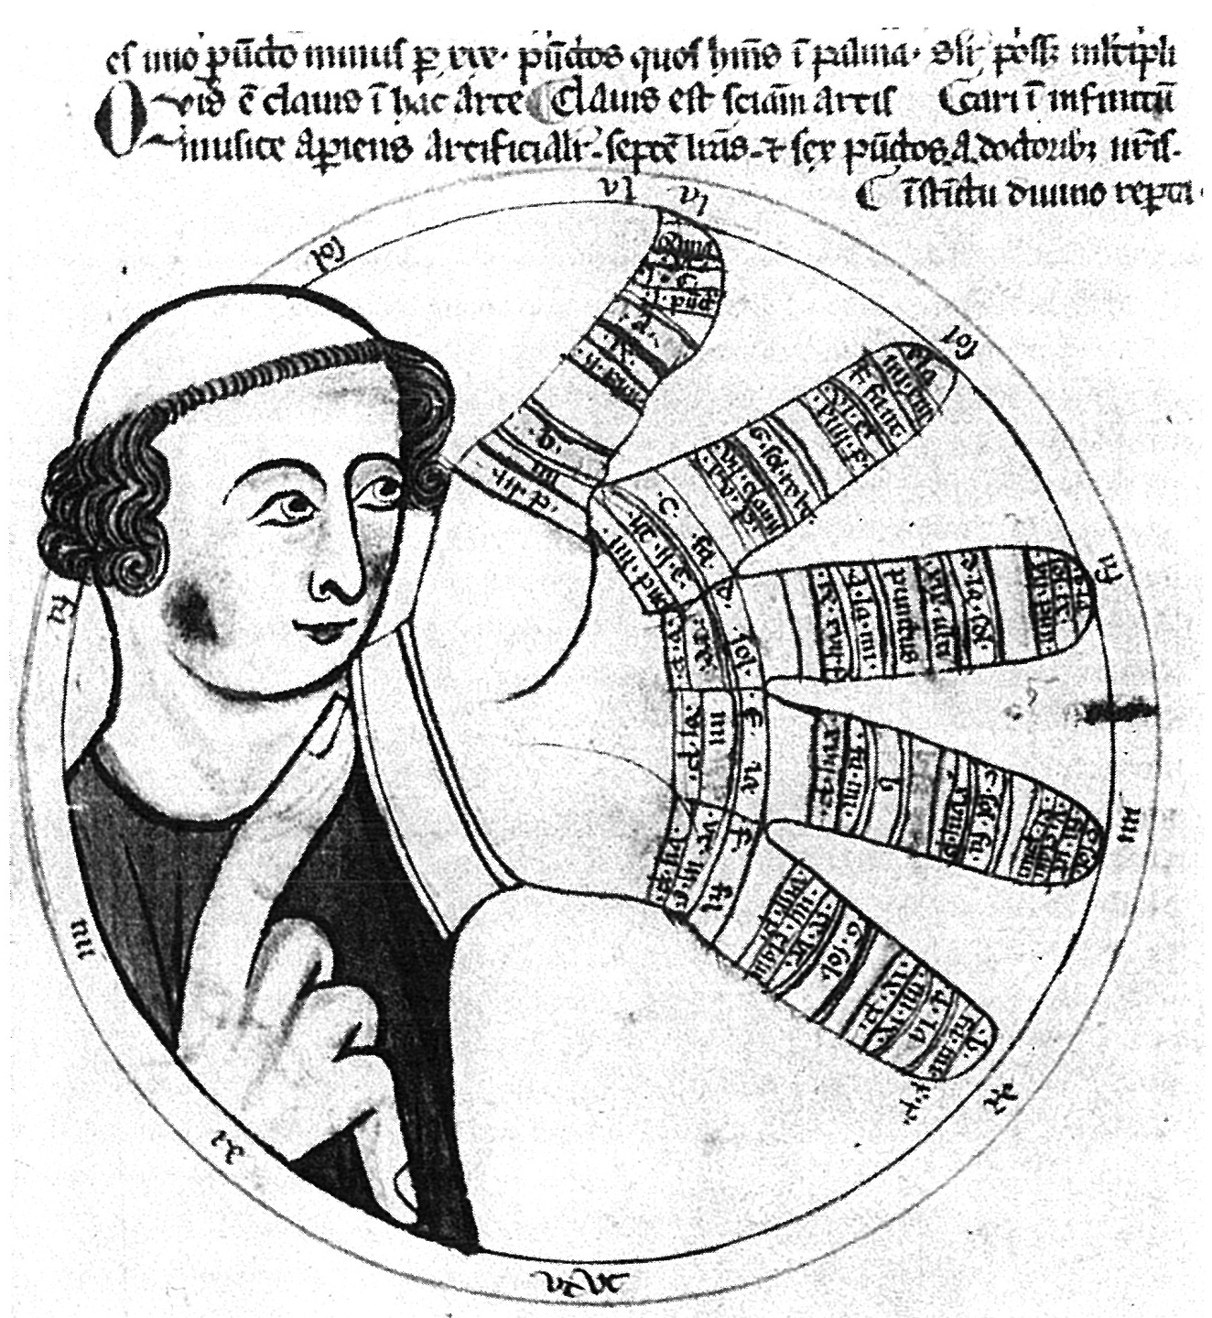
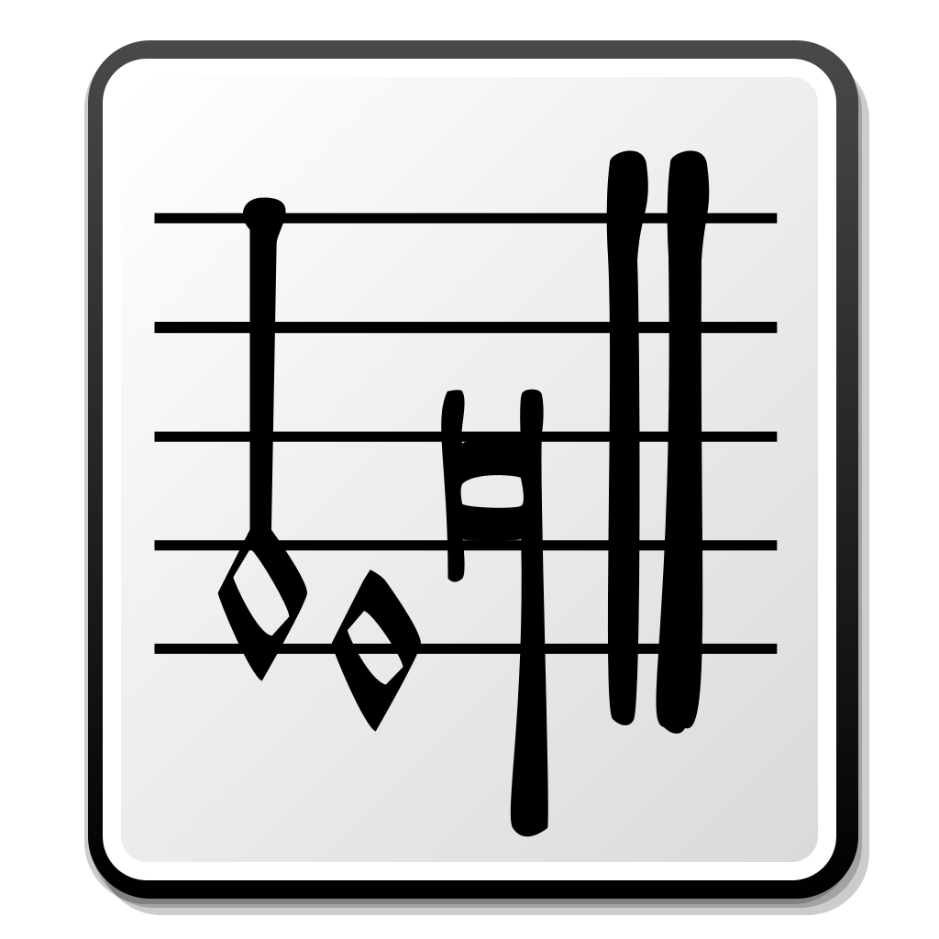
1,000AD Music notation invented
Scholars today can read this music, so we know what their music sounded like.

Slide 13
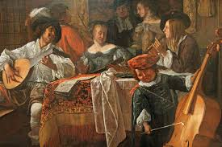
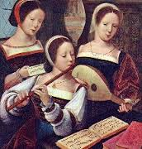
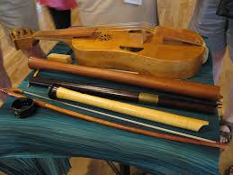
Renaissance Period 1400 - 1600
People gathered to sing, play instruments and dance

Slide 14

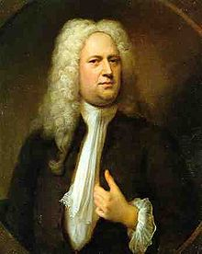
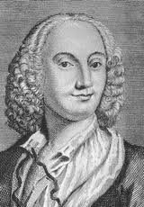

Baroque Period 1600 - 1750
The violin sounded the same as it does today
Johann Sebastian Bach
1685 - 1750
Born in Germany
Church Musician
wrote music for voice, harpsichord, organ
George Friderich Handel
1685 - 1759
Born Germany
Antonio Vivaldi
1678 - 1741
Born Italy
Wrote Hallelujah Chorus
Famous for violin
Wrote The Four Seasons
harpsichord

Slide 15
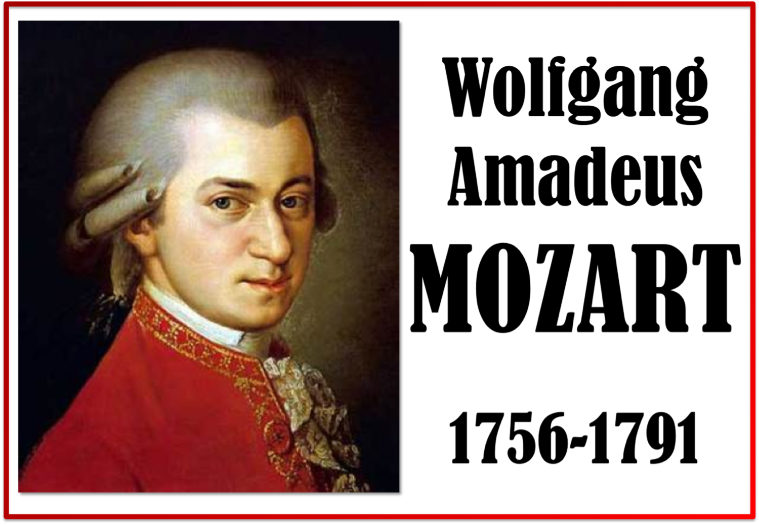
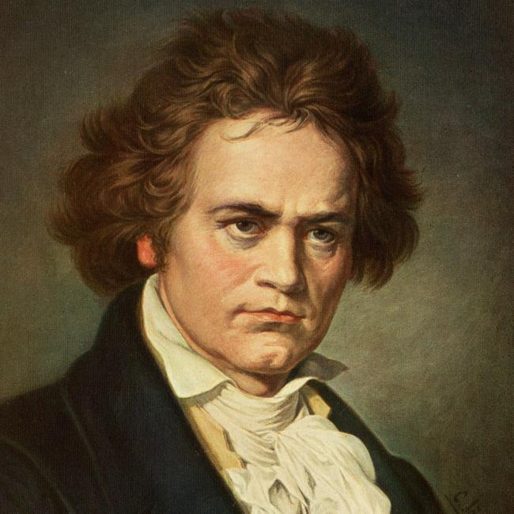
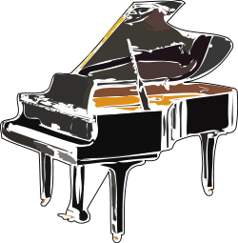
Classical Period 1750-1830
People went to orchestra concerts, operas, and played music in their own homes.
Child prodigy
Wrote over 600 pieces of music
Ludwig van Beethoven 1770 - 1827
Born in Germany
Composer and pianist
Wrote symphonies, piano music and chamber music
Was deaf by the end of his life
Piano was invented late 1700s

Slide 16
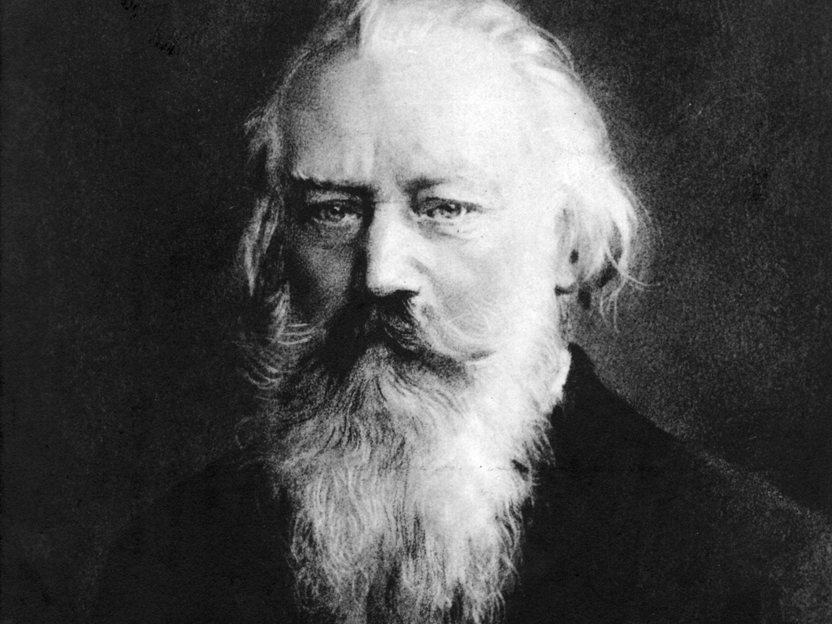
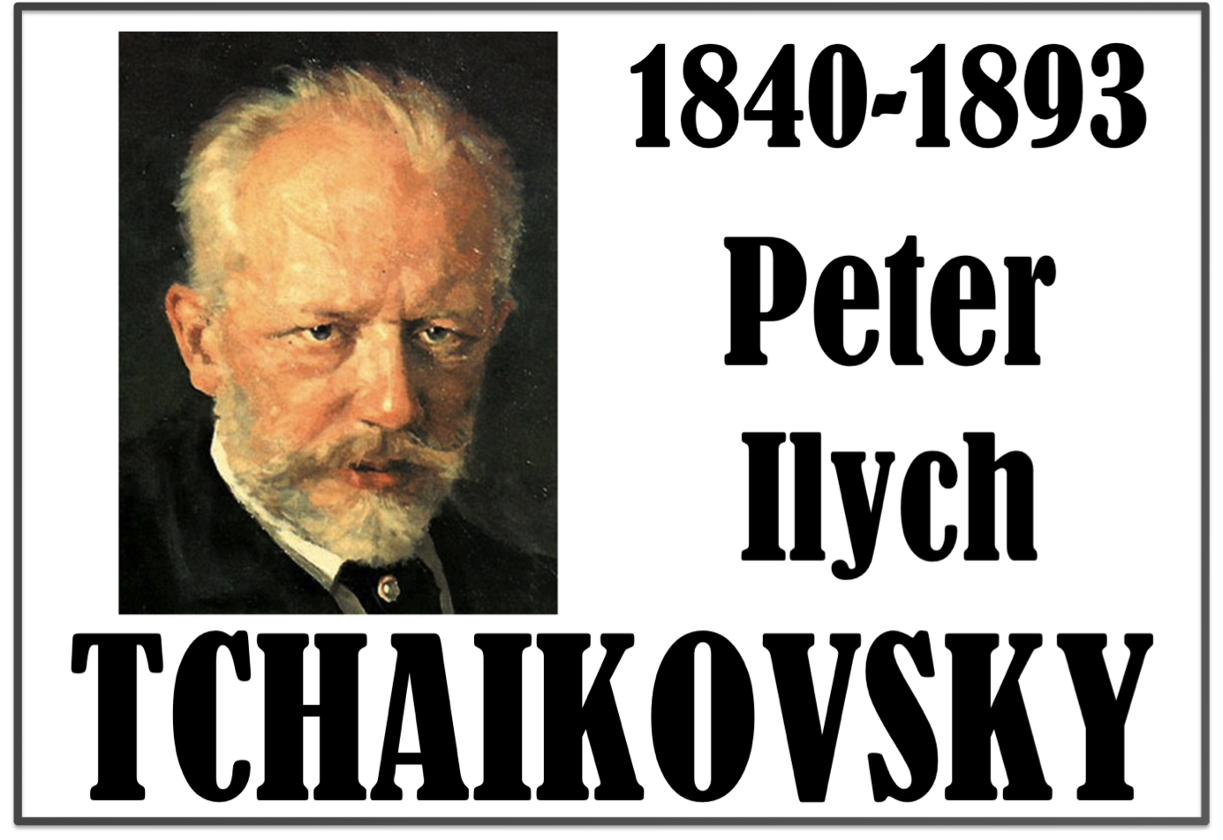
Romantic period 1830 - 1900
Johannes Brahms
1833 – 1897
Born in Russia
Wrote the Nutcracker and other Ballets
Orchestra pieces include 1812 Overture and March Slav
Born in Germany
Famous for Hungarian Dances
Wrote music for orchestra, piano and other instruments

Slide 17
In the 1800s, they way we experience music changed!
Late 1800s

Slide 18
1940s

Slide 19
1950s

Slide 20
1960s
1980s

Slide 21
1990s
2000s

Slide 22
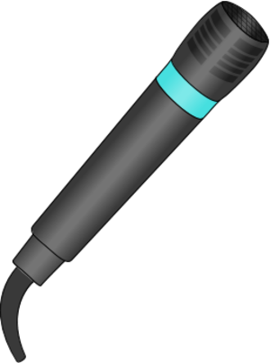
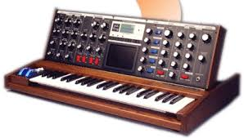
Name one way technology has changed the way we experience music.
Opera 1600s – present
Live performance that tells a story with music
Movie 1900s – present
Recorded performance that tells a story with music
microphones
Amplify music
New sounds
Synthesizers, MIDI
High speed data transfer
Can collaborate with someone across globe
Broadcasting (TV and Radio)
Can experience a performance from your home
Invention of loop machines
Make a one man band

