Slide 2
Wade in the Water
African American spiritual

Slide 3
Wade in the water.
Wade in the water children
Wade in the water.
God’s gonna’ trouble the water.

Slide 4
Call: Now Jordan’s water is chilly and cold.
Response: God’s gonna trouble the water.
Call: It chills the body but not the soul.
Response: God’s gonna trouble the water.

Slide 5
Wade in the water.
Wade in the water children
Wade in the water.
God’s gonna’ trouble the water.

Slide 6
Call: Now Jordan’s water is deep and wide
Response: God’s gonna trouble the water
Call: Meet my mother on the other side
Response: God’s gonna trouble the water.

Slide 7
Wade in the water.
Wade in the water children
Wade in the water.
God’s gonna’ trouble the water.

Slide 8
Call: If you get there before I do
Response: God’s gonna trouble the water.
Call: Tell all my friends I’m comin’ too
Response: God’s gonna trouble the water.

Slide 9
Wade in the water.
Wade in the water children
Wade in the water.
God’s gonna’ trouble the water.

Slide 10
What do the words really mean?
http://www.pbs.org/video/2181639247/

Slide 11
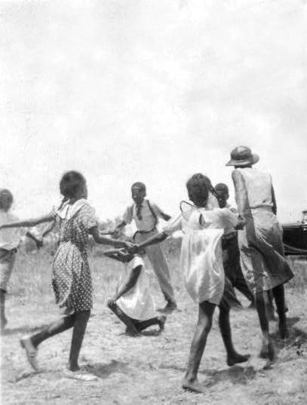
Just from the Kitchen
Eatonville girls singing, 1935

Slide 12
Major or Minor?

