Slide 1
The Lake Sybelia
Facts Project
A Collection of Fun Facts about
Lake Sybelia Elementary School
By: Miss Kelly’s 4th Grade Class
May, 2013

Slide 2


The LSE Facts Project
This project began when Miss Kelly's class sent out a survey to collect data about many different topics in our school. We collected data from teachers in every grade and gathered data from our P.E teachers, art & music teachers, nurse, parents, students and more!
When all the results came in from the survey, we gathered and organized our data and then worked to draw conclusions from it. With our information ready, we then began to make Power Points in order to create a product which would share with our community what Lake Sybelia Elementary is all about!
There are facts about everything from food to art.
Enjoy!

Slide 3

At LSE, students consume about
1,200
slices of pizza every month!
CF

Slide 4
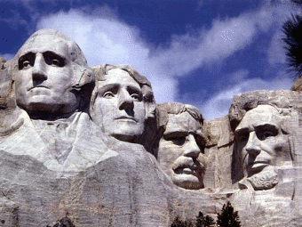

55% of LSE students are taught about
11-25
historical figures!
AB

Slide 5
At Lake Sybelia,
82% of students solve
11-40
Math Problems in class each day.
EM

Slide 6

of students answer
82%
11 - 40
Math questions each day!
EM

Slide 7
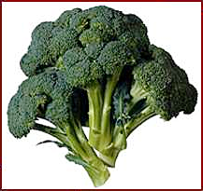
At LSE, students eat about
200
pounds of vegetables each week!
CF

Slide 8
64% of LSE students participate in more than
12-20
Science lessons each grading period.
AB

Slide 9

Here at Lake Sybelia,
we get about
51-60
visitors every day!
H.W.

Slide 10
55% of LSE teachers complete
hours
of professional development each year.
21+
H.W.

Slide 11


4,397
of the books in the media center are Fiction.
That’s 49% of the books!
L.M

Slide 12


At Lake Sybelia,
we use at least
10
gallons of paint every year!
RG

Slide 13


23%
Here at LSE,
of teachers have about 15 students in their class.
Small teacher-student ratios are a priority at LSE!
H.W.

Slide 14

4,553 books in the LSE media center are
Non-Fiction.
Wow! That’s 51%! That probably means LSE students like
non-fiction books a lot.
L.M

Slide 15


96% of LSE teachers teach
4 - 8
math lessons per week.
Class 2+2=4
Our teachers are very determined to have their students
learn new things in math!
2+2=4
EM

Slide 16
“lefties”
14%
of LSE teachers have
Three in their classrooms!
H.W.

Slide 17
158
students
    read 3 or more Sunshine State Books each year.
LD

Slide 18
At LSE we have
10,984
books in the
media center
Kids at LSE like to read books from the Media Center.
L.M

Slide 19


In 2012-2013 the most checked out book was
LD

Slide 20


At LSE, students devour about
350
hamburgers each month!
CF

Slide 21
Here at LSE, we use about
45
pounds of clay each year!
RG

Slide 22

Two people at LSE say that they have
1,000
books at home!
57% of us have 100 – 400 books!
L.M

Slide 23

Here at LSE,
64%
of our teachers have 2 or more degrees!
H.W.

Slide 24

Here at LSE the third, fourth, and fifth graders run about…..
1 mile
each week in PE!
NP

Slide 25
Approximately
183
Media Center books are lost each year!
LD

Slide 26


At LSE,
we spend
$1,000
on art supplies every year!
Wow! That’s a lot of masterpieces!
RG

Slide 27
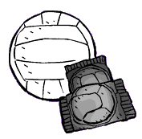



52% OF LSE FAMILIES GO TO SPORTING EVENTS REGUARLY
NP

Slide 28

At LSE, fewer than
1%
of students say they have a TV in their bedroom.
RS

Slide 29



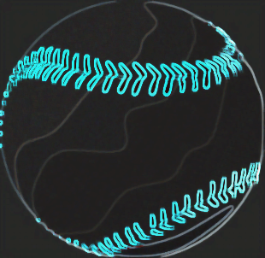
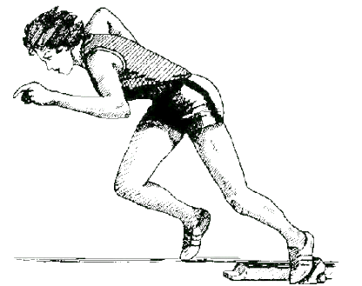
Students at LSE have
over 40
special talents!
NV

Slide 30


At Lake Sybelia, we create
630 to 1,260
Art projects every grading period!
RG

Slide 31
55% of LSE teachers say that 1-2 professional scientists help their students learn
each year!
Some come in person, others help us learn through educational videos, websites, articles, and even books!
R.B

Slide 32

In the Art Room, we create at least
1,000
paintings each school year!
SeM

Slide 33


There are about
500
instruments in the music room.
SeM

Slide 34
At LSE, over
68
percent of our teachers have been teaching for over
10 Years!
SoM

Slide 35


At the Lake Sybelia Clinic,
35
Another 40 are treated with
Band-Aids!
Ouch!
Injuries are treated with ice each week!
SoM

Slide 36
of our teachers have more than one teaching certificate.
88%
LR

Slide 37
At Lake Sybelia, less than,
1%
of the students speak
a second language
besides English!
SoM

Slide 38
At LSE, 82% of classes solve
11-40
Math problems each day!
SB

Slide 39


Here at LSE
71%
of teachers use movement
Breaks on a regular basis.
ZM

Slide 40
At LSE
26-30
minutes are spent moving at each PE Class.
ZM

Slide 41


LSE students do
Over 200 sit-ups
each 9 weeks.
ZM

Slide 42

41% of LSE teachers said they have more than
300
Kids at LSE must love to read!!
books in their classroom library !
C.R

Slide 43
55% of teachers say that their students get to make up to
10 choices each day.
Classroom choices are things like what to read, where to sit, class votes, and how to share new knowledge!

Slide 44


In an average month,
7,450
Half-pints of milk
are served
in the LSE cafeteria.
CL

Slide 45


On an average day, 56% of kids eat school made lunch at LSE.
This probably means that the lunch room staff has to work hard every day!
CL

Slide 46
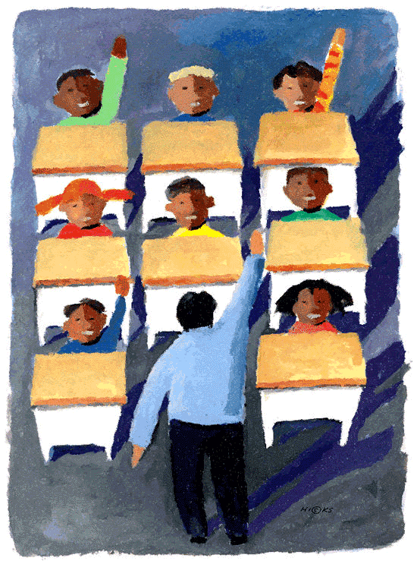
Did You Know…
That probably means that those grades have the most kids!
Wow!
That 1st and 3rd grades have the most teachers?!
C.R

Slide 47

150 lbs.
of
frozen food
are delivered to LSE each week.
CL

Slide 48


On an average day,
It's important to be on time to school!
19
students are late for school!
!
C.R

Slide 49
62% of our teachers say that their LSE students will learn over
400
new words each year!
C.R

Slide 50

On an average day,
cars go through the car line.
On a Walking School Bus day, that number drops to 58!
73
C.R

Slide 51
The most popular video game at L.S.E. seems to be
Minecraft
according to the surveys.
JS

Slide 52
91% of LSE families participate in fundraisers each year!
We are very fortunate to have such amazing and supportive families!
LR

Slide 53

41% of LSE classes use the playground for over 60 minutes per week.
15-minutes a day helps us to learn and grow!
LR

Slide 54
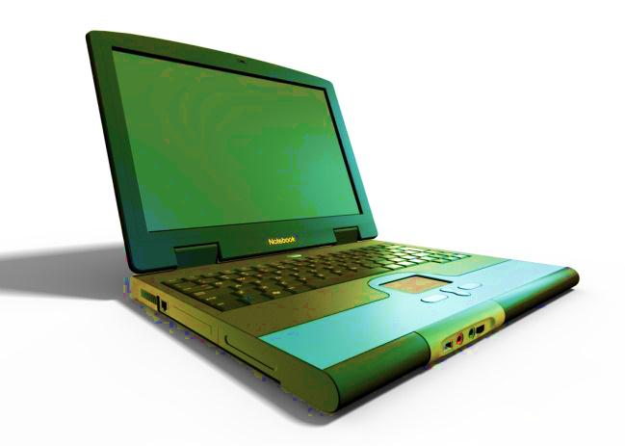
The most frequently used computer program in L.S.E. is
SuccessesMaker

Slide 55
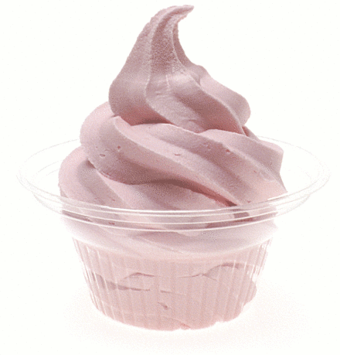
48% of LSE families go out for frozen yogurt at least once a month.
We must really like yogurt!!!
LR

Slide 56
36% of LSE teachers participate in
‘’Lunch Bunch’’ regularly.
R.B

Slide 57

55% of teachers spend more than $200 per year on their classrooms.
ACL

Slide 58
Our primary students run
half-a-mile
at each week.
That’s about
18 miles
each year!
Intermediate students run twice that far! That means by the end of fifth grade you will have run about 162 miles!
That’s like running to Tampa and back!
CF

Slide 59
36% of LSE students play video games for
3 to 5 hours a week!

Slide 60
A Few Notes About Our Project
This project gave us a great opportunity to create and refine questions, to work with real data, to practice a few Math skills, to draw conclusions, and to use our technology skills.
We would like to recognize the fact that this survey gives a partial view of our school community. With only a small percentage of the student and parent groups responding to the survey, we realize that not all of our numbers accurately represent our school. To help with this problem, we occasionally compared our responses to the whole student population rather than to just the small number of students who responded, with the intention of giving the most accurate view available from the data we have.
If you would like to see the Student Survey and Parent Survey, follow these links: http://www.surveymonkey.com/s/ZMSTGBL (parent) and http://www.surveymonkey.com/s/ZM6T96T (student).

Slide 61
Credits Page
Movement pages by: Nick & Zion
Reading and Books by: Logan & Lewai
Food done by: C.J. & Conner
Science and Social Studies by: Andrew and Ryan B.
Math and Numbers by: Emma & Sydney
Art and People done by: Hannah & Raivynn
Entertainment by: Lauren & Jacob
Other by: Claire

