Slide 1
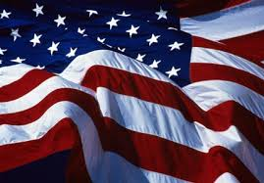
Happy Celebrate Freedom Week!

Slide 2
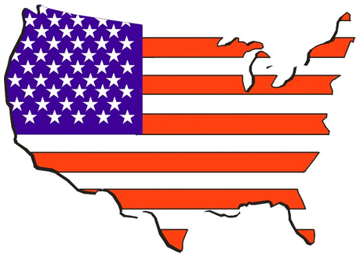
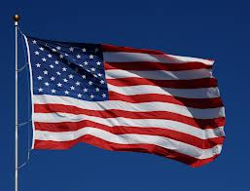
Star Spangled Banner
Star Spangled Banner was written in 1814 by Francis Scott Key.
After the Revolutionary War the American flag was still standing!

Slide 3
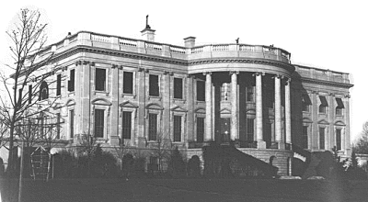
The White House
The White House in 1846.
Every president except George Washington lived in the White House.

Slide 4
The American Flag
The American Flag has 13 stripes. It has 7 red stripes and 6 white stripes.
The first American Flag was made in 1777.

Slide 5
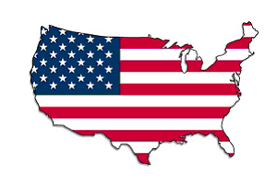
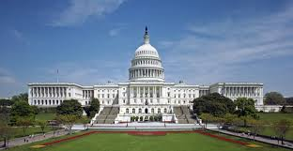
Washington, D.C.
Washington D.C was named after George Washington and Christopher Columbus .
Congress has met in Washington D.C. for over 200 years!

Slide 6
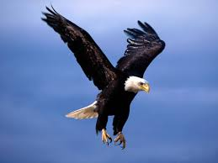
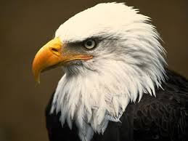
The Bald Eagle
The name of the Bald Eagle (not bald at all) comes from the word “piebald”.
A bald eagle is 8 feet long and can fly at 40 miles per hour!
Bald eagle nests can weigh up to 2 tons!

Slide 7
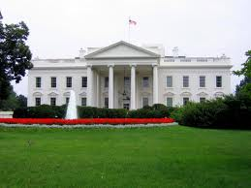
The White House
It took 8 years to build the White House and it has 107 rooms.
The White House is at 1600 Pennsylvania Ave., Washington, D.C.

Slide 8
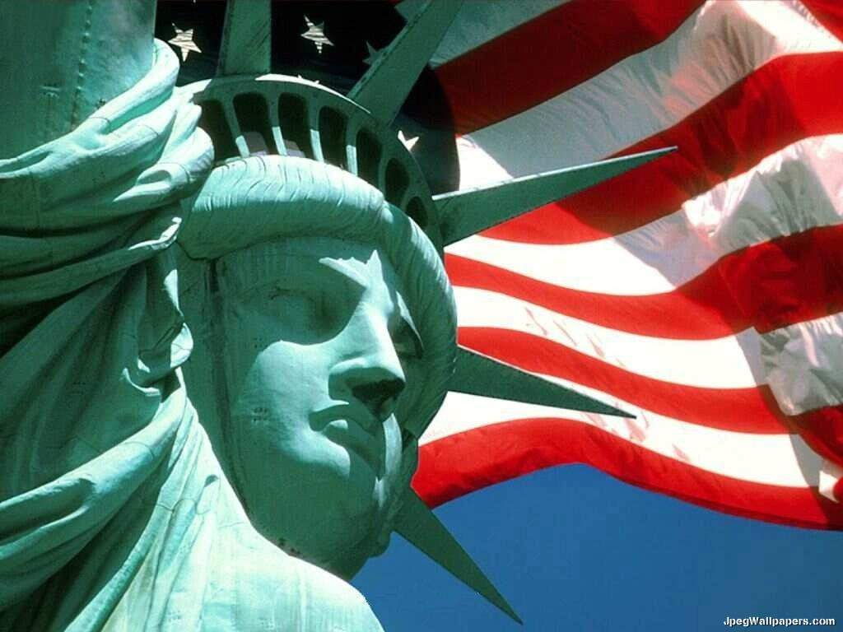
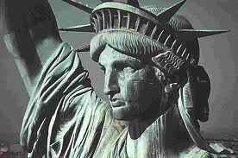
The Statue of Liberty
This statue symbolizes freedom and was a gift from France. It is located in New York Harbor. You can climb the stairs inside of it.

Slide 9
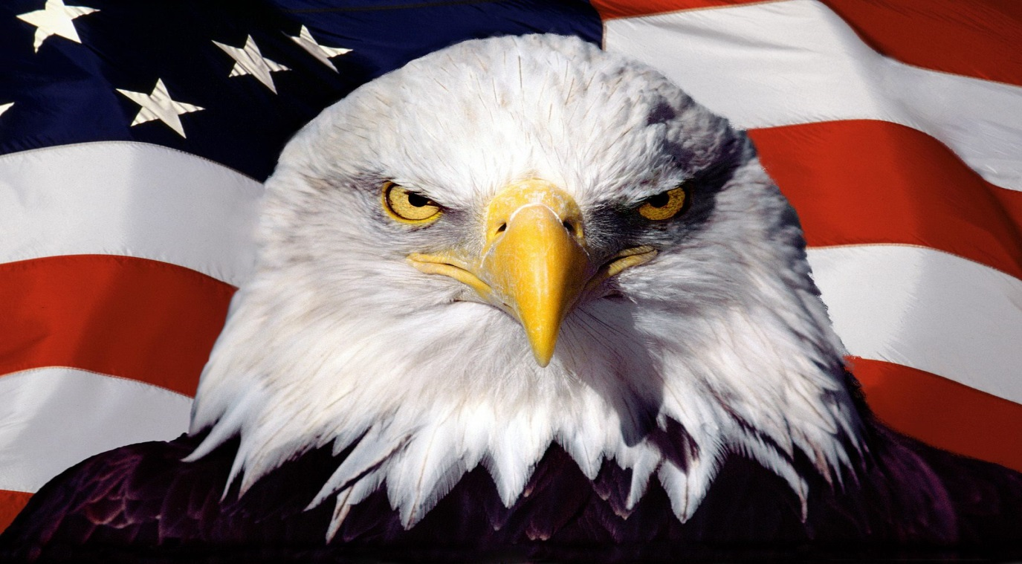
The Bald Eagle
The Bald Eagle was chosen as the national bird in 1782. It only lives in North America.
The eagle is on our money.

Slide 10
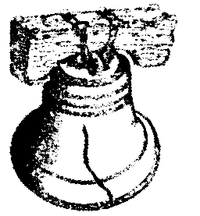
The Liberty Bell
The Liberty Bell is a symbol of freedom.
There were three bells made, not just one.
The last time the bell rang was on February 23, 1846, on George Washington’s birthday.

Slide 11
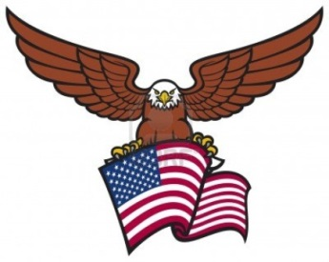
Washington, D.C.
The motto of Washington, D.C. is “Justia Omnibus” which means, “Justice for all.”

Slide 12
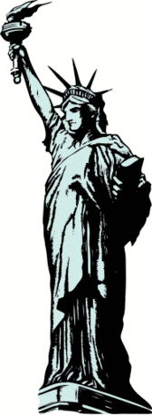
The Statue Of Liberty
The Statue Of Liberty’ real name is “Liberty Enlightening the World”
The Statue Of Liberty has the Declaration of Independence in her hand.
The Statue Of Liberty’s torch was a gift for America’s 100th birthday.

Slide 13
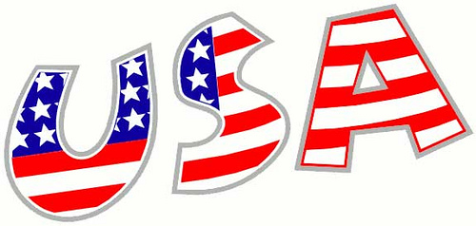
Thanks for watching!
Created by Miss Kelly’s Third Grade Class.

