Slide 1
Valencia Dual Enrollment
Next Steps, program details, etc.

Slide 2
I am accepted…Now what?
Atlas Account
-atlas.valenciacollege.edu
-Sign up for an account
DE Online Orientation
-In Atlas account
On Campus DE Orientation
-Check Atlas email
4) Meet with Counselor
5) Register for Classes

Slide 3
Registering for VC Classes at DP
Potentially here at DP:
College Algebra & College Trig
Intro to Humanities, & Asian Humanities
During the Summer you will receive updates via your student email
Meet with School Counselor
School Counselor will automatically enroll
Will be in DP schedule (at beginning of school year)

Slide 4
Registering for Classes at Valencia
Meet with School Counselor
Graduation Requirements
What classes at DP if any
Keep in mind certain classes only specific periods here at DP
Register in Atlas- Opens by May 31st (Fall Only)
Choose campus, online or hybrid
Have to go to each campus for textbooks
Cannot take flex start classes or classes less than 3 credits
Schedule MUST be provided to Counselor by July 7th (Email or In person)

Slide 5
What Classes Should I Take?
What college do you want to go to?
AP vs DE
Public vs Private
In State vs. Out of State
Purpose of DE
Meet high school requirements
AA Degree
Prerequisites for Major
What do you want to major in?
How rigorous of a schedule can you handle?
A “C” is a “C” is a “C”
Start of college transcript

Slide 6
Full Time vs. Part Time
Can meet most graduation requirements at VC
Most Courses: 1 course Valencia equals 1 credit at DP
Speech, New Student Experience, etc. are 0.5 credits at DP
2 American History Courses at VC meets grad requirement
Need extra online component for Economics
Part Time Students
Some classes at DP and some at Valencia
What can you handle?
Full Time Students
All classes at Valencia
4 classes in Fall, 4 in Spring, and 2 in Summer

Slide 7
Getting an AA Degree
2 full years (60 credit hours)
Transfers to Florida State Colleges (12 colleges)
May still have over 2 years at transfer school
Direct Connect to UCF
Apply as 1st time freshman to colleges Senior year
Must “apply” for AA degree (meet with grad coach, etc.)

Slide 8
Textbooks
Investigate what textbooks you will need
In Atlas
Courses, Registration, Get Books, and Checkout
Classes MUST be on your DP Schedule
Week of August 12th to pickup textbooks (Specific Dates to be sent through Remind Class)
If DP does not have textbook, you will be issued a voucher
Bring voucher to specific campus that you are taking your classes at
May need online textbook
May have extra expenses (lab coat, calculator, etc.)
Syllabus before class starts will state needs
Voucher MUST be used by 1st two weeks of VC class

Slide 9
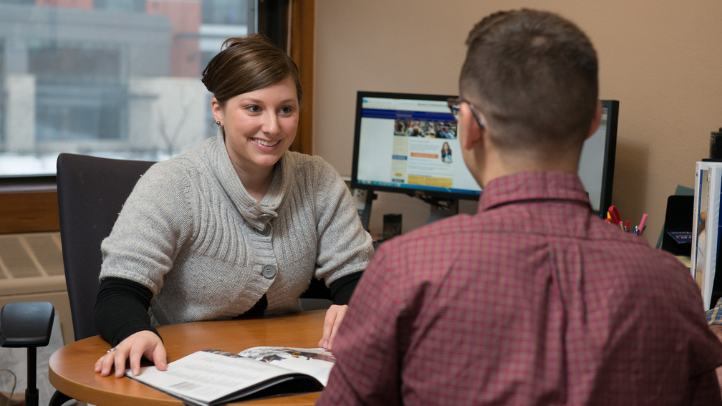
Drop and Add Classes
Before dropping you MUST check with school counselor
School Counselor needs to be made aware
You can drop classes into first week of class
Does not show on transcript
Must attend 1st day of class
You can add classes up to the first week
School Counselor needs to be made aware

Slide 10
Withdrawing from Classes
W
Can Withdraw from class by withdrawal deadline
Will receive a “W” on transcript
Need to meet with School Counselor FIRST
Once you have 2 Withdrawals and you will be dropped from DE program
May effect financial aid
May effect college acceptances
If Withdraw after deadline
Will receive a “WF”
W
W
W
W

Slide 11
Important Reminders
Must maintain:
3.0 high school GPA
2.0 Valencia GPA
Cannot withdraw from 2 courses
Cannot take flex start classes
Student Detail Schedule to Counselor by July 7th
Textbooks week of August 12th
Check Atlas email, school email, and sign up for Valencia DE Remind group
Stay in contact with School Counselor
This is the start of your college transcript

Slide 12
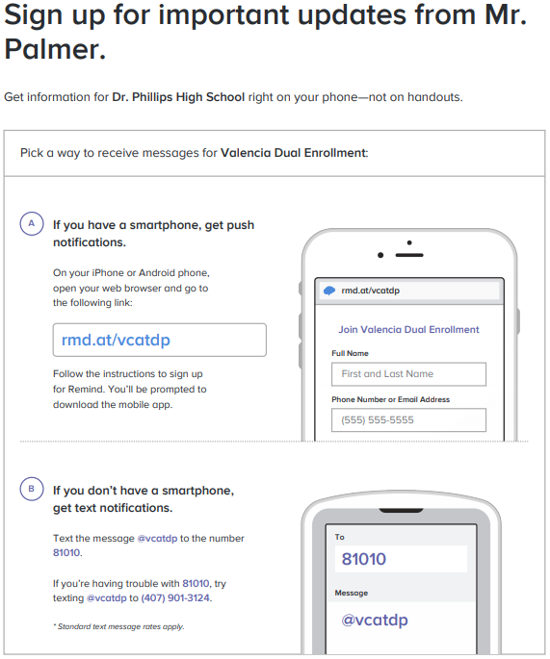
Valencia DE Remind Group/Valencia How Tos
Need help on how to navigate your Atlas account? Visit http://valenciacollege.edu/support/howto/ for detail guides:

