Slide 1
WELCOME TO DPHS
CLASS OF 2024
www.dphs.ocps.net

Slide 2
MEET YOUR GUIDANCE COUNSELORS
Ms. Holmes A-BT
Mrs. Correa BU-DEA
Mr. Fonnett DEB-GI
Ms. Holt GJ-JOK
Mrs. Fink JOL-MB
Mrs. L. Smith MC-PA
Mrs. Castell PB-R
Mrs. A. Smith S-T
Mrs. Reed U-Z and Tangelo Park

Slide 3
Essential Question
How will students register for their 9th grade courses using knowledge of graduation requirements?

Slide 4
Learning Goal
Students will develop an understanding of graduation requirements and the process of requesting courses for the 2020-21 school year.

Slide 5
EXPECTATIONS:
Please Pay Attention!
Cell phones OFF!
Please remain seated.
Participate!
Be Respectful.

Slide 6
Learning Scale
Scale of 1-4: How much do you know right now about high school graduation requirements and how to register for 9th grade classes?
4= I totally understand graduation requirements and can complete the registration form independently
3= I have an understanding of graduation requirements and the process of requesting courses for the 2020-21 school year
2=I am aware of graduation requirements and how to request classes but I am unsure of completing the process
1= I am unfamiliar with graduation requirements and I do not know how to register for 9th grade classes

Slide 7
Graduation Requirements Traditional 4-Year Plan
1 Art
8 electives
Meet State Assessment Requirements
Note: World language is NOT required for graduation but required for admission into state universities
Students must complete one on-line course (virtual school).
Minimum 24 credits
Minimum 2.0 cumulative GPA
English-4 credits
Science-3 credits/2 labs
Math-4 credits including Algebra I and Geometry
1 World History
1 American History
.50 Economics
.50 Amer. Government
1.0 HOPE (PE/Health)

Slide 8
HOPE Requirement
You may do the following to complete this graduation requirement:
Take on campus 9th grade
Take ROTC for 2 school years
Take through www.FLVS.net
IF you choose this, you MUST be 80% completed with the course BEFORE the 2020-2021 school year begins!

Slide 9
NOW - LET’S LOOK AT THE REGISTRATION FORM!
You will fill out the top portion, which includes your name and other demographic information. Please do that now.

Slide 10
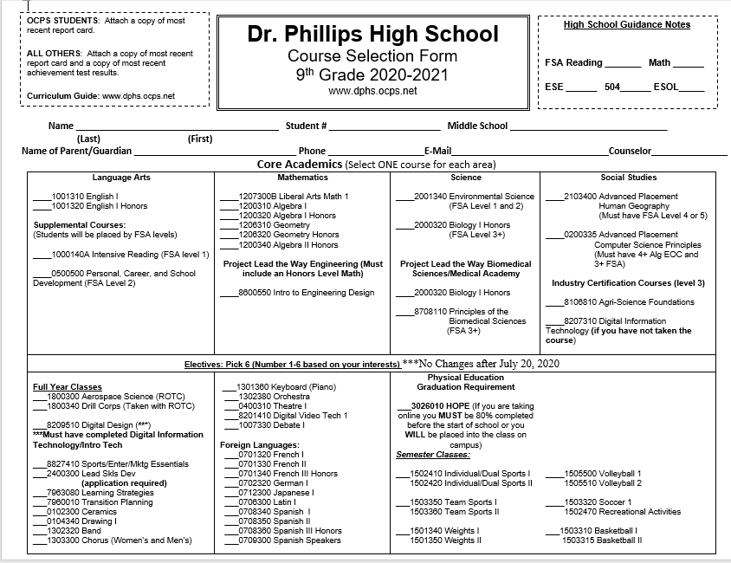
Insert new registration form

Slide 11
Insert new elective details

Slide 15
Earning Industry Certifications Project Lead the Way & Career Technical Programs

Slide 16
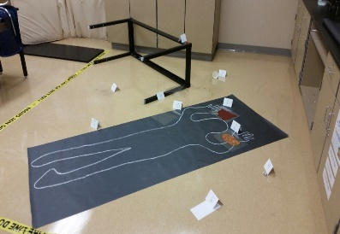
Project Lead the Way: Biomedical Science
The World’s Biggest Health Challenges are Investigated in Your Classroom!
4 course sequence
Principles of Biomedical Science
Human Body Systems
Medical Interventions
Biomedical Innovations
Honors Weight
Potential for an Industry Certification after year 3
Medical Academy Requirement

Slide 17
Medical Academy By Application Only
The DPHS Medical Academy is designed for students wishing to pursue careers in the medical/health field.
–Specific courses that prepare them for college and/or post high school employment.
–Job shadowing, senior projects, and guest speakers that focus on the medical field are also an essential part of the program.
–Teachers from various departments volunteer to teach Academy students, working together to offer a cross curriculum approach with an emphasis on the medical fields.
–As a part of the program you will take 4 Project Lead the Way Biomed classes focused on the medical/biotechnical aspect of science, along with other required science courses.
–Must maintain a 2.5 Unweighted GPA throughout the 4 year program, along with other requirements as outlined on application
Freshman Year –
Pair with Biology

Slide 18
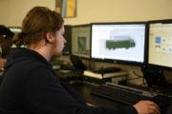
Project Lead The Way: Engineering
Empower Your Students to Step Into the Role of an Engineer
develop engineering knowledge and skills
work in teams to design and test solutions
develop in-demand occupations
develop skills like collaboration, critical thinking, and communication

Slide 19
Business Academy https://dphsbusinessacademy.weebly.com/apply-today.html
9th Graders can take classes:
Digital Information Technology
Business Software Application
Digital Design 1
Marketing Essentials
Business Academy: May take any Business or Marketing Classes to be eligible
Application are Online/Paper

Slide 21
Foreign Languages
Languages are not required for graduation
They ARE required for any University or 4 Year College
They ARE required for the Bright Futures Scholarship
DPHS Offers:
Japanese -Spanish
German -Latin
French

Slide 22
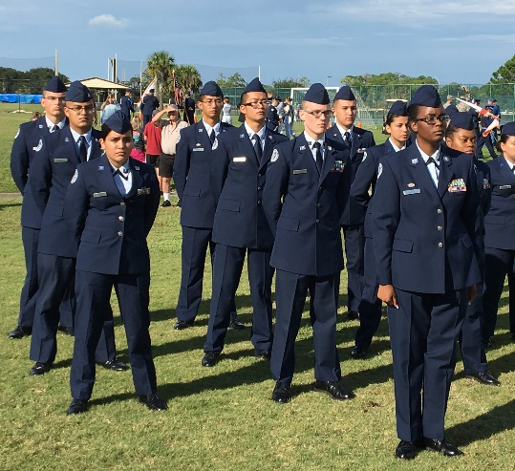
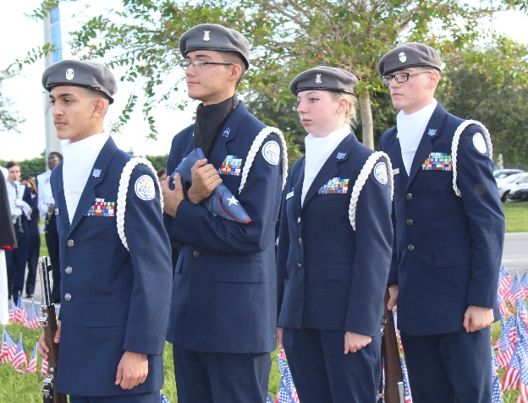
Aerospace Science 1
and Advanced Aerospace Science
No Military Requirement after HS
Wear Uniform in Air Force Standards
Community Service Opportunities
2 Years = HOPE and Fine Arts
Clubs and Extracurricular Activities
Focus on Character, Leadership, Teamwork
I Will Not Lie, Cheat, or Steal,
Nor Tolerate Those Who Do

Slide 23
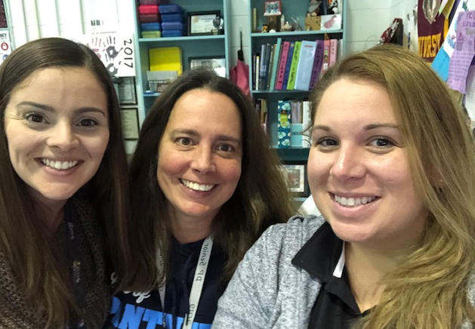
What Does Student Council Do?
Participate in LEADERSHIP courses
Plan school events: Homecoming, Spirit Weeks
D3 meetings
Advisors:
Mrs.Eberhardt
Mrs.Parm
Mrs. Schellhammer

Slide 24
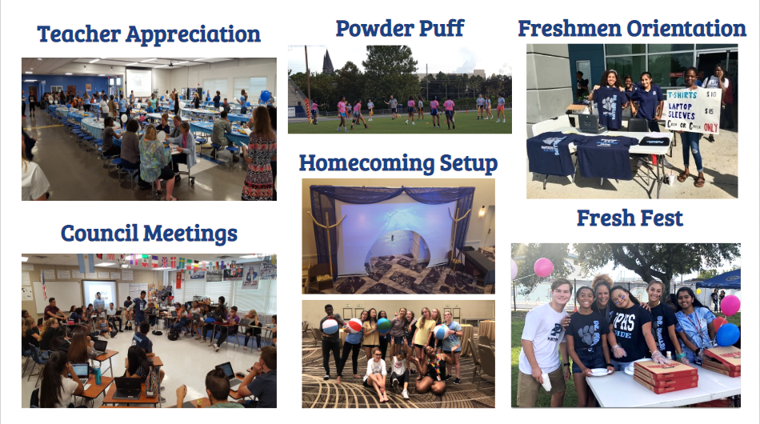
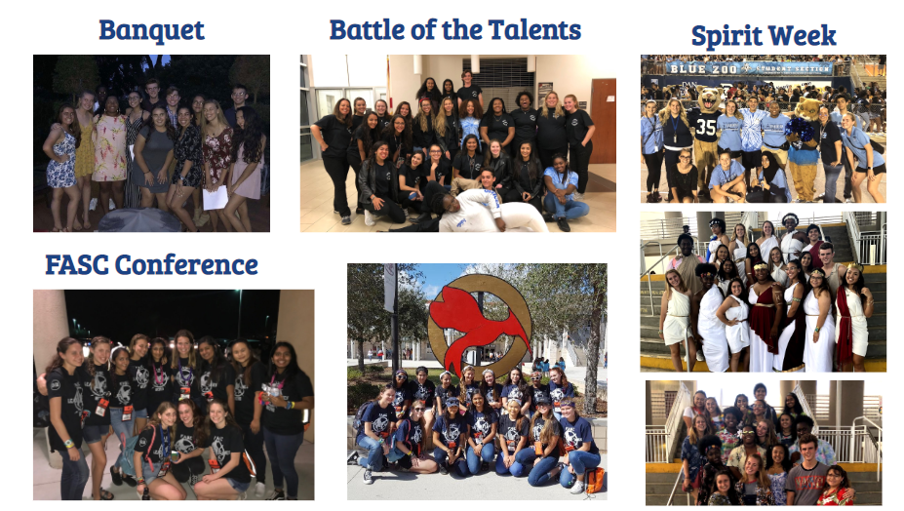
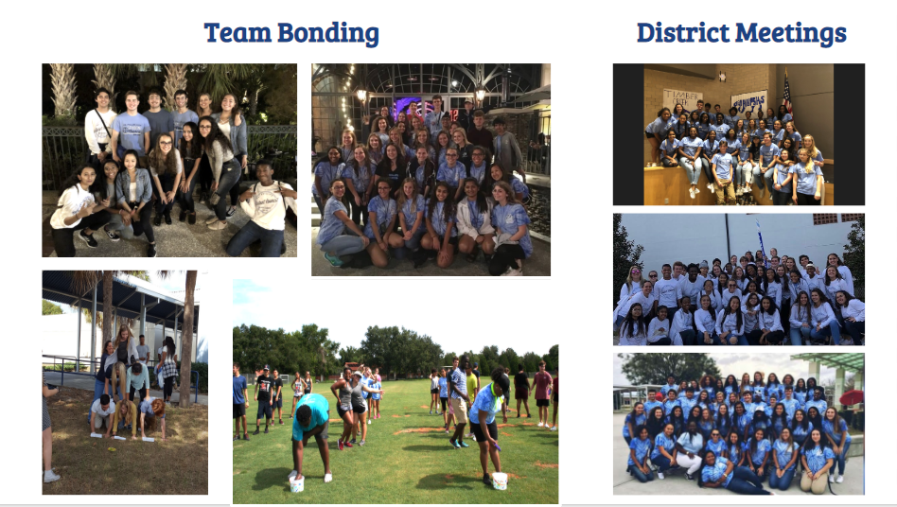
Apply on-line at:
tinyurl.com/2020DPSGA

Slide 25
SOME OF OUR CLUBS!
Animal Rescue | BETA | Club Africa | Chess | Eco-Action
JROTC Honor Guard | Anti-Bullying | Film Appreciation | Surf Rider | Harry Potter
Coding Club | German | Divine Treasures Dance | DECA | Art Club
For more information on our clubs, go to the Dr. Phillips website and click on “Clubs and Organizations” or directly to:
https://www.ocps.net/lc/southwest/hdp/clubs/Pages/default.aspx

Slide 26
A FEW OF OUR SPORTS!
Softball | Basketball | Bowling | Flag Football | Golf
Football | Golf | Volleyball | Water Polo | Swimming
Remember to play sports, you need to maintain a cumulative GPA of 2.0!
For more information on DPHS sports, go to
http://dpathletics.ocps.net/

Slide 27
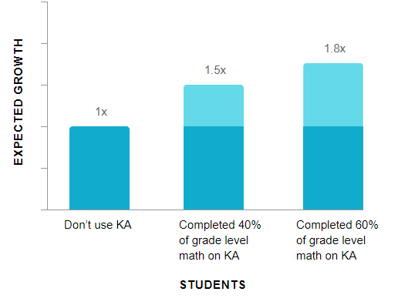
Offers practice exercises, instructional videos, and a personalized learning dashboard that empower learners to study at their own pace in and outside of the classroom
Correlates with score gains on Standardized Achievement tests
ACT/SAT/PSAT
20 Hours of practice = an average 115-point increase on standardized assessments

Slide 28
WHAT IS THE NEXT STEP?
REVIEW the Curriculum Guide online at WWW.DPHS.OCPS.NET
SELECT courses for 9th grade
DISCUSS course selection with parents
RETURN completed request form on ********.

Slide 29
CHECK FOR UNDERSTANDING!
RAISE YOUR HAND IF YOU KNOW
THE ANSWER:
How many credits are needed for graduation?
24
What grade point is needed in order to graduate?
2.0
T or F: All students must take an Online class.
True
Name 2 electives offered at Dr. Phillips.
Answers will vary!

Slide 30
Check for Understanding! Raise your hand if you know:
When are registration forms due?
********* counselors will return to go over your course selection form with you!
What happens if a student does not turn in a form?
Counselors will choose the classes. No changes!
Can a student change an elective after school starts if they decide they don’t like the class or the teacher?
No, that is not a reason for changing a class
How many elective choices should you check?
6

Slide 31
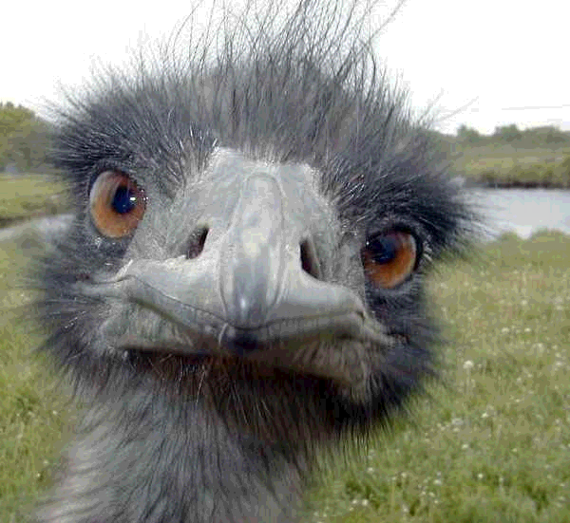
ANY QUESTIONS???
http://teacherpress.ocps.net/dpstudentservices/

