Slide 1
Getting to Know…
Marsha Greinke

Slide 2
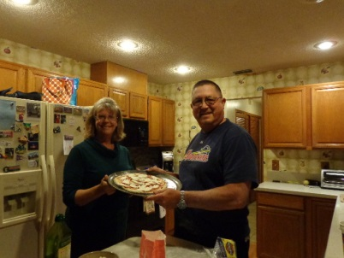
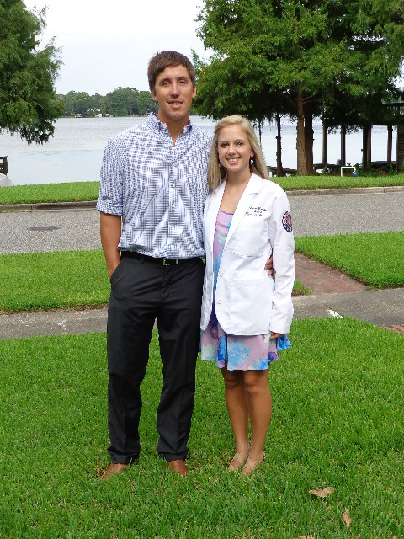
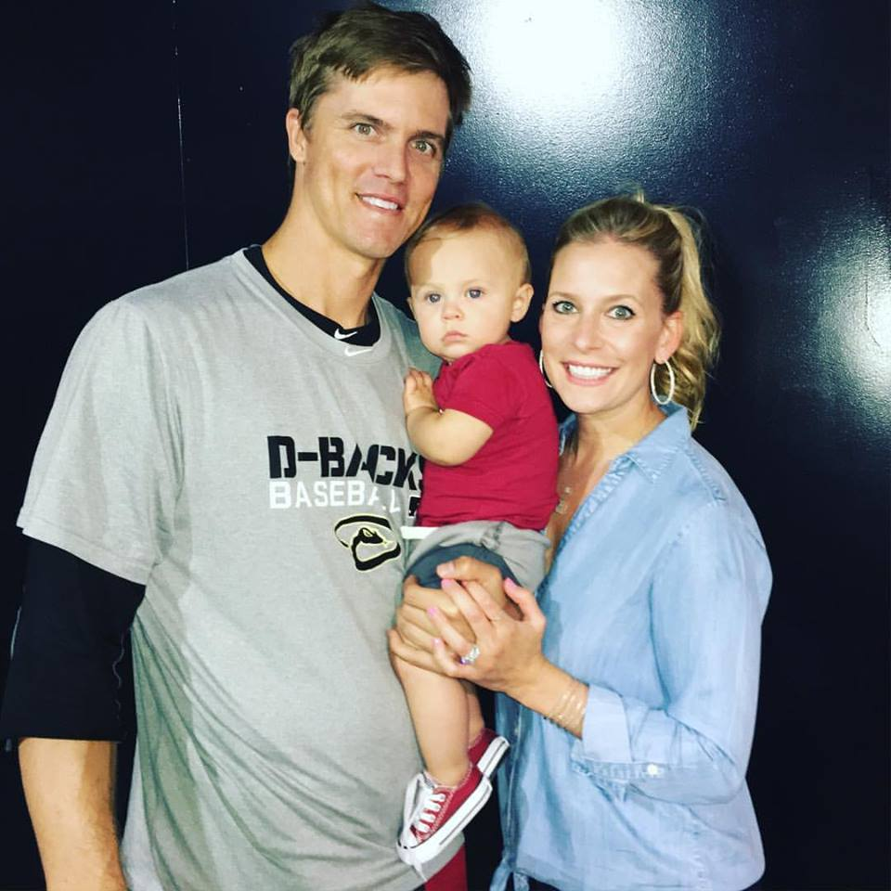
Family
Marsha, Don
Zack/Emily/Bode
Luke/Teresa

Slide 3
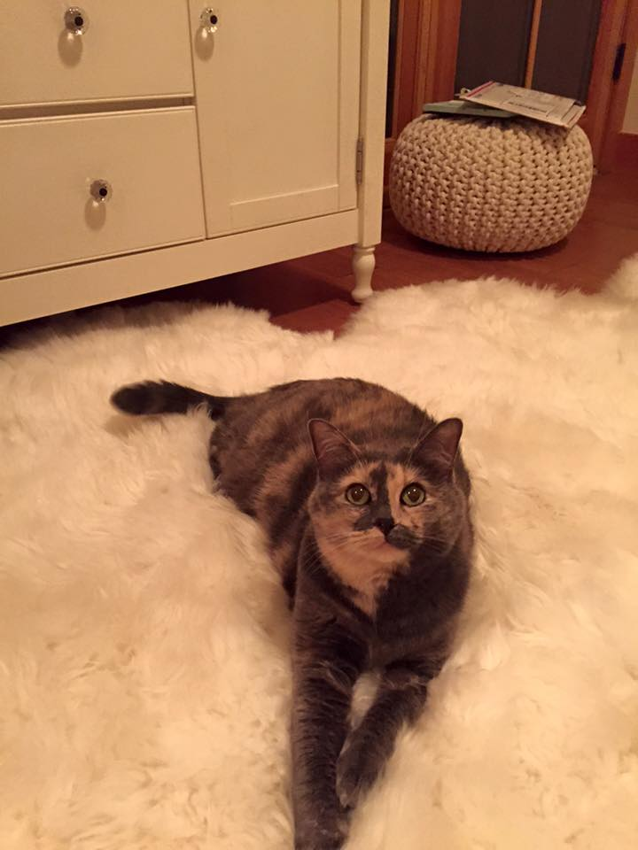
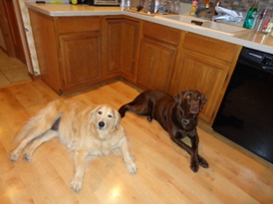
Our Pets
Hank
Abby
Wilsy

Slide 4



Hobbies and Interests
Growing Orchids
Sporting Events
Visiting New Places
Reading

Slide 5
Work Experience
Business Education Instructor
Jones High School
(10 years)
Boone High School
(20 years)
Substitute Teacher
Computer Operator at the Orlando Convention and Visitor’s Bureau
Textbook Rep for Cengage
Orange Technical College (part-time instructor)

Slide 6

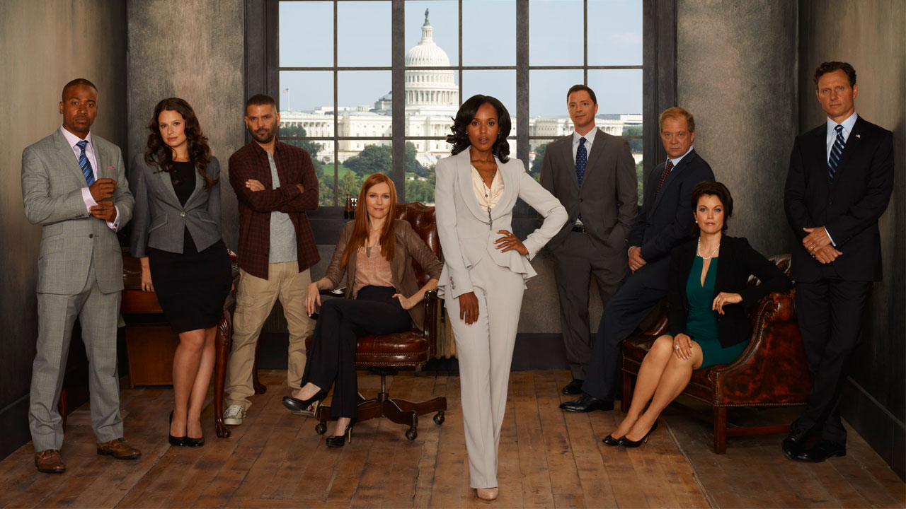
Favorite TV Shows/Movies
TV Shows
Scandal
Project Runway
Master Chef
Modern Family
Gray’s Anatomy
Movies
Sweet Home Alabama
The Proposal

Slide 7
Goals
Short-Term Goals
Complete two courses at Valencia
Spend time with family
Try new things (Zip Line!)
Spoil my grandson
Take Yoga or Pilates class
Long-Term Goals
Travel
Develop and follow an exercise routine
Live!!!!

