Slide 1
Chill Position

Slide 2
Chill Position
When Miss Jaques needs your attention (give her your eyes, freeze, give her all of your attention, and do not talk)
Chill can happen by saying Chill, blowing whistle, or standing on podium

Slide 3
Relax Position

Slide 4
Relax Position
You can talk and sit “relaxed” (don’t be silly though)

Slide 5
Playing Position

Slide 6
Playing Position
How to sit when you are playing your instrument

Slide 7
Rest Position

Slide 8
Rest Position
How to sit when you are about to play (edge of chair [except tuba and percussion], sitting tall, feet flat, staring straight ahead, and no wiggling)

Slide 9
Concert Position

Slide 10
Concert Position
How to sit when you are waiting for your turn at a concert (same as rest, but you can scoot back and you can watch the band that is performing)

Slide 11
Accent on Achievement
Book 1

Slide 12
Getting Ready to Play

Slide 13
Getting Ready to Play
1.Instrument needs to be ready
2.Properly put instrument together

Slide 14
Instrument Care

Slide 15
Instrument Care
1.Most important thing
2.How to make sure your instrument will work for a long time
3.Cleaning items needed to keep instrument working
4.How to use these cleaning items

Slide 16
Embouchure

Slide 17
Embouchure
A French word used to describe the way you shape your mouth while playing.

Slide 18
Producing Your First Tone

Slide 19
Producing Your First Tone
1.Baby version
2.Big breath all the way to the very bottom of your stomach (do not raise shoulders).~Santa Belly~
3.Tonguing while blowing (Too-Too-Too-Too).

Slide 20
Practice Tips

Slide 21
Practice Tips
1.Good firm chair with no interruptions. Use a music stand.
2.Reed instruments rotate reeds used.
3.Start with long tones.
4.Review stuff played in class.
5.Spend time on “difficult” items.
6.Play along with AOA CD.

Slide 22
The Staff

Slide 23
The Staff
5 lines and 4 spaces usd for writing music

Slide 24
Treble Clef

Slide 25
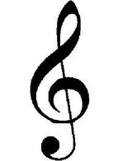
Treble Clef Flute, Oboe, Clarinet, Bass Clarinet, All Saxes, French Horn, Trumpet, and Percussion (bells/piano)
Also called G clef. The second line of the staff is the note G.

Slide 26
Bass Clef

Slide 27
Bass Clef Bassoon, Trombone, Euphonium, Tuba, and Percussion (timpani)
Also, called F clef. The fourth line of the staff is the note F.

Slide 28
Bar Line

Slide 29
Bar Line
Divides the staff into measures.

Slide 30
Measure

Slide 31
Measure
The distance between two bar lines.

Slide 32
Time Signature

Slide 33
Time Signature
Tells us how many beats are in a measure and what kind of note gets one beat.
4
4

Slide 34
Double Bar

Slide 35
Double Bar
The end of a section of music.

Slide 36
The Musical Alphabet

Slide 37
The Musical Alphabet
The musical alphabet uses only the letters A though G. These are used to name the notes on the staff in LINE-SPACE-LINE-SPACE order (A, B, C, D, E, F, G, A, B, etc.). There are rules that help us remember the names of the lines and spaces of the staff.

Slide 38
Treble Clef Space Notes

Slide 39
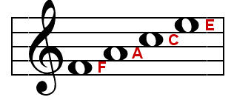
Treble Clef Space Notes

Slide 40
Treble Clef Line Notes

Slide 41
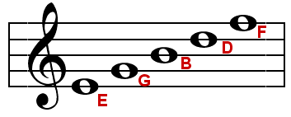
Treble Clef Line Notes
Every Good Boy Does Fine

Slide 42
Bass Clef Space Notes

Slide 43
Bass Clef Space Notes

Slide 44
Bass Clef Line Notes

Slide 45
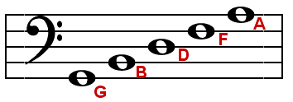
Bass Clef Line Notes
Good Boys Do Fine Always

Slide 46
Ledger Lines

Slide 47
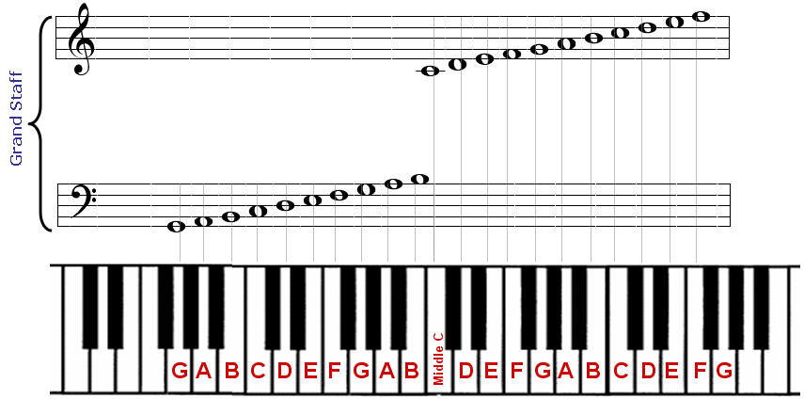
Ledger Lines
Used to extend the staff.

Slide 48
Fingering Chart

Slide 49
Fingering Chart
Shows you how to play a note (sound) on your instrument. It also shows you where this note is found on the staff and what it is called (its’ letter name).

Slide 50
Solo

Slide 51
Solo
One person playing.

Slide 52
Time Signature 4 4

Slide 53
Time Signature 4 4
4= 4 beats in each measure
4= quarter note receives 1 beat

Slide 54
Whole Note

Slide 55
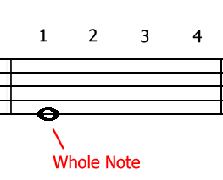
Whole Note
Receives 4 beats in 4
4

Slide 56
Whole Rest

Slide 57
Whole Rest
Indicates a whole measure of silence.

Slide 58
Flat

Slide 59
Flat
Lowers the pitch of a note 1 half step.

Slide 60
Sharp

Slide 61
Sharp
Raises the pitch of a note 1 half step.

Slide 62
Quarter Note

Slide 63
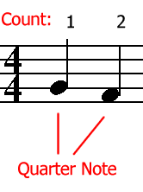
Quarter Note
Receives 1 beat in 4
4

Slide 64
Breath Mark

Slide 65
Breath Mark
A suggested place to take a breath (have to breathe there).
’

Slide 66
Duet

Slide 67
Duet
A composition with parts for two players.

Slide 68
Half Note

Slide 69
Half Note
Receives 2 beats in time 4 time.
4

Slide 70
Half Rest

Slide 71
Half Rest
Receives 2 beats of silence in time 4 time.
4

Slide 72
Time Signature 2 4

Slide 73
Time Signature 2 4
2= 2 beats in each measure
4= quarter note receives 1 beat

Slide 74
Quarter Rest

Slide 75
Quarter Rest
Receives 1 beat of silence in
2 and 4 time
4 4

Slide 76
Repeat Sign

Slide 77
Repeat Sign
Play the music again from the beginning.

Slide 78
Round

Slide 79
Round
Playing the same music beginning at different times.

Slide 80
Tie

Slide 81
Tie
Joins two notes of the same pitch to make one long note (add them together & do not tongue the second one).

Slide 82
Key Signature

Slide 83
Key Signature
Indicates notes which are to be flatted or sharped (stay for the whole song unless there is an accidental).

Slide 84
Tempo

Slide 85
Tempo
How fast or slow you play.

Slide 86
Moderato

Slide 87
Moderato
Medium tempo.

Slide 88
Allegro

Slide 89
Allegro
Fast tempo.

Slide 90
Duet

Slide 91
Duet
A composition with parts for two players.

