Slide 1
Learning Goal for the Week
Superior Class
Superior class was 3rd. They had the most helpful class (3rd you hit your game day- game day on TUESDAY next week)! ☺
I will understand ALL Ghosts, ALL Rockin, and ALL Thriller PICKY.
September 29th
Bonus Band ☺
*Paperball Thursday*
Do Right Away (ALL):
1-Jobs and then “class” set-up
2-LG Leaders do your spiral check
3-7 set-up steps

Slide 2
Learning Goal for the Week
Superior Class
Superior class was 3rd. They had the most helpful class (3rd you hit your game day- game day on TUESDAY next week)! ☺
I will understand ALL Ghosts, ALL Rockin, and ALL Thriller PICKY.
September 29th
Bonus Band ☺
*Paperball Thursday*
Do with Miss Jaques:
1-LG/Superior Class
2-Thriller!!!
BONUS Band Reminders:
-$10 and extra white shirts due TOMORROW
-Ghosts, Thriller, & Rockin will be for a Concert on October 13th
THIS IS 2 WEEKS FROM TODAY!!!!!!
Class’
LG Progress
4
3
2
1
0

Slide 3
Learning Goal for the Week
Superior Class
Superior class was 3rd. They had the most helpful class (3rd you hit your game day- game day on TUESDAY next week)! ☺
I will understand Accent 41-50, HB, & ALL Stomp.
September 29th
2nd
*Paperball Thursday*
Do Right Away (ALL):
1-Normal set-up
2-LG Leaders Spiral
3-Complete your 7 set-up steps

Slide 4
Learning Goal for the Week
Superior Class
Superior class was 3rd. They had the most helpful class (3rd you hit your game day- game day on TUESDAY next week)! ☺
I will understand Accent 41-50, HB, & ALL Stomp.
September 29th
2nd
*Paperball Thursday*
Do with Miss Jaques:
1-LG/Superior Class
2-Treble Clef/Bass Clef Videos
3-Christmas Stomp
Reminders:
-Practice proof due TOMORROW ☺
Class’
LG Progress
4
3
2
1
0

Slide 5
Learning Goal for the Week
Superior Class
Superior class was 3rd. They had the most helpful class (3rd you hit your game day- game day on TUESDAY next week)! ☺
I will understand Accent 41-50, HB, and ALL Yuletide.
September 29th
3rd
*Paperball Thursday*
Do Right Away (ALL):
1-Normal set-up
2-LG Leaders spiral check
3-Complete your 7 set-up steps

Slide 6
Learning Goal for the Week
Superior Class
Superior class was 3rd. They had the most helpful class (3rd you hit your game day- game day on TUESDAY next week)! ☺
I will understand Accent 41-50, HB, and ALL Yuletide.
September 29th
3rd
*Paperball Thursday*
Do with Miss Jaques:
1-LG/Superior Class
2-Treble/Bass Clef Videos
3-Yuletide
Reminders:
-Practice proof due TOMORROW ☺
Class’
LG Progress
4
3
2
1
0

Slide 7
Half Note
1-Play
2-Clap & Count
3-Pretend & Sizzle
Quarter Note
1-Clap & Count
2-Pretend & Sizzle
3-Play
Eighth Note
1-Pretend & Sizzle
2-Play
3-Clap & Count

Slide 8
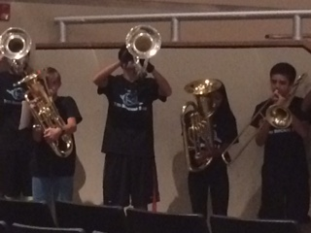
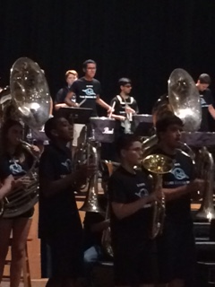
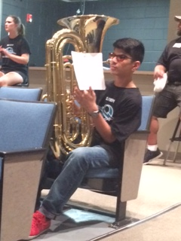
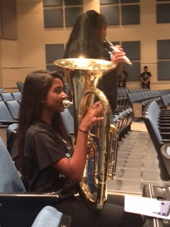
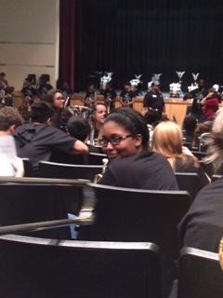
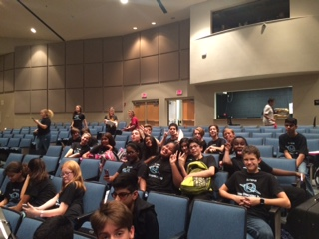
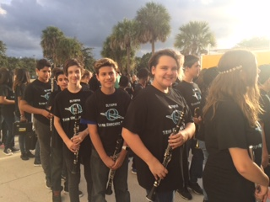
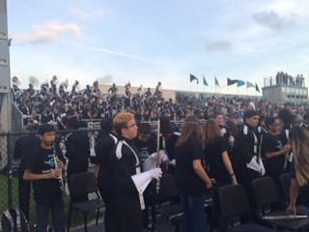

Slide 9
Learning Goal
Superior Class
The Superior Class from Monday/Tuesday was Monday. They got to play more because they were superior listeners!!! ☺
I will understand pages 1-5 in book.
September 29th
The Beats
Do Right Away (bag, recorder, and book,):
1-Sit in your assigned chair & HANG UP YOUR PRACTICE PROOF
2-Put ALL pencils in cubby
3-Take out recorder and practice songs 1-4 (ONLY 1-4)
4-If you are disciplined you will have your BLACK BAND ☺

Slide 10
Learning Goal
Superior Class
The Superior Class from Monday/Tuesday was Monday. They got to play more because they were superior listeners!!! ☺
I will understand pages 1-5 in book.
September 29th
The Beats
Do With Miss Jaques:
1-LG/Superior Class
2-Warm-up with President (G) and then B, A, & G quarter notes
3-Playing our songs ALL of page 4 and Hot Cross Buns
4-How to get your 1st belt!!!!! (Hot Cross Buns)
Reminders:
NEW PRACTICE PROOF- Due: October 7th
I will understand page 5 and earn my WHITE BELT!!!!
Class’
LG Progress
4
3
2
1
0

Slide 11
DUE DATE: 9/30
I will understand book pages 1-5.

Slide 12
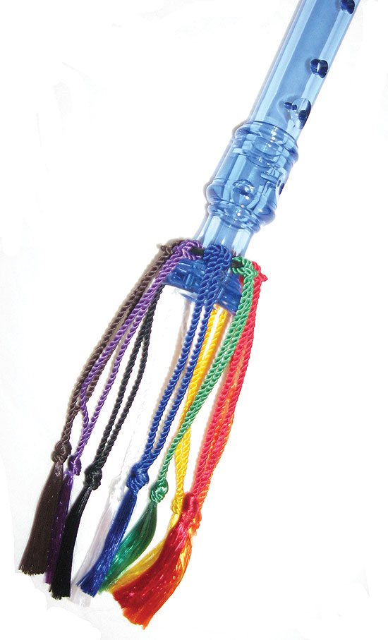
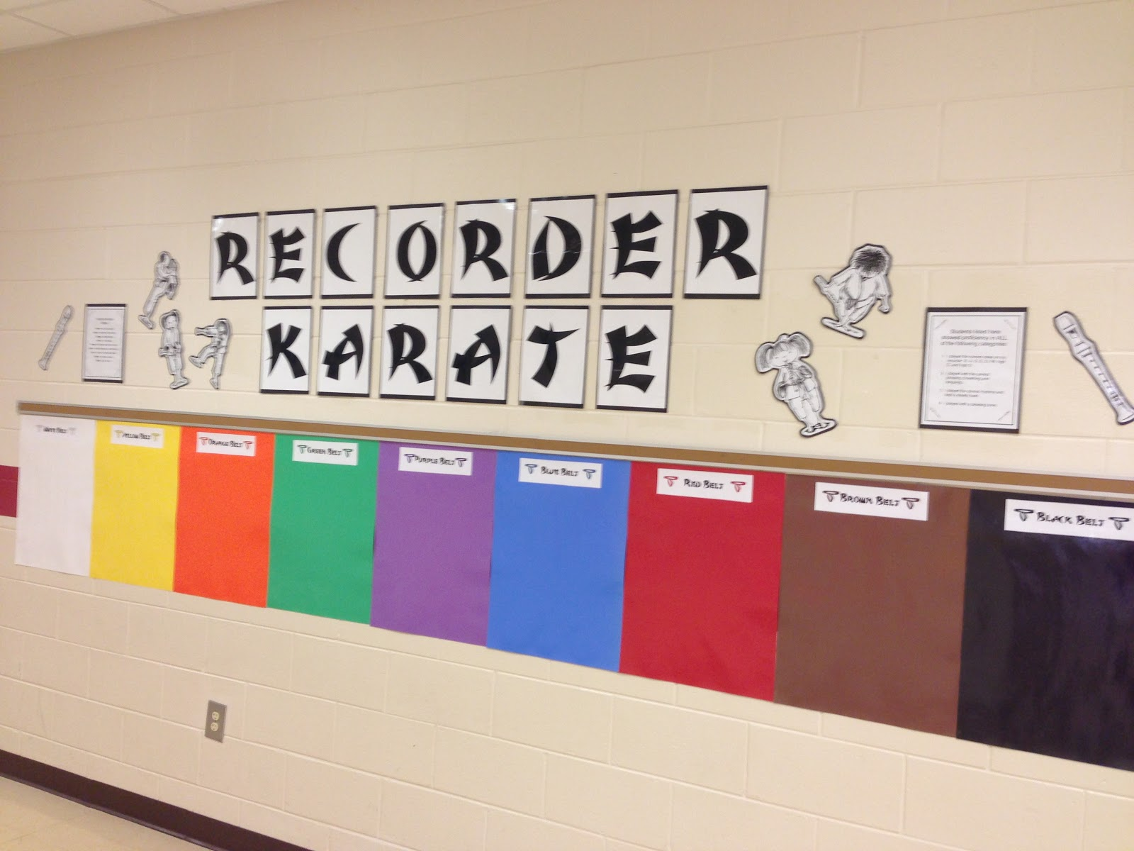

Slide 13
Do For ALL Music
1-Name right hand corner (books on the cover and 1st page)
2-

Slide 14
Learning Goal
Superior Class
The Superior Class from Thursday/Friday was Friday. They got a lot further in their lesson and even know how to tune!!!
I will understand fingering chart and Accent pages 1-6.
September 27th
The Tones
Do Right Away (ALL):
1-Set-up doing steps 1-6 (this means hook on your tuner and play your *F with it)
2-Open to 3rd divider fingering chart and see if you can learn ALL of your notes ☺ (you can play them)

Slide 15
Learning Goal
Superior Class
The Superior Class from Thursday/Friday was Friday. They got a lot further in their lesson and even know how to tune!!!
I will understand fingering chart and Accent pages 1-6.
September 27th
The Tones
Do With Miss Jaques:
1-LG/Superior Class
2-With President- *F and *F whole note/whole rest/whole note/whole rest
3-Accent pages 1-6
Reminders:
-Band Instruments & Supplies are LATE NOW
-Band Practice proof is due by FRIDAY
Class’
LG Progress
4
3
2
1
0

Slide 16
DUE DATE: 9/30
I will understand fingering chart & Accent pages 1-6.

Slide 17
Welcome to Band!!! ☺
Have a question???
See Miss Jaques by the polka dot tables in the back of the room
Want to order your supplies and/or
get your child their instrument???
See Band Room by the WORD WALL

Slide 18
1
1-Play
2-Clap & Count
3-Pretend & Sizzle
2
1-Clap & Count
2-Pretend & Sizzle
3-Play
1-Pretend & Sizzle
2-Play
3-Clap & Count

Slide 19
☺ PARTY TIME!!!☺
*Put bag up and sit on floor or any chair
*Wait for instructions ☺
*You Get:
-2 slices of the pizza you ordered
-1 water or capri
-1 bag of chips
-1 cookie
-1 cupcake
-1 pastry
-1 lollipop (tootsie or gum)
-2 small chocolate candies

Slide 20
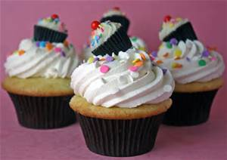
Best Section???
Every day the best section (worked together / helped one another / listened / tried / had supplies / played the best) will earn a sticker for their section
For every morning or afternoon practice you attend you will earn your section a sticker
After MPA the section with the most stickers wins a FREE 2 day in-class party (you get to tell me exactly what food you want for both days, get to have the bonus room—can even watch a movie in there)

Slide 21
*If you have a snack eat it by the MONKEY POSTER
*Everyone has until 3:15 pm to be set-up (use bathroom/water now)
*Set-up in any chair and make your Friday assessment SUPERIOR ☺
*Ready to take your assessment now??? Have a question??? Then sign-up to see Miss Jaques (by the little black filing cabinet by the practice rooms). To be fair Miss Jaques will see/help you for 3 minutes (she will set a timer).
*Best Practicer WINS a full size candy bar at the end of practice (or +100 points)!!!
*Break around 4:15

