Slide 1
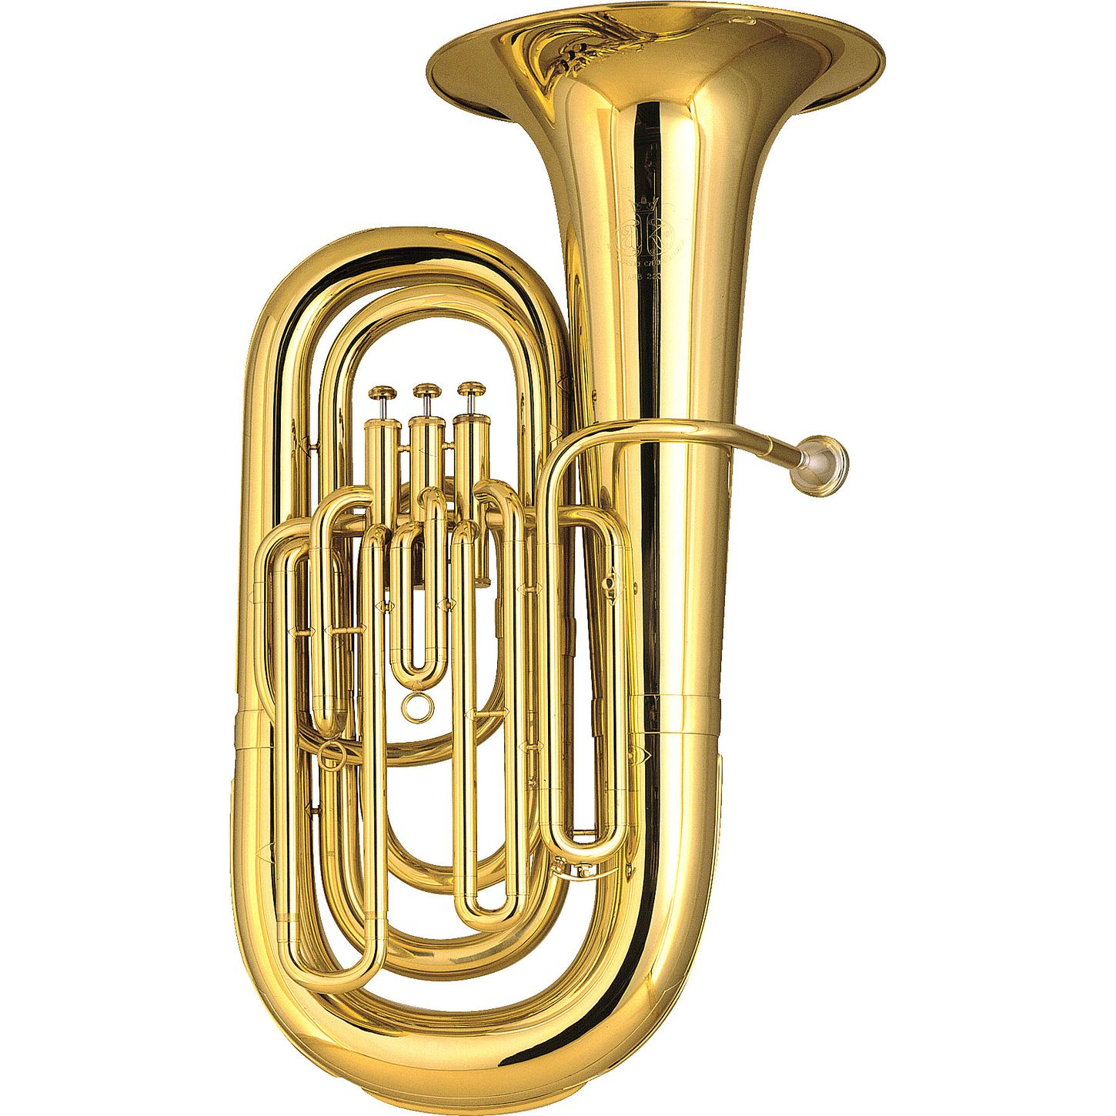
Tuba
2 Tubas

Slide 2
Tuba
*Brass instrument
*Two main parts:
mouthpiece and instrument (with slides)
*Has three buttons to produce different sounds (can have 4)
*Has the largest silver mouthpiece

Slide 3
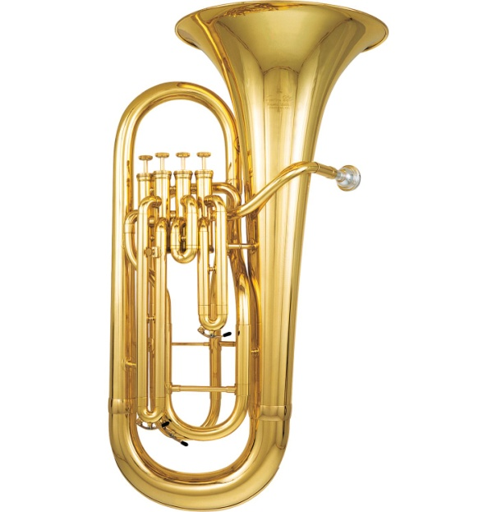
Euphonium
1 or 2 Euphonium(s)

Slide 4
Euphonium
*Brass instrument
*Two main parts:
mouthpiece and instrument (with slides)
*Has three buttons to produce different sounds (can have 4)
*Has the same mouthpiece as the trombone

Slide 5
Trombone
3 or 4 Trombones

Slide 6
Trombone
*Is a brass instrument
*Has three main parts
-bell, slide, and mouthpiece
*Is the only instrument that uses a slide to get different sounds (there are no buttons!)
*Has a larger mouthpiece than the trumpet

Slide 7
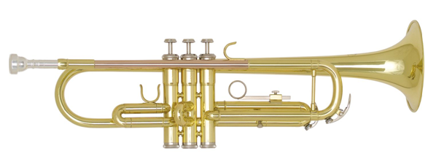
Trumpet
2 Trumpets

Slide 8
Trumpet
Brass instrument
Two main parts:
mouthpiece and instrument (with slides)
Has three buttons to get different sounds
Hold straight out from your mouth

Slide 9
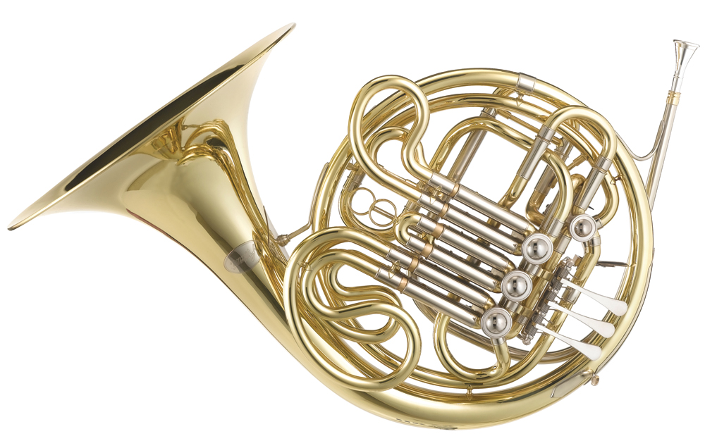
French Horn
2 French Horns

Slide 10
French Horns
*Brass instrument
*Two main parts:
mouthpiece and instrument (with slides)
*Has three buttons to produce different sounds (can have 4)
*Has the smallest silver mouthpiece

Slide 11
Flute
3 Flutes

Slide 12
Flute
Woodwind instrument
Three parts:
Head joint, body, and foot joint
Has many buttons to push in different combinations to get different sounds
Hold straight over right shoulder

Slide 13
Clarinet
4 Clarinets

Slide 14
Clarinet
*Woodwind instrument
*Five parts:
mouthpiece, barrel, upper section,
lower section, bell
*Uses a reed to get sound
*Has a lot of buttons used to get different sounds

Slide 15
Bass Clarinet
1 in total Bass Clarinet
(unless you get your own and then 1 per group)

Slide 16
Bass Clarinet
*Woodwind
*Similar to Clarinet but larger

Slide 17
Oboe
1 Oboe

Slide 18
Oboe
*Woodwind instrument
Has three main parts
Upper section, lower section, and bell
*Uses a reed to get sound
*Has no mouthpiece

Slide 19
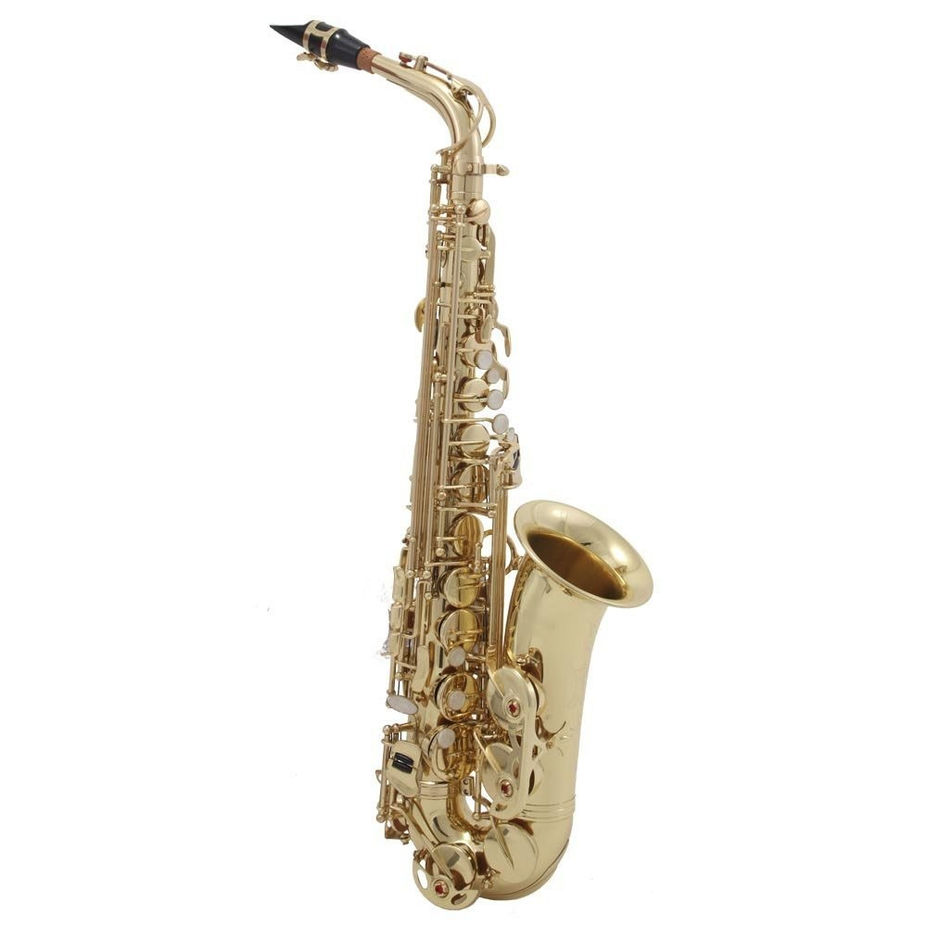
Saxophones
-2 Alto
-1 Tenor in total (unless you get your own)
-1 Bari in total

Slide 20
Saxophones
*Woodwind instrument
*Three parts:
mouthpiece, neck, body
*Uses a reed to get sound
*Alto-smallest we have here
Tenor-little larger than the Alto
Baritone-largest Saxophone

Slide 21
Bassoon
1 Bassoon in total

Slide 22
Bassoon
*Woodwind instrument
* Has five parts
*Uses a reed to get sound
*Has no mouthpiece (has a bocal that you connect the reed to)

Slide 23
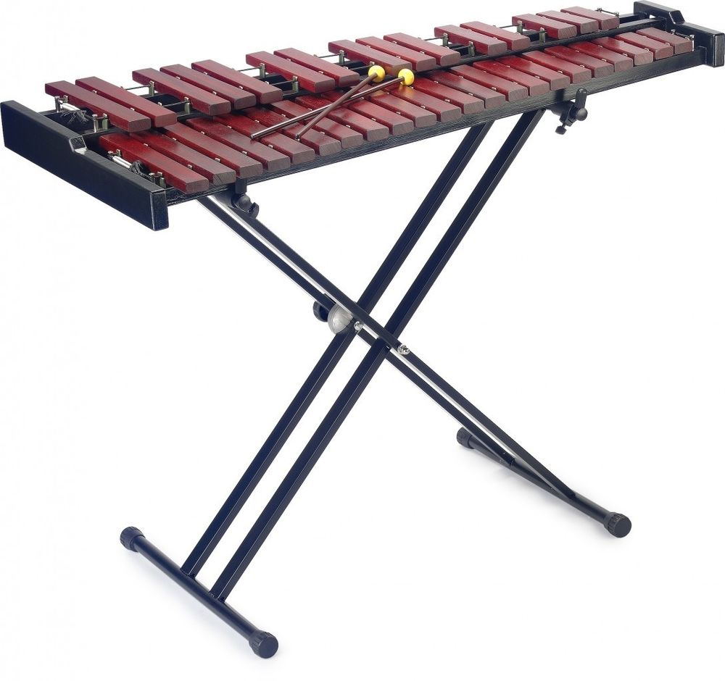
Percussion
3 percussionists

Slide 24
Percussion
*Not a Woodwind nor a Brass, it is PERCUSSION
*1st 9 weeks you will ONLY play bells/xylophone
*Once you are a master at bells/xylophone you will start to learn the other percussion instruments too
*Have to be able to stay after school on Thursdays (since most of the instruments you will play can’t go home-too big)

