Slide 1
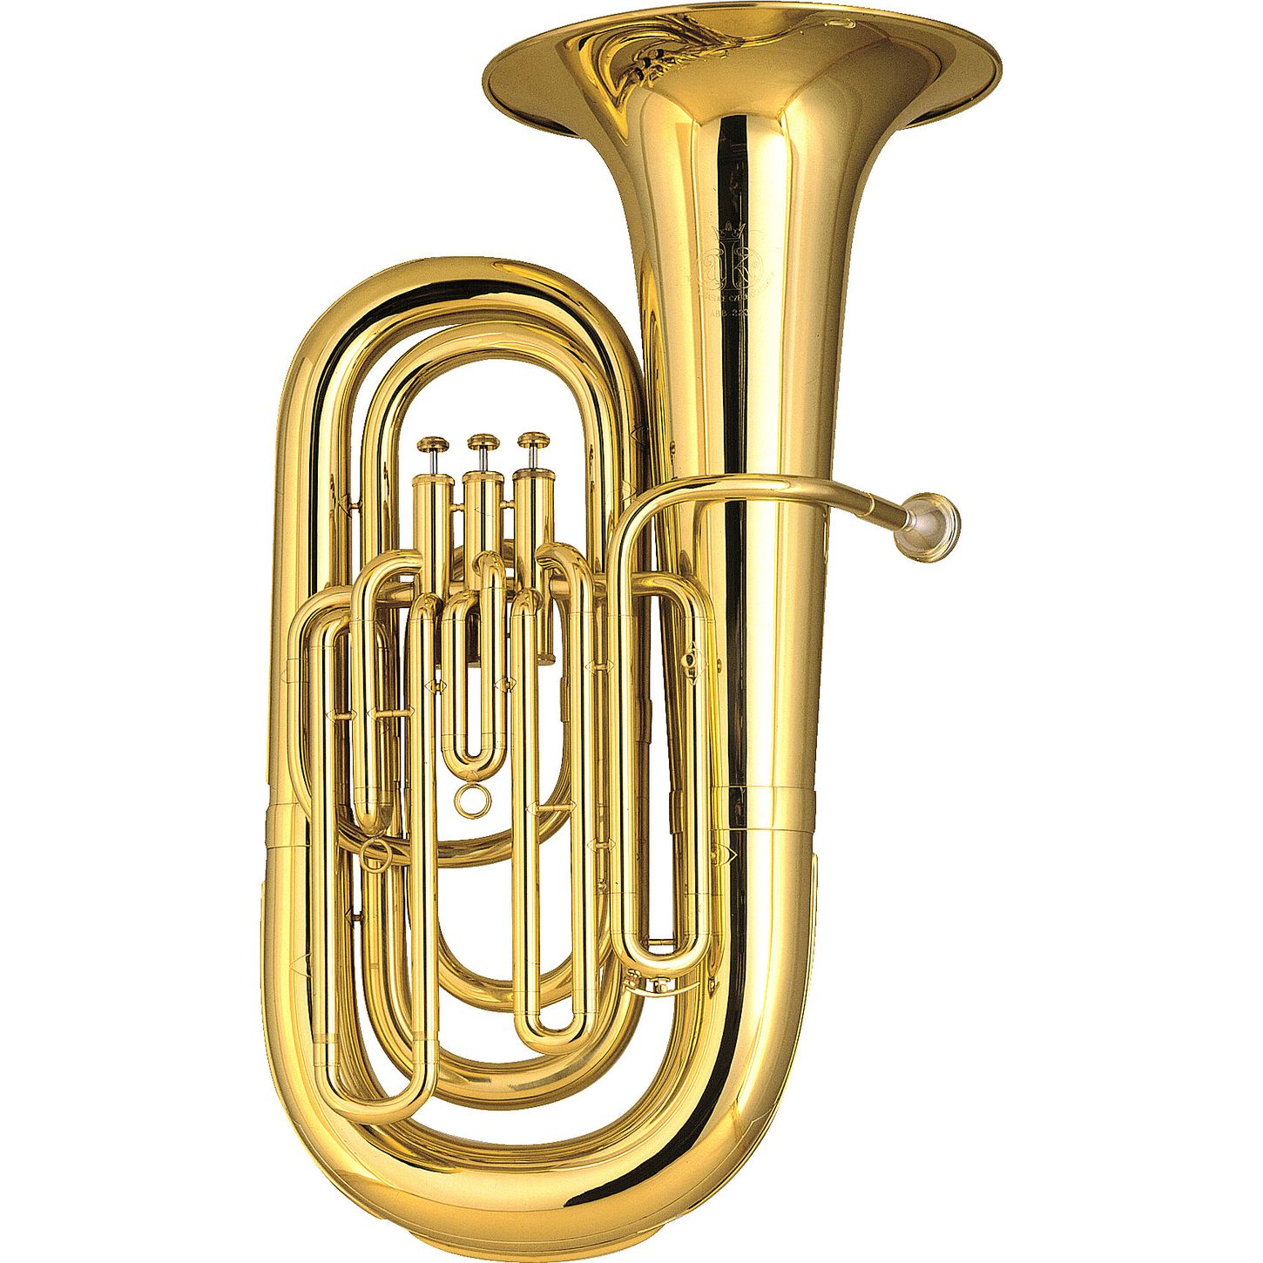
Tuba
*1st Period Band = 1 Tuba
*5th Grader Bands = 2 Tubas per class

Slide 2
Tuba
*Brass instrument
*Two main parts:
mouthpiece and instrument (with slides)
*Has three buttons to produce different sounds (can have 4)
*Has the largest silver mouthpiece

Slide 3
Flute
*1st Period Band = 1 Flute
*5th Grader Bands = 2 Flutes per class

Slide 4
Flute
Woodwind instrument
Three parts:
Head joint, body, and foot joint
Has many buttons to push in different combinations to get different sounds
Hold straight over right shoulder

Slide 5
Trombone
*1st Period Band = 1 Trombone
*5th Grader Bands = 2 Trombones per class

Slide 6
Trombone
*Is a brass instrument
*Has three main parts
-bell, slide, and mouthpiece
*Is the only instrument that uses a slide to get different sounds (there are no buttons!)
*Has a larger mouthpiece than the trumpet

Slide 7
Clarinet
*1st Period Band = 1 Clarinet
*5th Grader Bands = 2 Clarinets per class

Slide 8
Clarinet
*Woodwind instrument
*Five parts:
mouthpiece, barrel, upper section,
lower section, bell
*Uses a reed to get sound
*Has a lot of buttons used to get different sounds

Slide 9
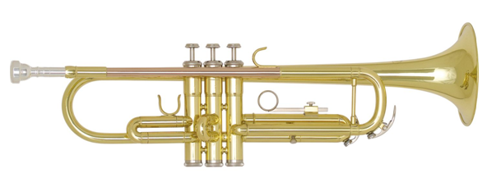
Trumpet
*1st Period Band = 1 Trumpet
*5th Grader Bands = 2 Trumpets per class

Slide 10
Trumpet
Brass instrument
Two main parts:
mouthpiece and instrument (with slides)
Has three buttons to get different sounds
Hold straight out from your mouth

Slide 11
Bass Clarinet
*1st Period Band = 1 Bass Clarinet
*5th Grader Bands = 1 Bass Clarinet per class

Slide 12
Bass Clarinet
*Woodwind
*Similar to Clarinet but larger

Slide 13
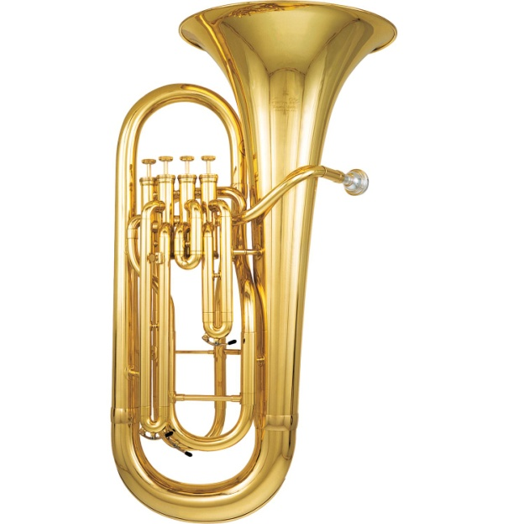
Euphonium
*1st Period Band = 1 Euphonium
*5th Grader Bands = 2 Euphoniums per class

Slide 14
Euphonium
*Brass instrument
*Two main parts:
mouthpiece and instrument (with slides)
*Has three buttons to produce different sounds (can have 4)
*Has the same mouthpiece as the trombone

Slide 15
Oboe
*1st Period Band = 1 Oboe
*5th Grader Bands = 1 Oboe per class

Slide 16
Oboe
*Woodwind instrument
Has three main parts
Upper section, lower section, and bell
*Uses a reed to get sound
*Has no mouthpiece

Slide 17
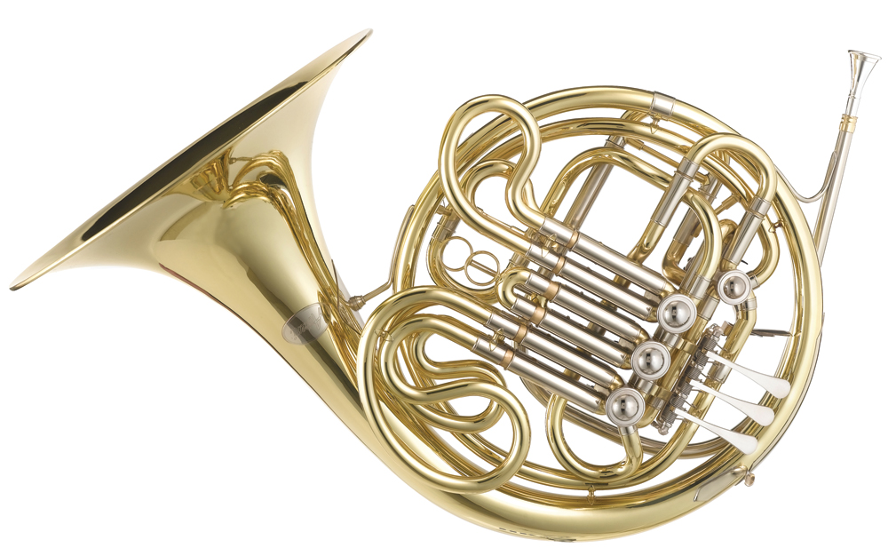
French Horn
*1st Period Band = 1 French Horn
*5th Grader Bands = 2 French Horns per class

Slide 18
French Horns
*Brass instrument
*Two main parts:
mouthpiece and instrument (with slides)
*Has three buttons to produce different sounds (can have 4)
*Has the smallest silver mouthpiece

Slide 19
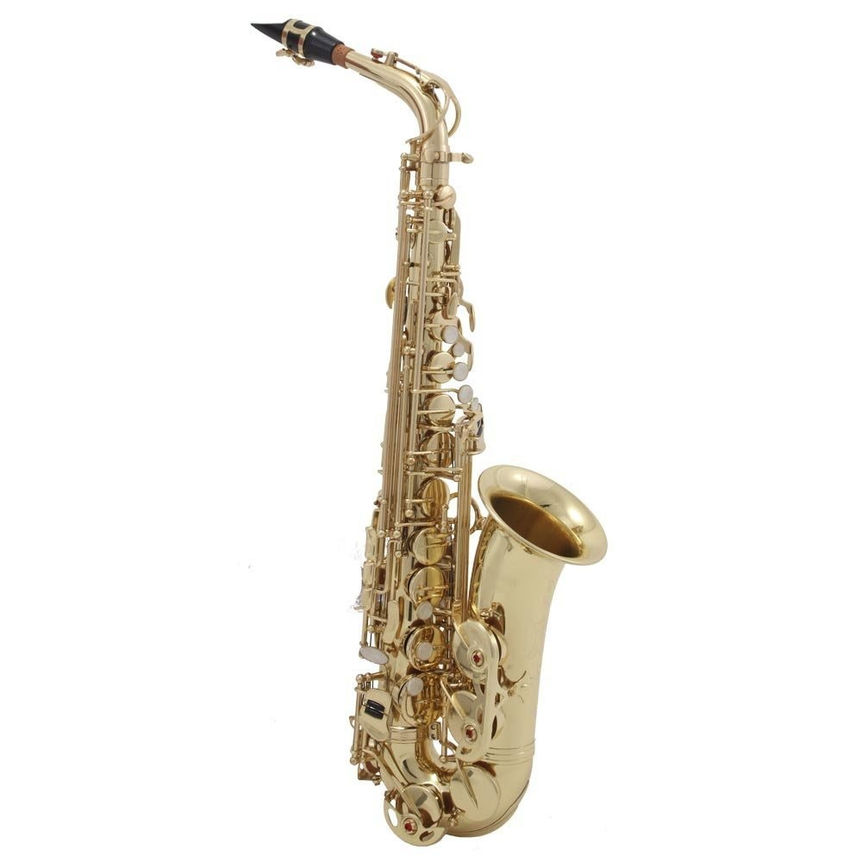
Saxophones
*1st Period Band = 1 Alto
*5th Grader Bands = 2 Saxophones per class

Slide 20
Saxophones
*Woodwind instrument
*Three parts:
mouthpiece, neck, body
*Uses a reed to get sound
*Alto-smallest we have here
Tenor-little larger than the Alto
Baritone-largest Saxophone

Slide 21
Bassoon
*1st Period Band = 1 Bassoon
*5th Grader Bands = 1 Bassoons per class

Slide 22
Bassoon
*Woodwind instrument
* Has five parts
*Uses a reed to get sound
*Has no mouthpiece (has a bocal that you connect the reed to)

Slide 23
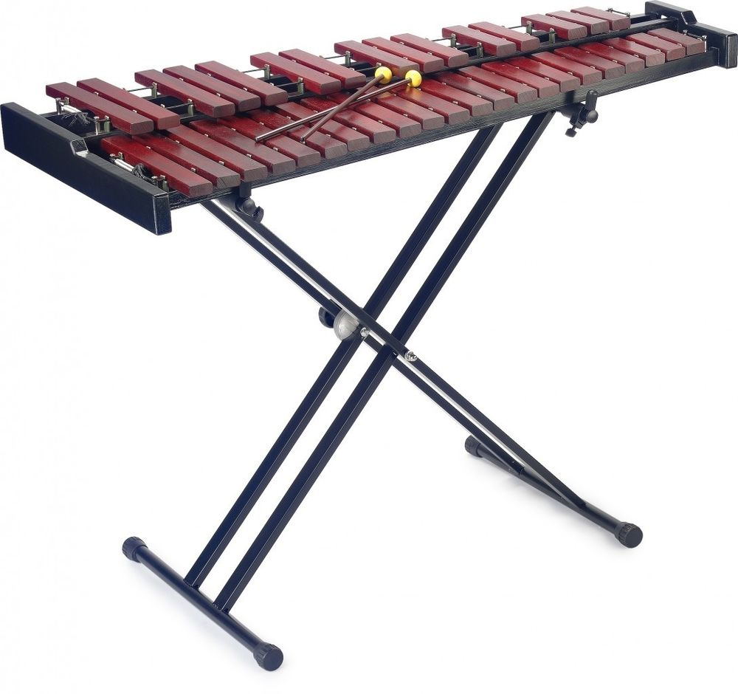
Percussion
*1st Period Band = 1 Percussion
*5th Grader Bands = 2 Percussionists per class

Slide 24
Percussion
*Not a Woodwind nor a Brass, it is PERCUSSION
*1st 9 weeks you will ONLY play bells/xylophone
*Once you are a master at bells/xylophone you will start to learn the other percussion instruments too
*Have to be able to stay after school on Thursdays (since most of the instruments you will play can’t go home-too big)

