Slide 1
Test
Prehistoric Art

Slide 2
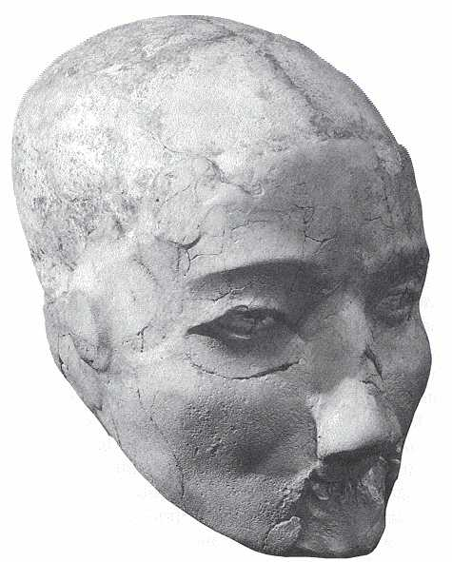
1
Notes:
By about 7000 BC Jericho, based on a natural spring, had developed into a large settlement which may have contained as many as two thousand individuals, and was defended by a substantial wall. The dead were often buried beneath the floors of houses. In some instances the bodies were complete, but in others the skull was removed and treated separately, with the facial features reconstructed in plaster.
The removal of the skull from the body and its separate burial was widely practised in the Levant during the seventh millennium BC. As in this example, the lower jaw was often removed and then, carefully and sensitively, the skull was remodelled with plaster to build up the facial features. Shells, either cowries or, as here, bivalves, were set into the empty sockets to represent the eyes. The skull was decorated with red and black paint to depict individual characteristics such as hair and even moustaches.
It is possible that this practice was part of an ancestor cult. Similarly plastered skulls have been found at sites in Palestine, Syria and Jordan.

Slide 3
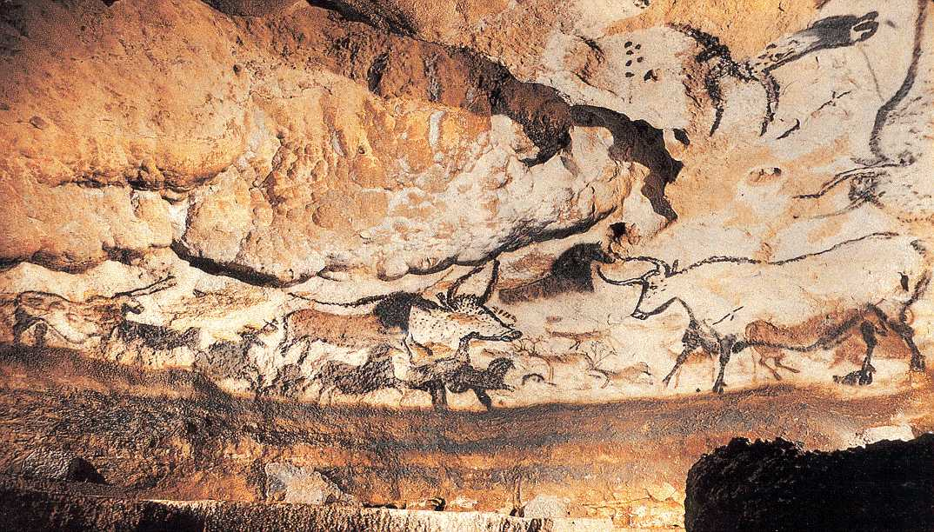
2
Notes:
initially researchers believed cave art was connected to hunting. Hunting was primitive man’s main job, and the paintings are mostly of animals — with the exception of a few human stick figures, handprints, and geometric patterns in some caves. Did primitive man believe that capturing an animal’s likeness on a wall with paint made it easier to kill the animal in the wild? If so, then primitive painting was probably a type of sympathetic magic, kind of like voodoo. The idea is, if you paint a picture of a creature, then you have power over it. In some cave paintings, spears and arrows seem to pierce the animals (like needles sticking in a voodoo doll).
If you wanted to kill lots of bulls, you painted lots of bulls on the walls of your cave! In the Lascaux cave, the roughly 65-foot-long cave gallery known today as the Great Hall of the Bulls could be an example of a large-scale, prehistoric magic ritual. But today researchers suspect that cave art was more than just hunting magic.

Slide 4
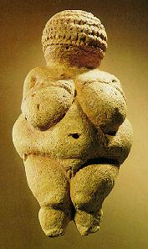
3
Notes:
Sculpture grew up alongside painting as a sister art. Most prehistoric sculptures were either small statues called statuettes or reliefs.
In a relief, the sculptor outlines an image in stone or wood, and then carves out the background so that the image projects above it. The most famous early
statuette is the Woman of Willendorf,
also known as Venus of Willendorf.
All nude female figures found by German archaeologists in the 19th century (including Woman of Willendorf ) were named Venus.
Woman of Willendorf is a pudgy 41/2-inch-high figure carved out of limestone. she may have been a fertility symbol 25,000 years ago.
Does this mean that cavemen thought that Woman of Willendorf
was hot stuff, the Marilyn Monroe of her day? Because concentric braids of hair wrapped around her head like a stocking cap conceal Woman of Willendorf ’s face, we can surmise that her looks didn’t matter. She wasn’t an
individual, but a type. She appears as if she were permanently pregnant
. The same female type is found in many prehistoric cultures around the world.
So what was the purpose of this type of figure and what was her appeal? Was
Woman of Willendorf
meant to turn people on? Probably not. More
likely, her purpose was to promote fertility and abundance. A woman might have held the statuette in her hand before having sex so that the
statuette’s fertility could be magically transferred to her.
But why is
Woman of Willendorf
so fat? Her ample proportions may have been a sign of wealth. Living off nuts, berries, and wild game didn’t make
primitive people chubby. Many primitive people probably died of malnutrition — only a few reached the age of 30. And only a very privileged
woman could afford to be this big.

Slide 5
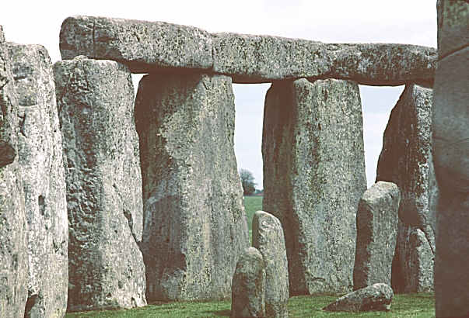
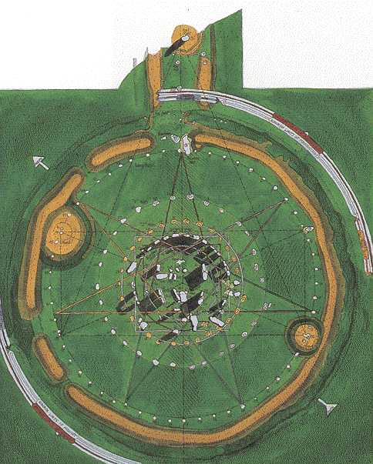
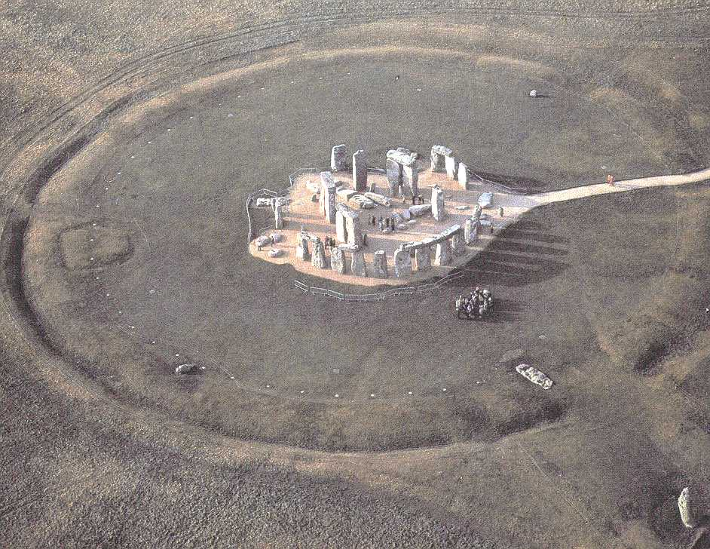
4
Notes:
The most interesting examples of New Stone Age architecture are the mysterious megaliths (huge stones) of Brittany and England. A megalithic
structure is a simple or complex arrangement of stones. Some appear to be stark, open-air temples built by mammoth-sized men. Others look likegraveyards with hundreds of headstones sprouting out of the earth. In fact, some megalith structures did serve as tombs, either for one person or
several people. Many megalithic tombs look like giant stone tables with two uprights supporting a massive horizontal slab laid across them. This
arrangement is called a
post-and-lintel system
(the post part is made up of the uprights, and the lintel is the horizontal slab). The post-and-lintel
system is one of man’s first architectural advances. Sometimes the tombs are covered with small rocks and dirt, forming a grave mound over the
horizontal.

Slide 6
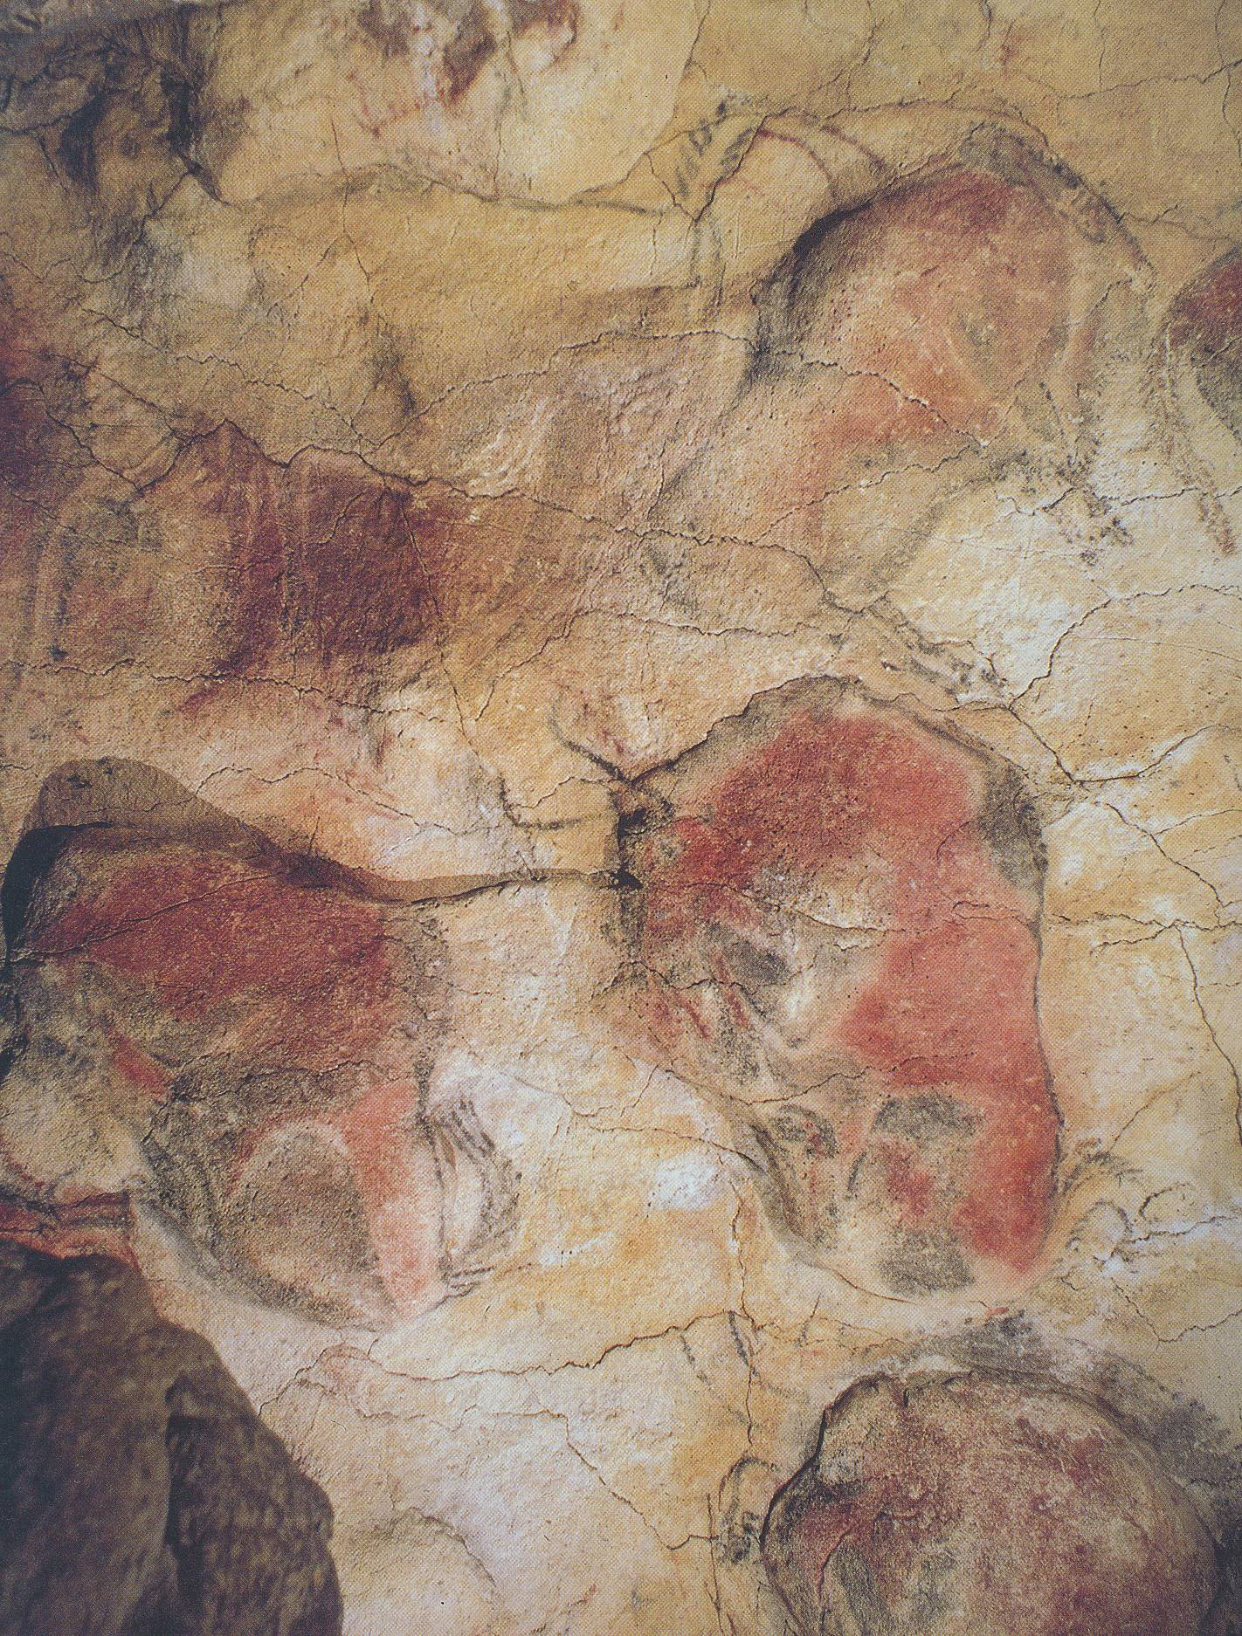
5
Notes:
Cool Cave Art or Paleolithic Painting: Why Keep It a Secret?
Prehistoric artists hid their paintings deep within the bowels of caves as if they were meant to be kept secret. The paintings are so well hidden, in fact, that the first discovery of a cave painting didn’t occur until 1879 in Altamira, Spain (see Figure 4-1). The second discovery took place in 1940 in Lascaux in Dordogne, France — two little boys followed their lost dog into a hole that opened into the ancient cave.

Slide 7
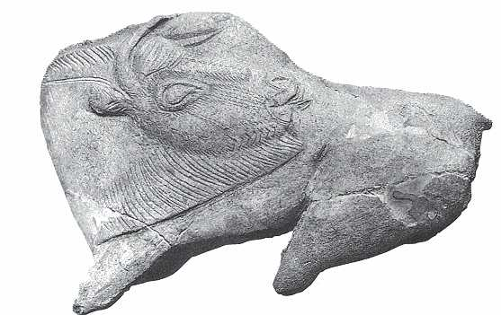
6
Notes:
Relief sculpture

Slide 8
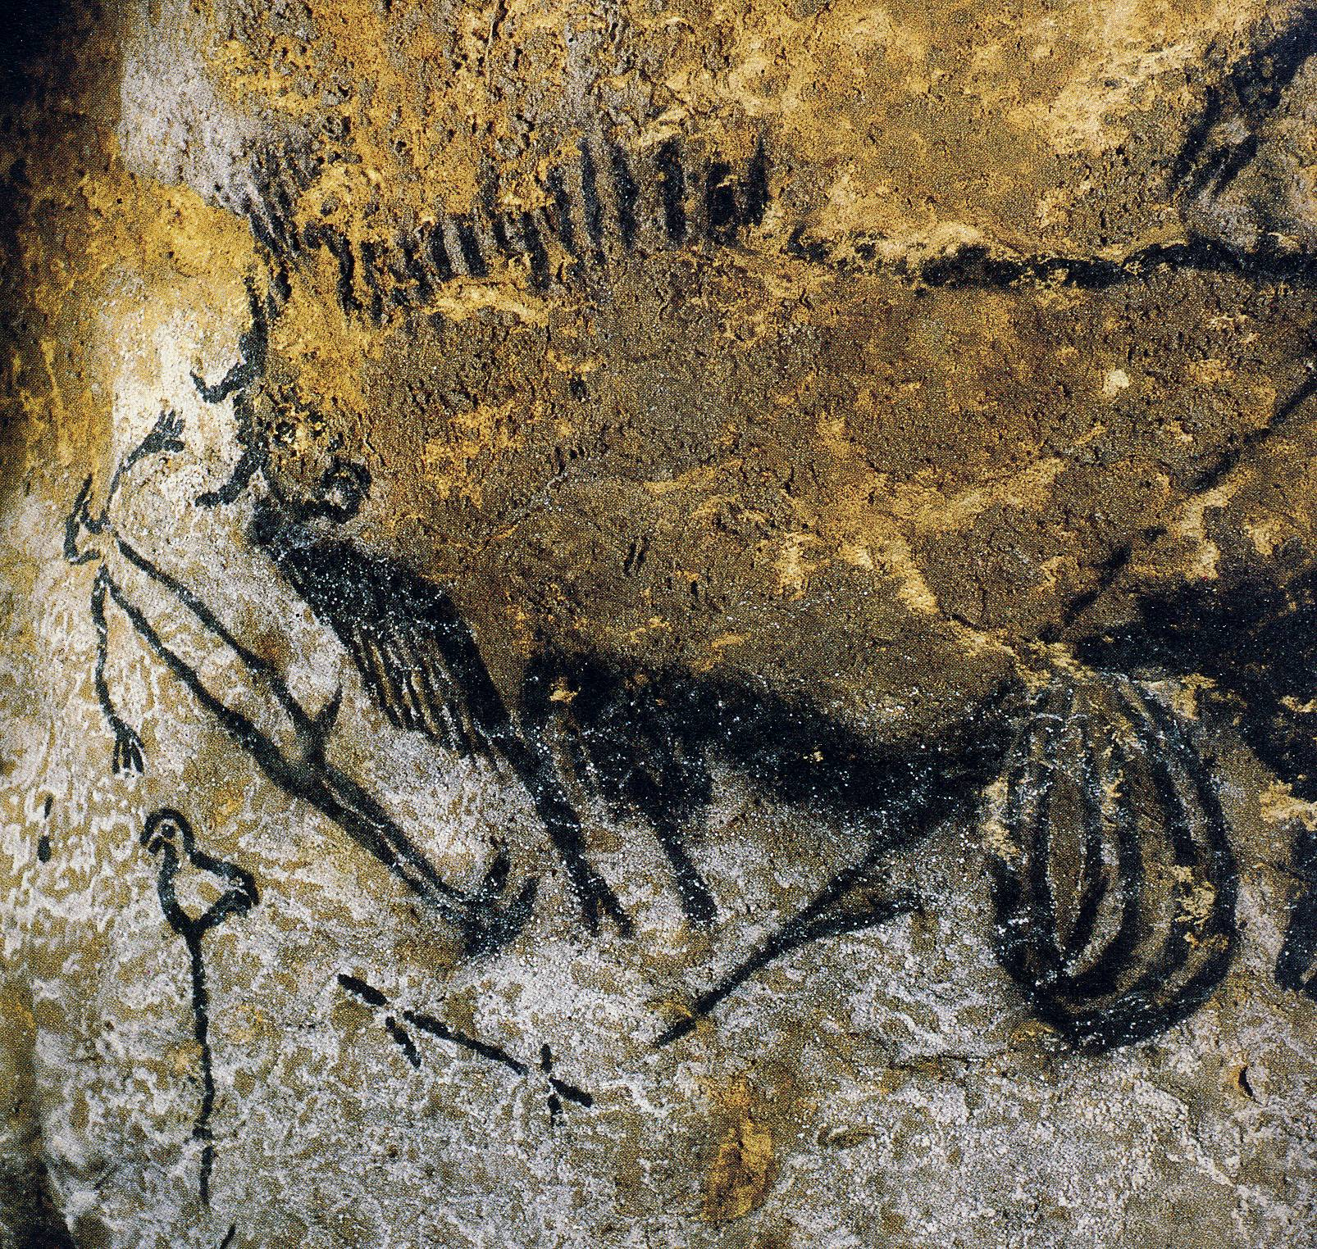
7
Notes:
Later researchers discovered that the animals that appeared on Old Stone Age dinner menus showed up least in cave art. Many paintings depict predators like panthers, lions, and hyenas — not typical dinner fare and not easy to hunt.
These researchers offered a new theory based on the fact that hunter-gatherer societies from Africa to Siberia and North America practiced shaman magic. Prehistoric hunter-gatherers probably did the same thing.
Some shamans appear to have used natural hallucinogens to give them a boost into the sixth dimension. Primitive peoples throughout the world often depict shaman journeys with hallucinogenic images of humans and animals entwining and even merging. Cave art might depict these journeys, too.
At first glance, Bird-Headed Man with Bison looks like a typical hunting scene. A hunter spears a bison in the belly. The beast’s entrails spill out of him. But why does the prone man beside the animal have a bird’s head? And why is a bird perched on a nearby pole like a totem? In 19th-century Siberia, shamans used a so-called “world pole” topped by a bird to launch their voyages into the underworld. The Lascaux bird-headed man and bird-topped pole may have been meant to give a prehistoric shaman a successful send-off into the spirit world.

