Slide 1
The Pre-Renaissance
1250-1470

Slide 2
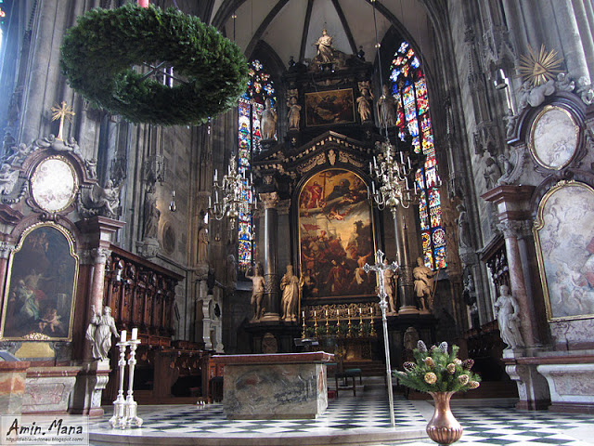
A departure in Italian painting took place in the 13th century because of a change in the religious ceremony of the church. Until then the mass had been celebrated with the priest behind the altar, facing the people (as it is done now) then the priests' position was changed so that he faced the altar form the front.
This freed the space behind the and above the altar for large paintings on wood panels. Like the manuscript illuminations, these works were painted with egg tempera.

Slide 3
Giotto (1267-1337)
How he was he discovered?
Who discovered him?
Who was Cimabue?
What makes his painting innovative?
Why were later Roman Artists not interested in painting realistically?
Notes:
http://www.saylor.org/site/wp-content/uploads/2012/07/ARTH206-Giottos-Lamentation-Article-Upload.pdf

Slide 4
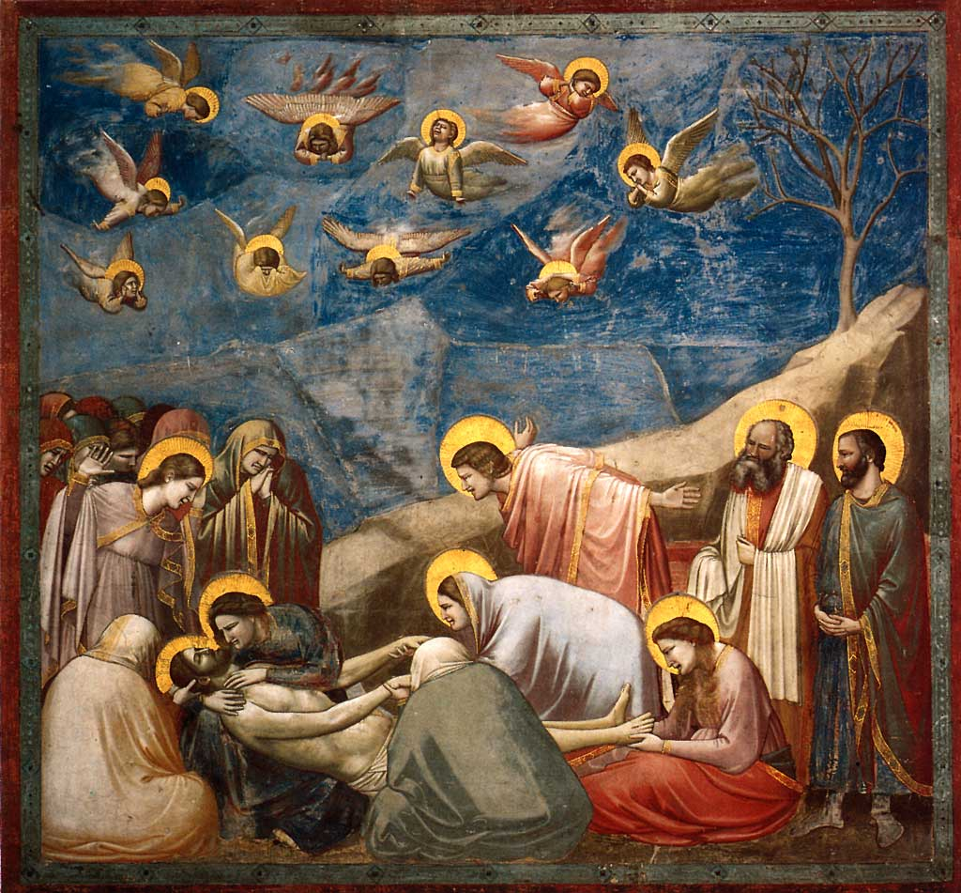
Lamentation
1305-1306 fresco
Where is it?
What does it illustrate?
What is the painting about?
What makes it special?
Notes:
http://www.saylor.org/site/wp-content/uploads/2012/07/ARTH206-Giottos-Lamentation-Article-Upload.pdf

Slide 5
Duccio (1278-1319)
What commission made him famous?
How long did it take him?
What happened when he finished?

Slide 6
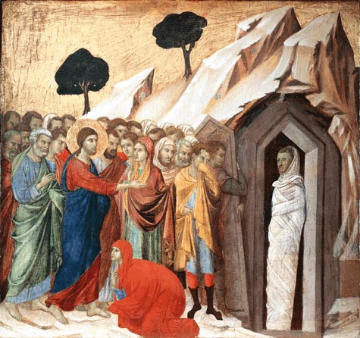
Christ Raising Lazarus from the Dead
1309-1311 fresco
Where is it?
What does it illustrate?
What is the painting about?
What makes it special?

Slide 7
Simone Martini 1284-1344
Who was his teacher?
Who did he work for?
Who did he pick up some ideas, techniques and style from?

Slide 8
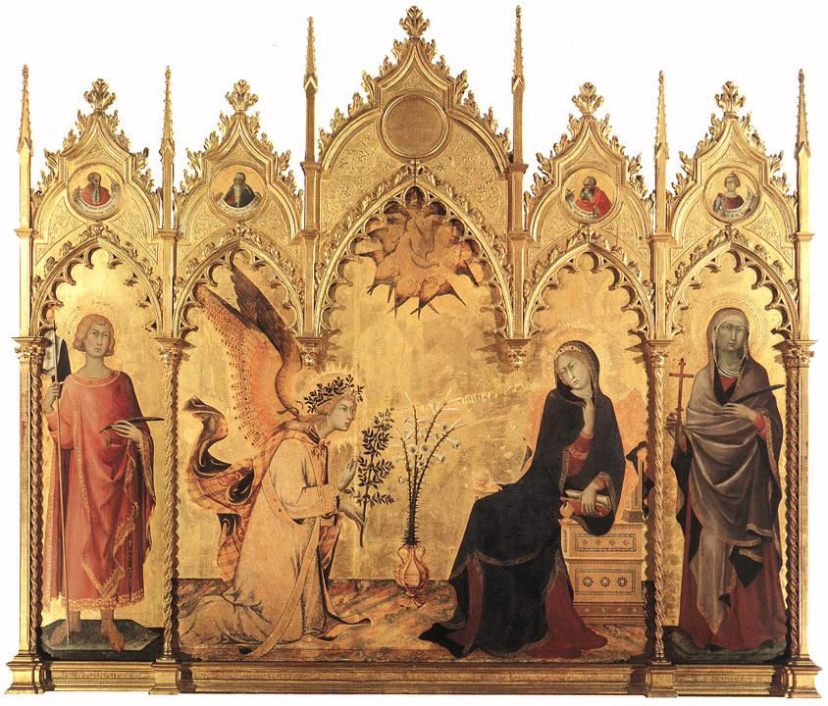
Annunciation
1333 fresco
Where is it?
What does it illustrate?
What is the painting about?
What makes it special?

Slide 9
The Early Italian Renaissance 1401-1600
Key Notes
Florence is the birthplace of the Renaissance.
Science and Mathematics become tools for artists.
Ancient Rome and Greece are sources of inspiration for artists.

Slide 10
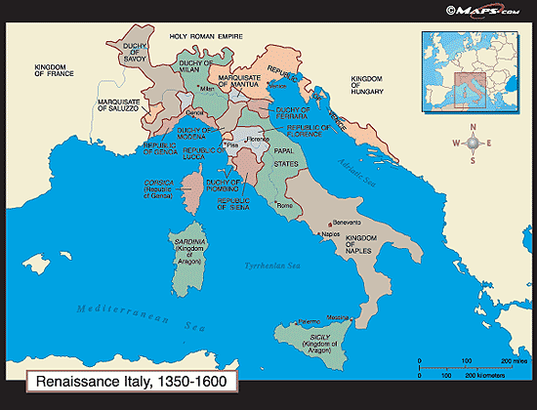
The Italian Renaissance
Renaissance means rebirth. In the early 1400s, a cultural rebirth created a period of intense artistic activity throughout Europe that would last for 200 years. Leaders in this artistic flowering lived in the city of Florence.

Slide 11
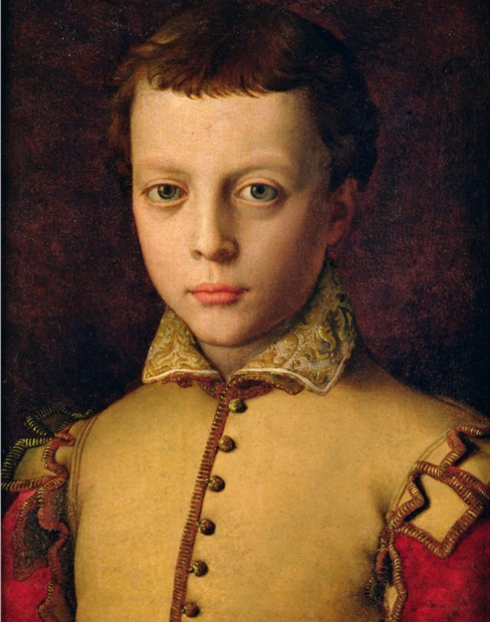
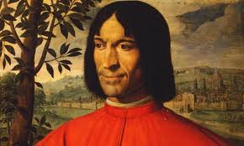
Florence was dominated by the Medici, a powerful family who were great patrons of the arts.
The Florentine artists, fueled by a renewed interest in the ancient Romans and Greeks as well as in science and math, created a city of extraordinary beauty . Though magnificent sculpture and architecture were produced, painting dominated the art of the Renaissance.

Slide 12
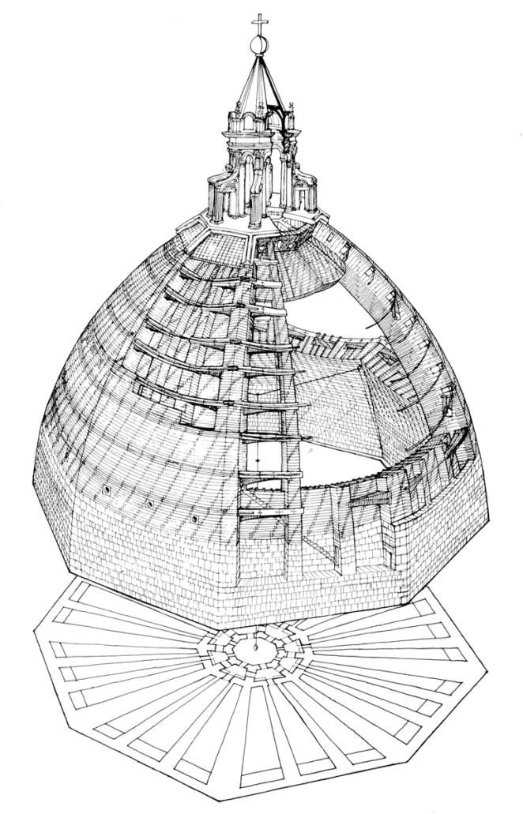
Fillippo Brunelleschi 1377-1446
What was his greatest architectural achievement?
Besides an architect, what else was Brunelleschi?
What is Scientific perspective?
What happened in 1418?
Why did he go to Rome?

Slide 13
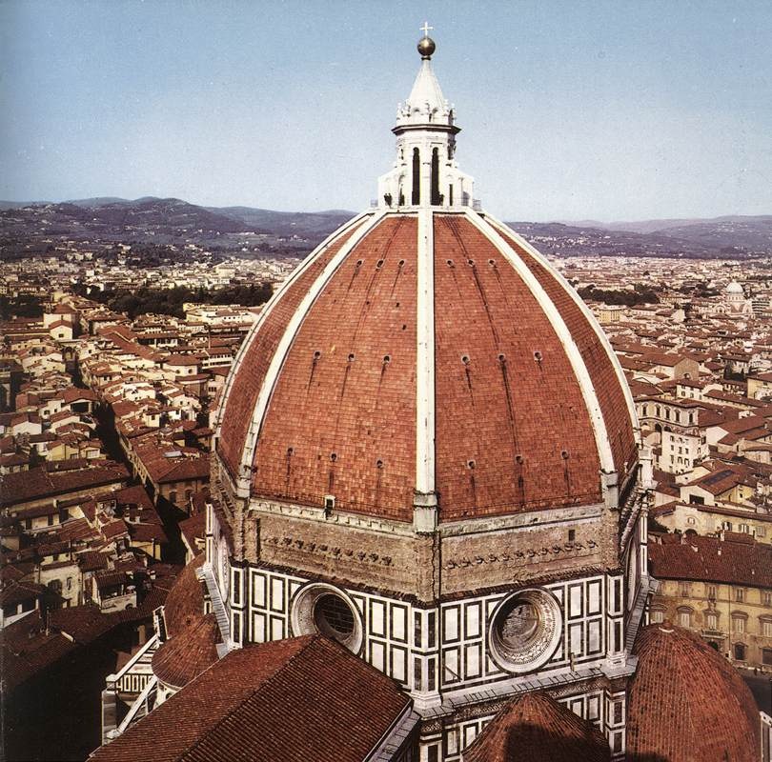
Dome for the Cathedral of Florence
1420-1436
How big is the dome?
How was his work different than previous Gothic architecture?
What is a cupola?

Slide 14
Lorenzo Ghiberti 1381-1455
How did he get his major commission?
What other major Renaissance artist was in this competition?
What makes his sculpture innovative?
How old was he when he created the artwork?
How long did it take him?

Slide 15
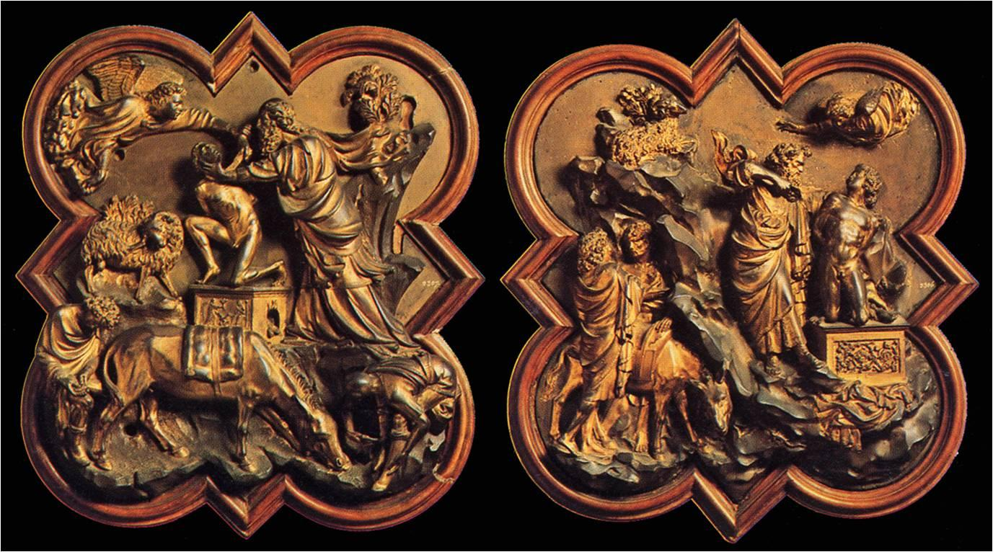
BRUNELLESCHI/ GHIBERTI– The Sacrifice of Isaac, competition plaques for the Babtistry Doors in Florence– 1401-02. --
What does the sacrifice of Isaac illustrate?
Why was Ghiberti’s chosen?
How many panels were there?

Slide 16
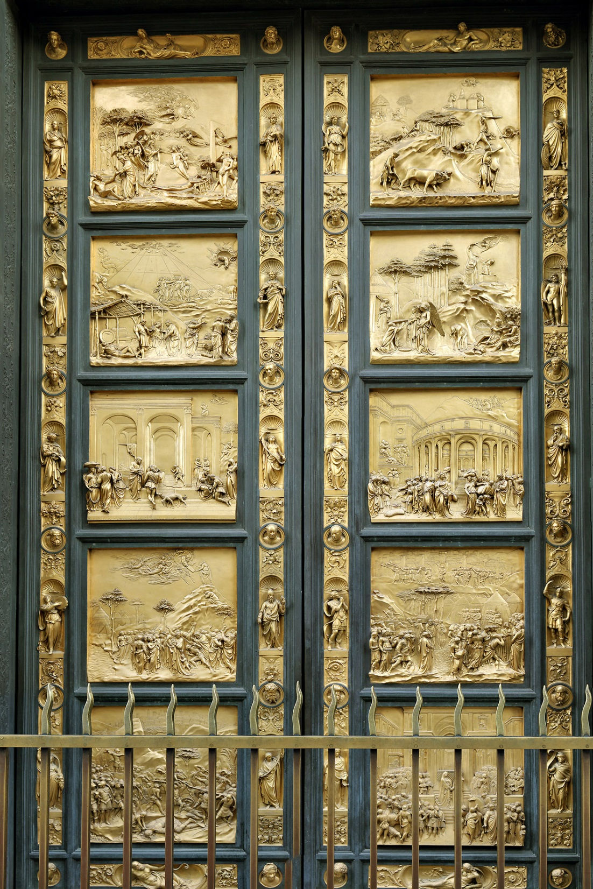
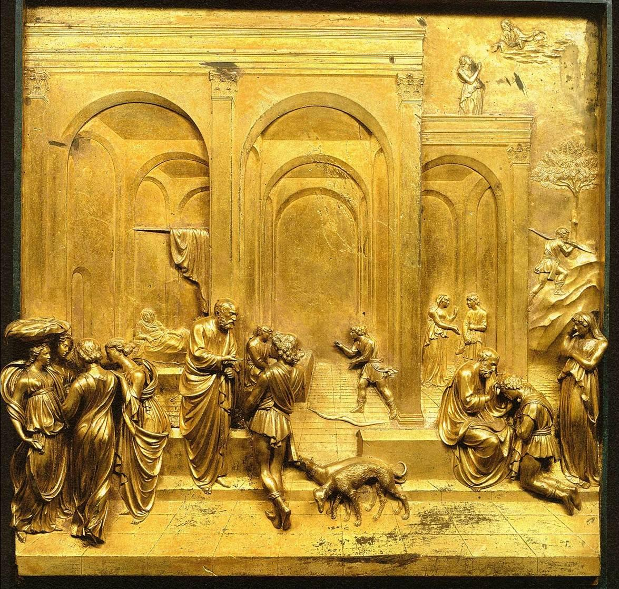
Gates of Paradise
1425-1452
Where is it located?
What is special about his work?

Slide 17
The Story of Jacob and Esau
1425-1452
From the Gates of Paradise
Link to breakdown of the art work…
Notes:
STORY OF JACOB -The Jacob story in Genesis (Chapter 25-27) as interpreted by Ghiberti at first glance seems to subvert the tale in the Bible.
Biblical version:
The Biblical narrative is one of birthrights and twins. Esau is the firstborn twin son of Isaac and Rebecca, Jacob the second twin. Rebecca favors Jacob because when she is pregnant God tells her:
"Two nations are in thy womb, and two manner of people shall be separated from thy bowels; and the one people shall be stronger than the other people; and the elder shall serve the younger."
She also prefers Jacob, her second-born, later in his life, because she doesn't like the wives that Esau has chosen to marry, "which were a grief of mind unto Isaac and to Rebekah." Isaac, the father, though, prefers Esau because Esau grows up to be a hunter who brings him venison to eat.When Isaac gets close to death and is nearly blind, he calls Esau to him and tells him to go out hunting to get venison and that after the meal he will give him his blessing.
Rebecca hears this plan and thwarts it by having Jacob obtain young goats which she quickly cooks for him to give as a meal to Isaac. Isaac eats the goats, then is prepared to give the blessing. He can't see Jacob but he hears his voice and thinks it is Jacob, his second son, not Esau, his firstborn. He is suspicious. The clue he searches for then to determine the identity of the child is the hairyness of his skin. Esau is a hairy man and Jacob "smooth." In order to fool Isaac into thinking he is blessing his firstborn, Rebecca tells Jacob to cover his hands and neck with the "skins of kids" and to wear a raiment of Esau's left in the house. Jacob knows he is lying to his father and is afraid his father will curse him if he finds out. But Isaac feels the "hairy" skin of the goats on Jacob's hands and smells the smells of the earth or the hunter on the clothing of Esau that Jacob is wearing and he believes that he is blessing Esau when he says:
"God give thee of the dew of heaven, and the fatness of the earth, and plenty of corn and wine; let people serve thee, and nations bow down to thee; be lord over thy brethren, and let thy mother's sons bow down to thee, cursed be every one that curses thee, and blessed be he that blesseth thee."

Slide 18
Donatello 1386-1466
What was his work a combination of?
What Rose did he mostly use in his sculptures and why?
What did the facial Expression did his statues provide?
What did most of his statues look out over?

Slide 19
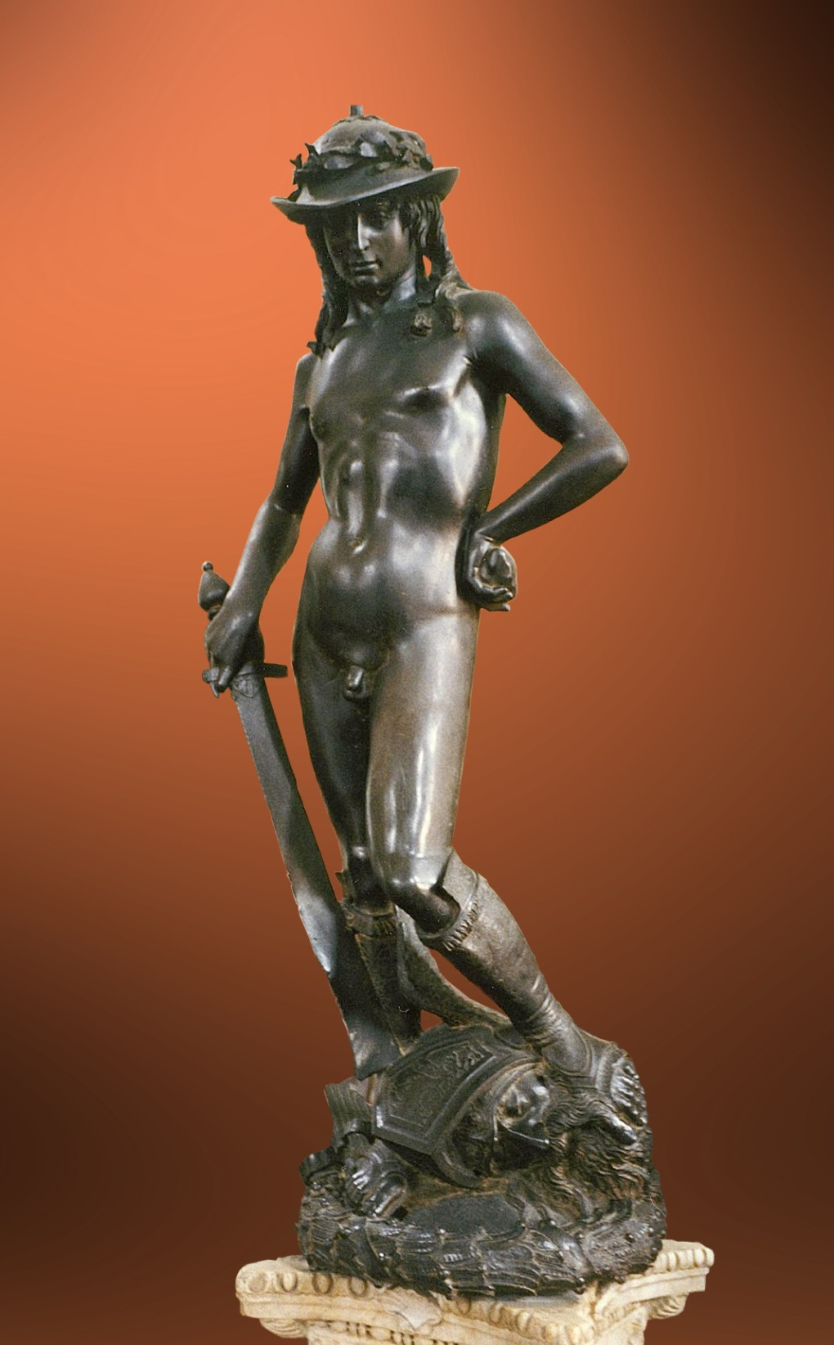
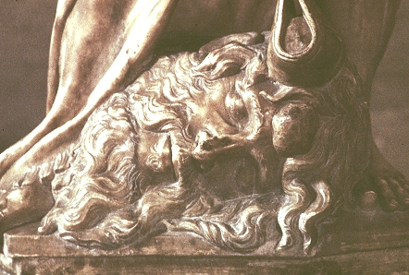
David 1430-1432
Where is it located?
What position is he standing in?
What is the statue about?
Why was David’s victory over Goliath symbolic?
Why did the Florentines think it became symbolic?

Slide 20
Masaccio 1401-1428
What age did he die at?
How did Masaccio revolutionize the art of painting?
How old was he at the time?

Slide 21
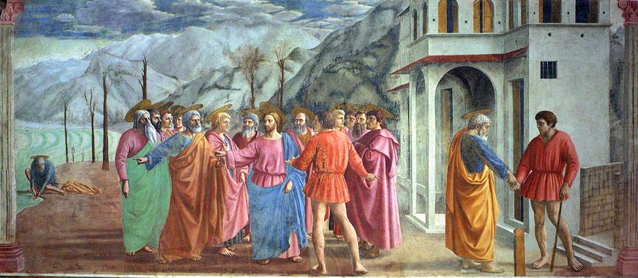
Tribute Money 1427
How does he use light in his paintings?
What kind of perspective did he use to initiate Renaissance painting in Florence?
What is the difference between Masaccio and Giotto’s depth?
What kind of painting is it and where is it located?
What is going on in the painting?

Slide 22
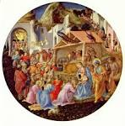
Fra Angelico 1400-1455
Where was he born?
What happened October 17, 1417?
What monastery did he work at?
What kind of art did he do at first?
Tondo- a painting round in shape (this is an example)

Slide 23
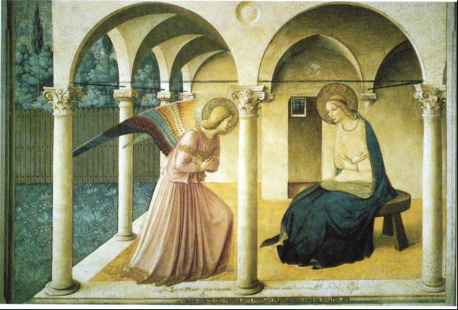
Annunciation
1440-1450
Who is the woman?
What is the name of the small window with bars over it?
What is happening in the picture?

Slide 24
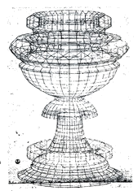
Paolo Uccello 1397-1475
where was he born?
When and where did he die?
What was he besides a painter?
Who was he an apprentice to?
Who was Lorenzo Ghiberti?

Slide 25
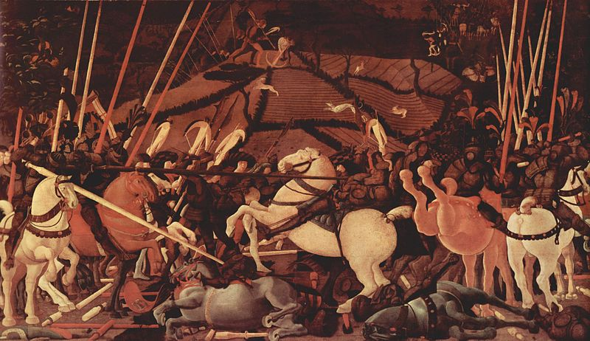
Battle of San Romano
1445
Does this look real? Why or why not?
What was this painting once a part of?
What do you see?
What is this painting about?
What was such a great concern to him and his artwork? What was the result?
Is there perspective in this painting?

Slide 26
Piero della Francesca
1420-1492
How long did he study art?
Where did he study?
What is he well known for?
Who were some of his teachers?
How is he related to the artists of today?

Slide 27
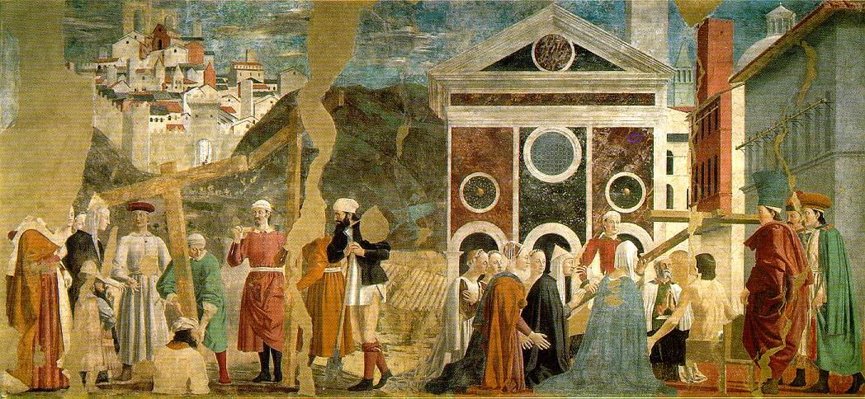
The Discovering and Proving of the True Cross
1453-54
What was on flaw in his work?
What do you see?
What is going on the painting?
Where was this located?
What is the name of the series of paintings this belongs to?

Slide 28
Sandro Botticelli 1445-1510
Who was his teacher?Fra Fillippo Lippi
Who was he a follower of?Girolamo Savonarola
Who did he spend most of his life working for?
The Medici Family
Who were they?

Slide 29
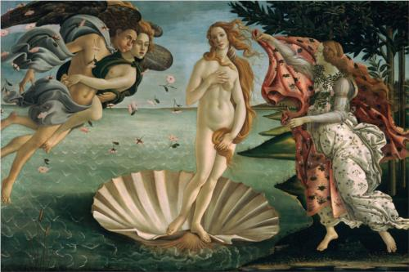
The Birth of Venus
1482
Where was it located?
What does it illustrate?
What is it about?
What makes it special?

Slide 30
Andrea Mantegna 1431-1506
Who was he apprenticing to?Francesco Squarcione.
Who was he influenced by? The florentine artists in his area.
What techniques did he use in his artwork?

Slide 31
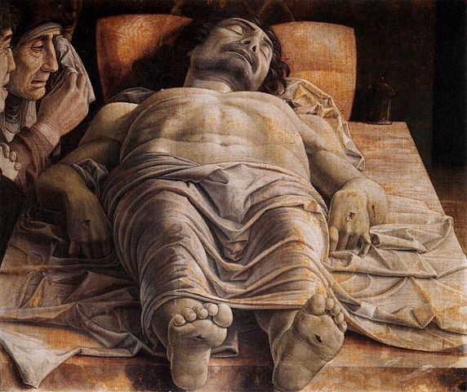
Dead Christ
1466
Who is this man?
What medium is this?
What were the proportions of the painting?
Where is this painting now?

Slide 32
Giovanni Bellini 1431-1516
What did most of his family do?
Who was he influenced by?
What city did he live and work in?

Slide 33
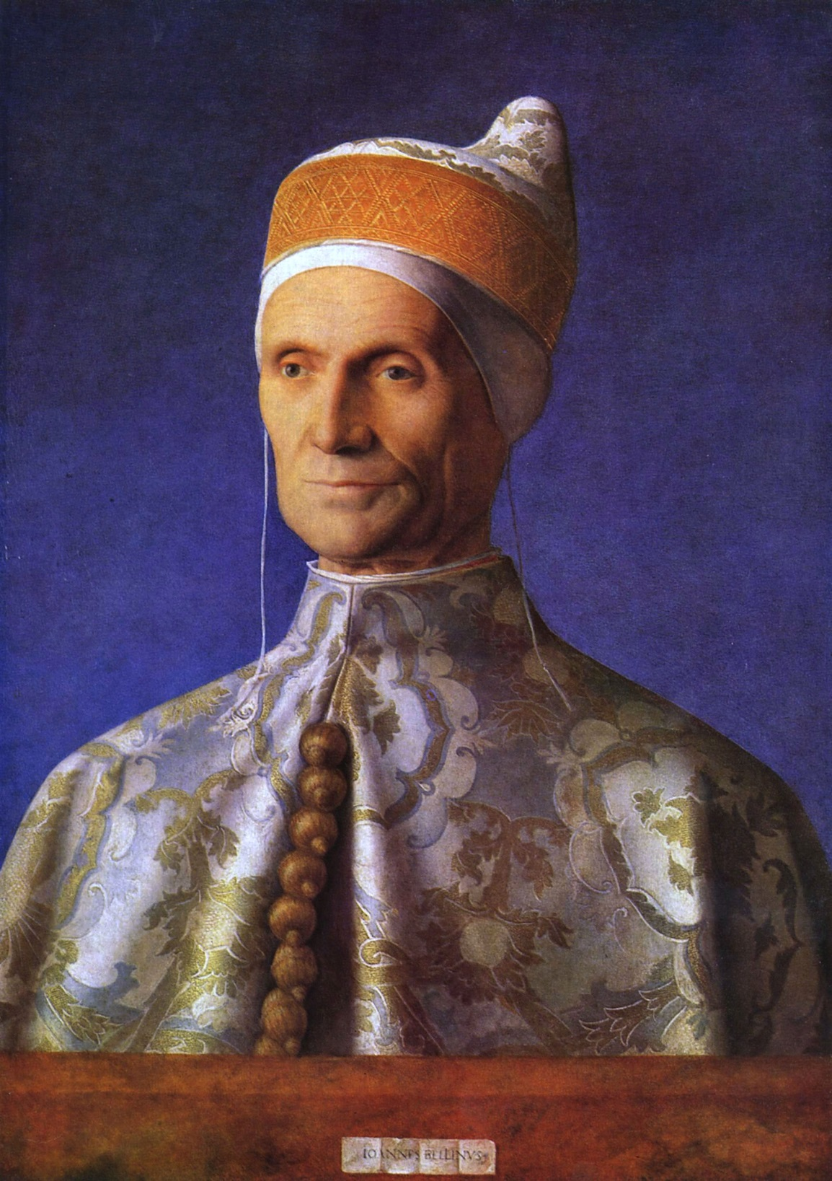
The Doge Leonardo Loredan
1502
Who is this a painting of?
What is the medium?
Locate the light source for this portrait.
What characteristics in his paintings demonstrate the influence of Northern European painters?

