Slide 1
The Language of Art
Elements of art and principles of design

Slide 2
Elements of Art
Line
Shape/Form
Value
Color
Texture
Space

Slide 3
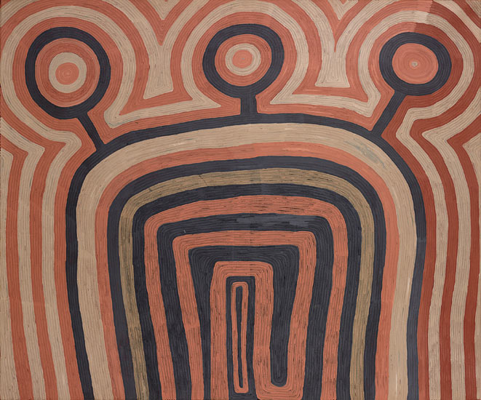
Line

Slide 4
line
descriptive
contour
outline
implied
edges
Hatching
individual
closure
Lines of sight
Expressive
Abstract
Line personalities
Movement
Shape
Directions

Slide 5
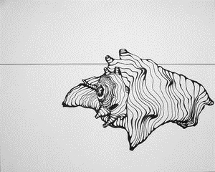
Descriptive line
Lines that help us understand what we are seeing. This includes outlines, contour lines, single lines, and hatching.

Slide 6
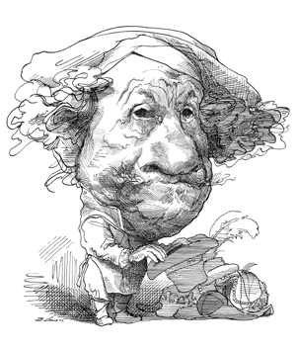
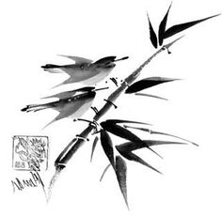
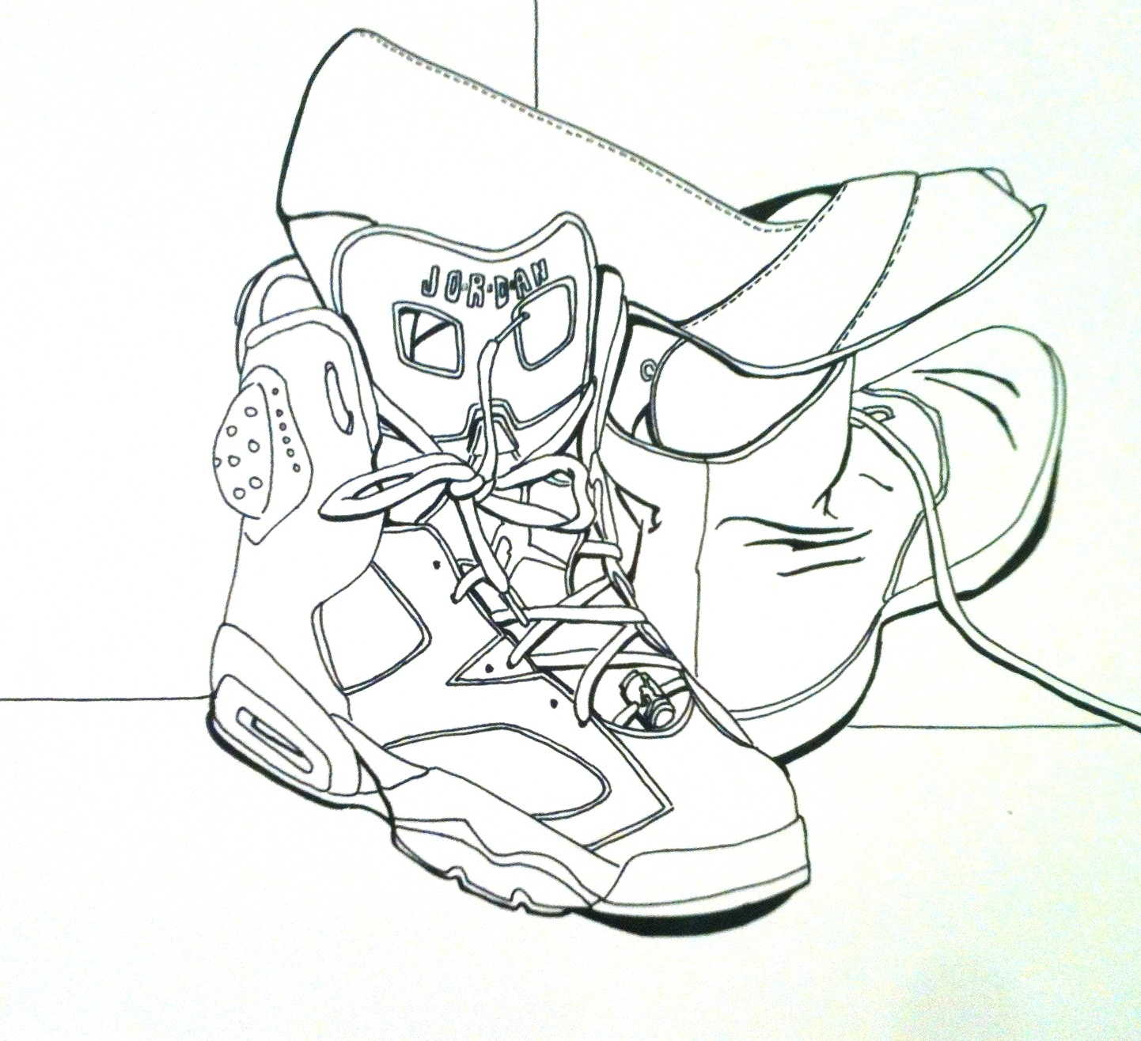
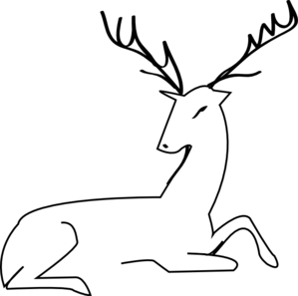
4 kinds of descriptive lines
Outlines
Contour lines
Individual lines
Hatching/crosshatching

Slide 7
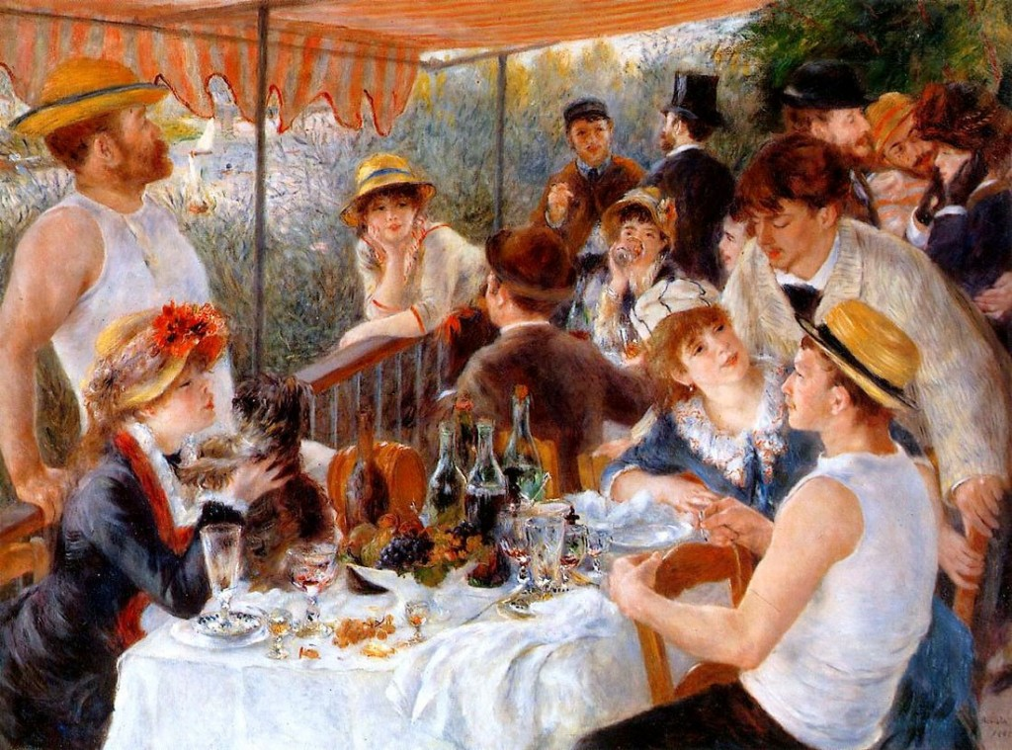
Implied lines-Edges
Lines that suggest an edge rather than clearly defining one. These occur where textures, colors and values change at edges of shapes in artwork.

Slide 8
Implied Lines-closure
Our tendency to see complete figures where lines are left open.

Slide 9
Implied lines- line of sight
The lines along which people look.

Slide 10
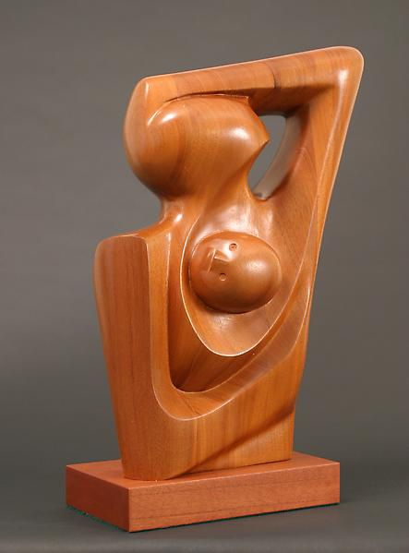
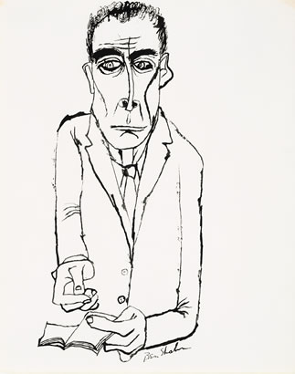
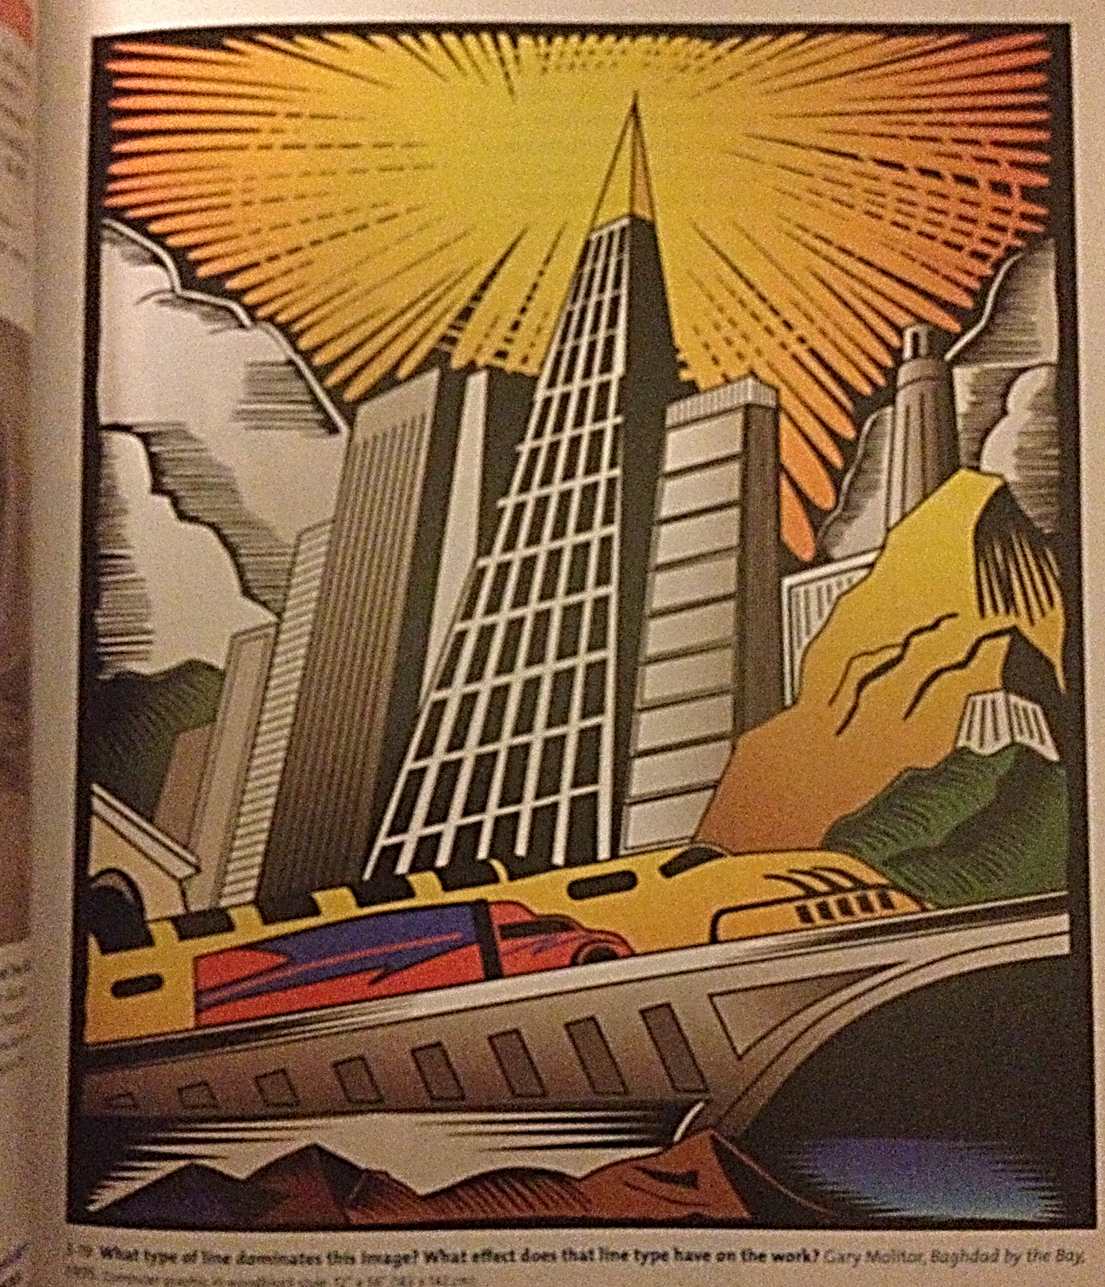
Expressive lines
Lines that send us messages about what the artist wants his or her work to make us feel. Abstract lines, which are expressive, may not show us objects we recognize, but can still create a feeling in us.

Slide 11
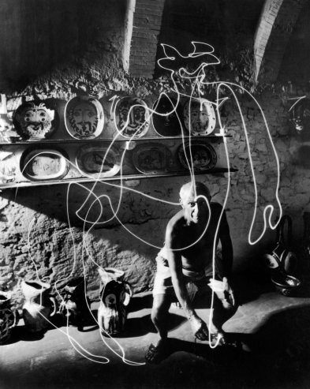
Line personalities
Shape
Movement
Direction
Abstract Lines

Slide 12
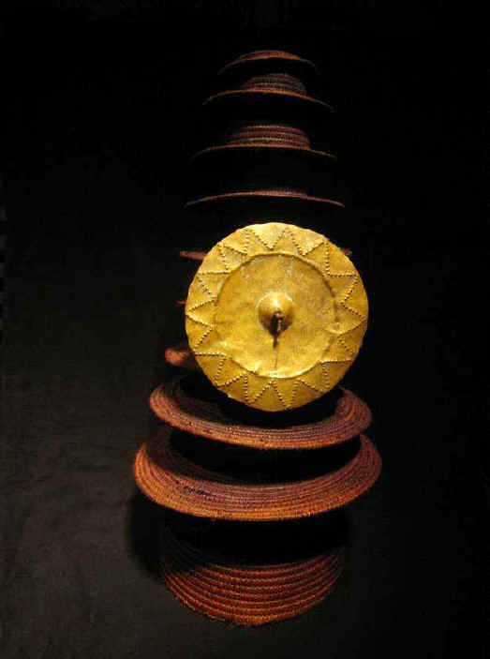
Shape and Form

Slide 13
Shape and Form
Real forms
closure
Expressive qualities
Figure/Ground
Positive shape
Organic
Forms in pictures
Negative shape
Closed/open
Geometric

Slide 14
Shape/Form
Shape - A two dimensional area with a recognizable boundary.
Form- a 3 dimensional shape
Closed Shapes
Geometric
Organic
Open Shape

Slide 15
Positive Shape/ Negative shape
a FIGURE is a positive shape
a Ground is a shape that seems to be underneath or around a figure.

Slide 16
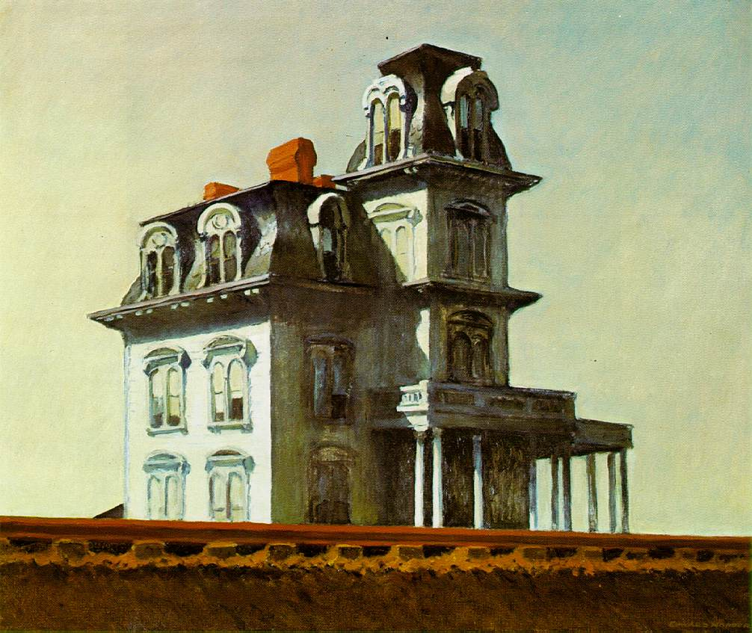
What kinds of shapes do you see?

Slide 17
Value and color
Value
hue
Value
Color in art and Daily life
Color harmonies
Light and Dark
Three Dimensions of Color
inensity
Expressive qualities
Color interactions

Slide 18
Value

Slide 19
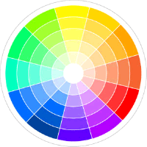
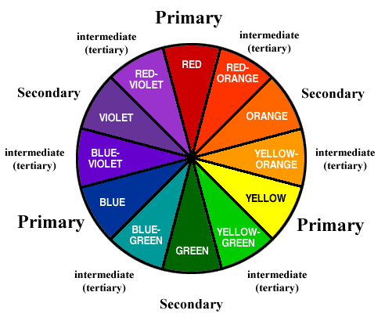
3 dimensions of color
Hue
Value
Intensity

Slide 20
Space
Space
In environment
Space in 2D art
Overlap
Space in 3D art
Placement
Linear perspective
Aerial Perspective
Positive/negative
Open/closed

Slide 21
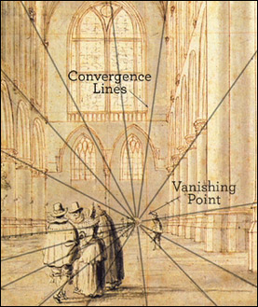
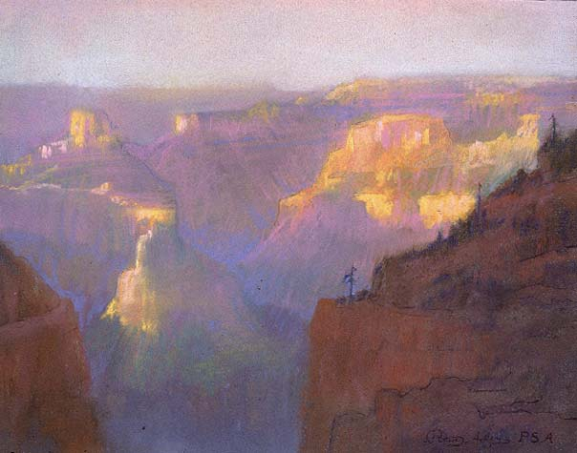
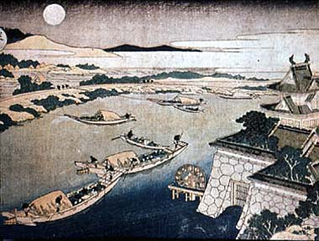
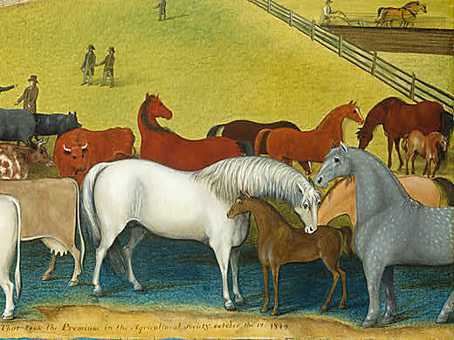
Space in 2D Art
OVERLAP
PLACEMENT
LINEAR PERSPECTIVE
AERIAL PERSPECTIVE

Slide 22
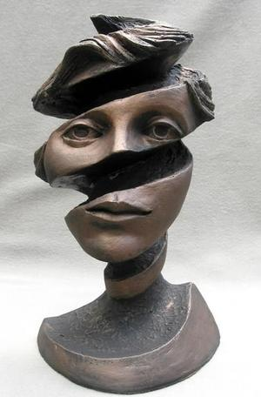
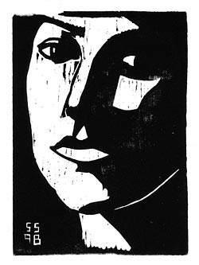
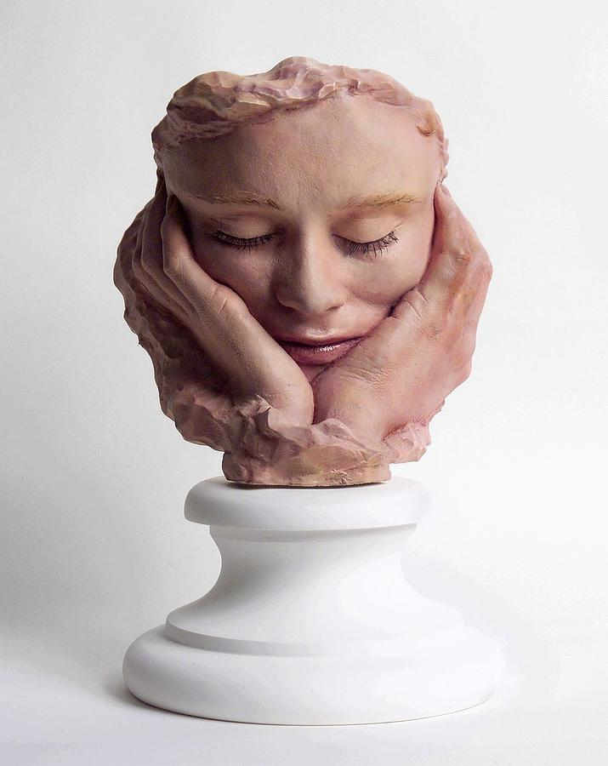
SPACE IN 3d ART
POSITIVE/NEGATIVE
OPEN/CLOSED

Slide 23
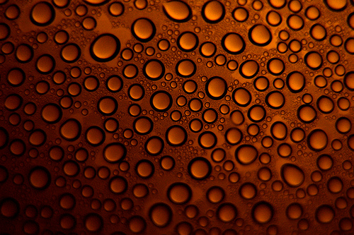
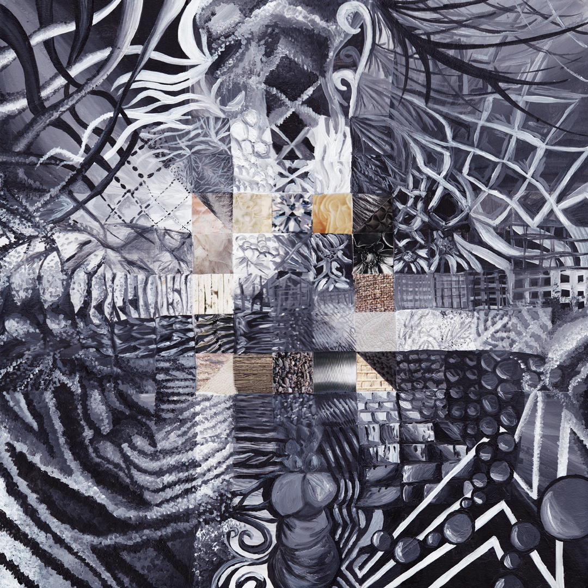
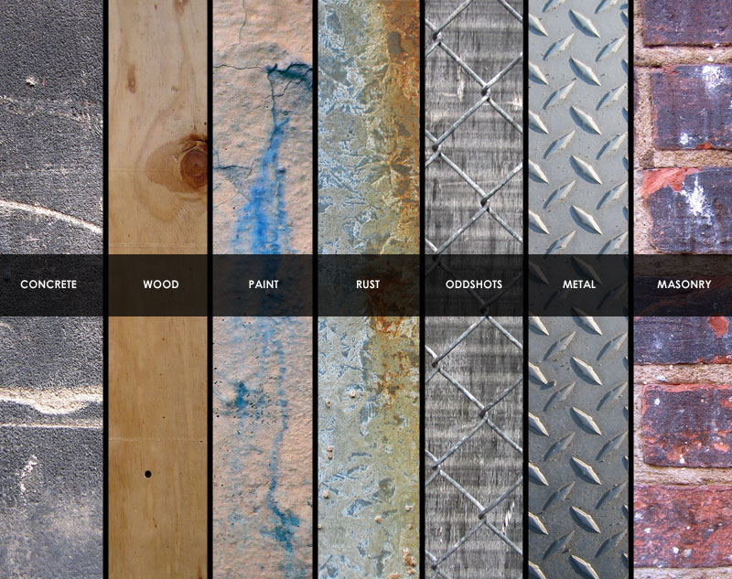
TEXTURE
IMPLIED
ACTUAL
INVENTED

