Slide 1
Art of the Middle Ages
Byzantine through Gothic

Slide 2
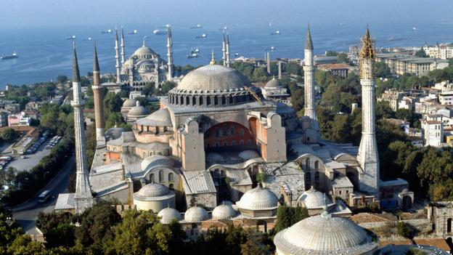
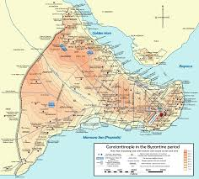
The Modern city of Istanbul was once Constantinople (named for Emperor Constantine). Before that the city was called Byzantium.

Slide 3
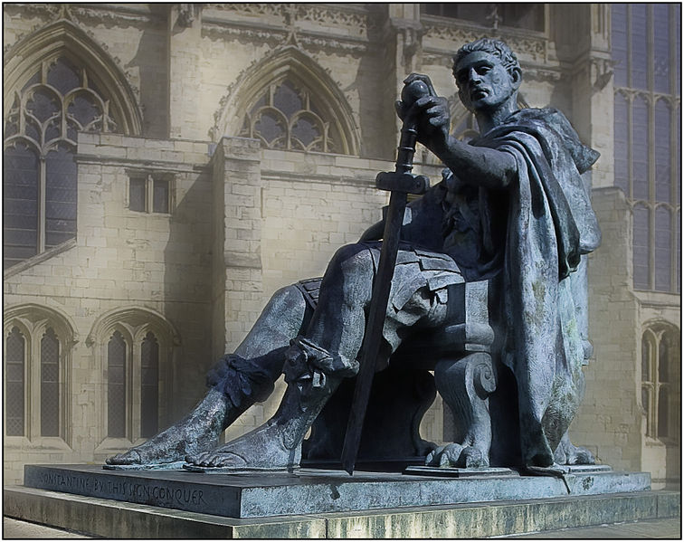
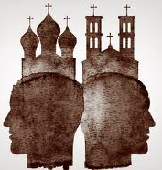
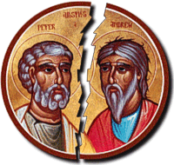
Emperor Constantine decided to move the capital of the Holy Roman Empire to Byzantium.
This resulted in the split of the Christian church into the Eastern orthodox church and the Western Catholic church.

Slide 4
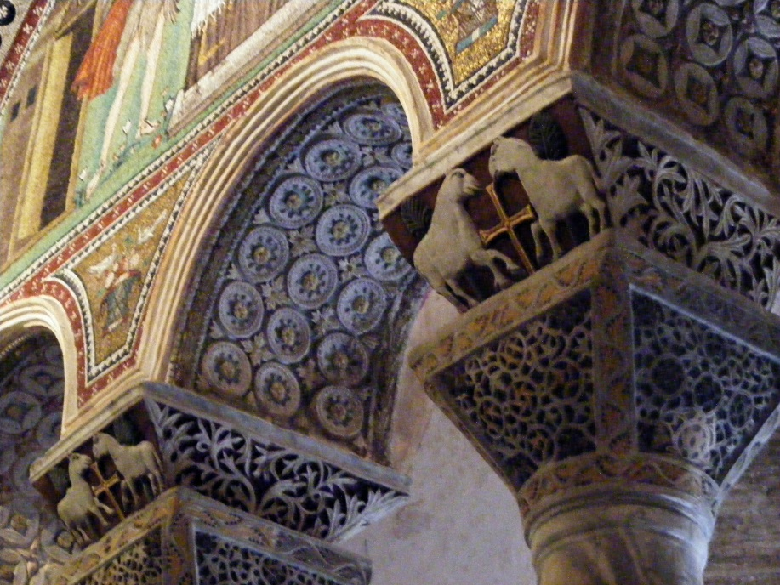
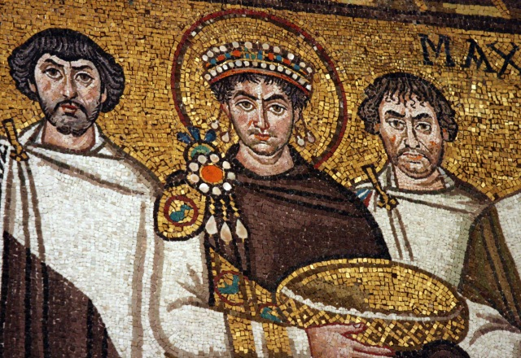
After the reign of Emperor Justinian (AD 527-565, religious images were forbidden. Numerous works of art were destroyed.
In spite of this the “Golden age of Byzantine art” that began during his reign lasted until the end of the 9th century. Byzantine greatness in art came to an end in 1453 when Constantinople was conquered by the Turks. Much of what we know today of Byzantine art is seen Ravenna, Italy, Greece, Serbia, and Russia.

Slide 5
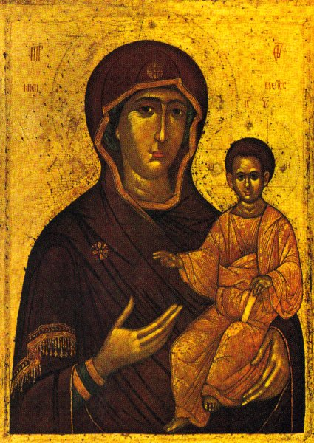
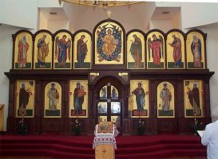
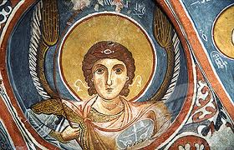
Painting
Frescoes were painted on walls, and icons (religious images) were painted on wooden panels.

Slide 6
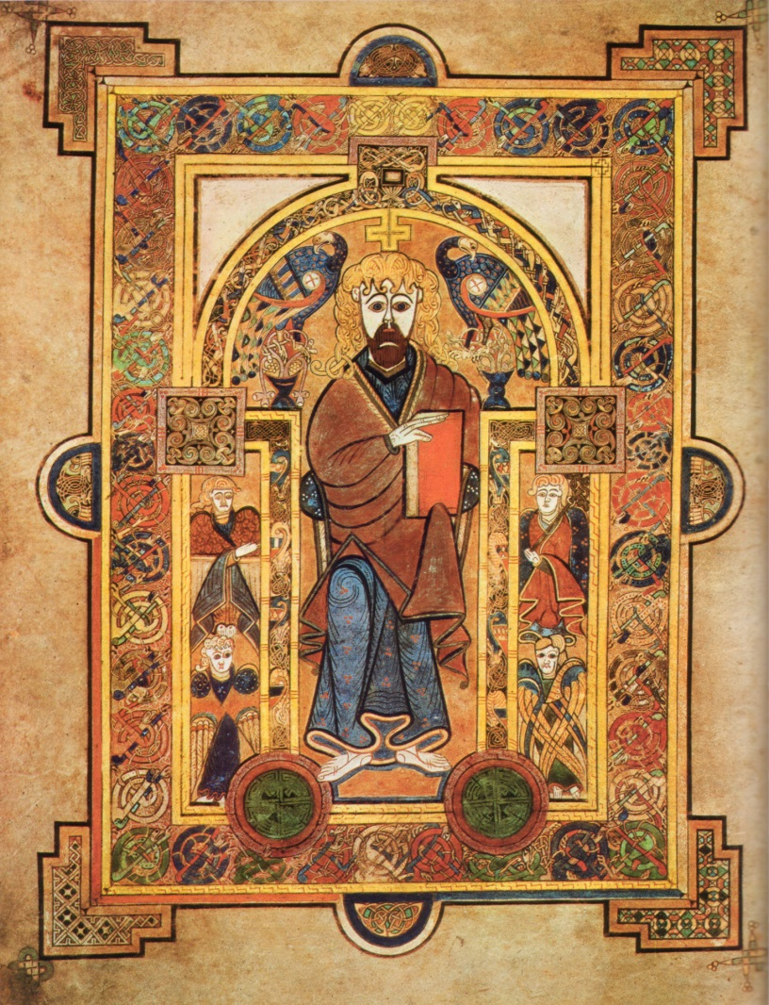
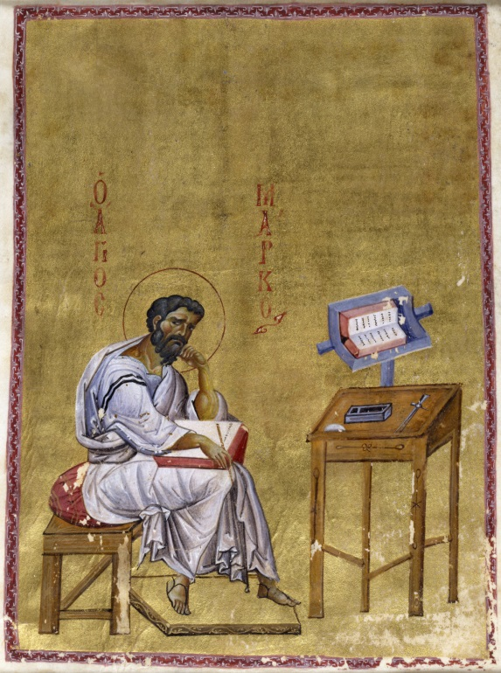
Manuscript illumination was the forunner to the dramatic mosaic representations later seen in many eastern orthodox churches. Early Byzantine painting was almost exclusively religious.
Figures were portrayed frontally, with large staring eyes, unsmiling features, and long, narrow faces demonstrating the lack of interest in the human form or realistic portraiture.

Slide 7
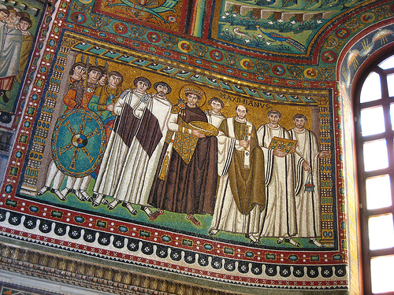

Slide 8
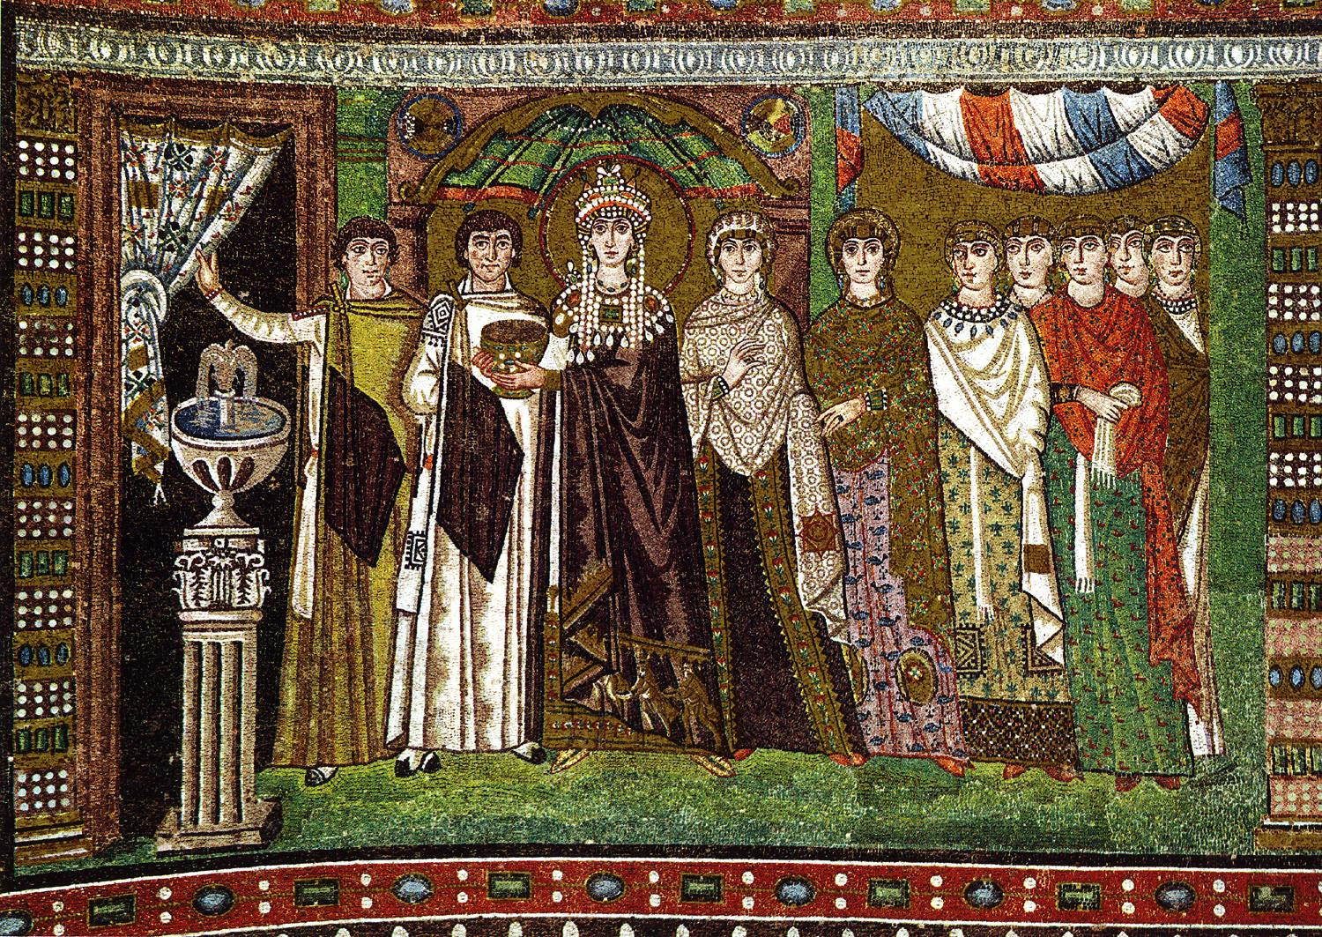

Slide 9
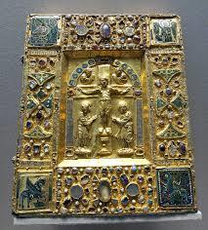
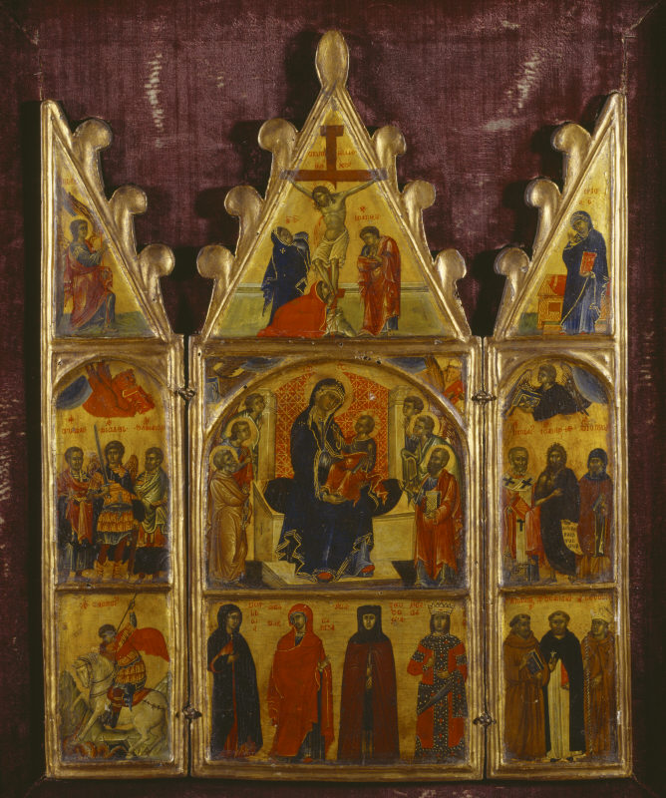
Sculpture
It was generally limited to small ivory book covers or small portable, hinged altars (diptychs, triptychs an polyptychs, depending on the number of panels.) Sculpture of the human form was considered idolatrous and was discouraged. Bas relief decorative carving was used in churches, and beautiful metalwork in gold and silver was created to house the relics of saints. These reliquaries were an important part of every church's treasury.

Slide 10
Architecture
Byzantine architecture had a far reaching influence on the construction of churches throughout Europe. A development in the construction of Hagia Sophia, a hug church constructed in Ad 532-537 in Constantinople, dramatically affected western architecture . The pendentive ( a concave triangular support allowed a round dome to be placed on square pillars.

Slide 11
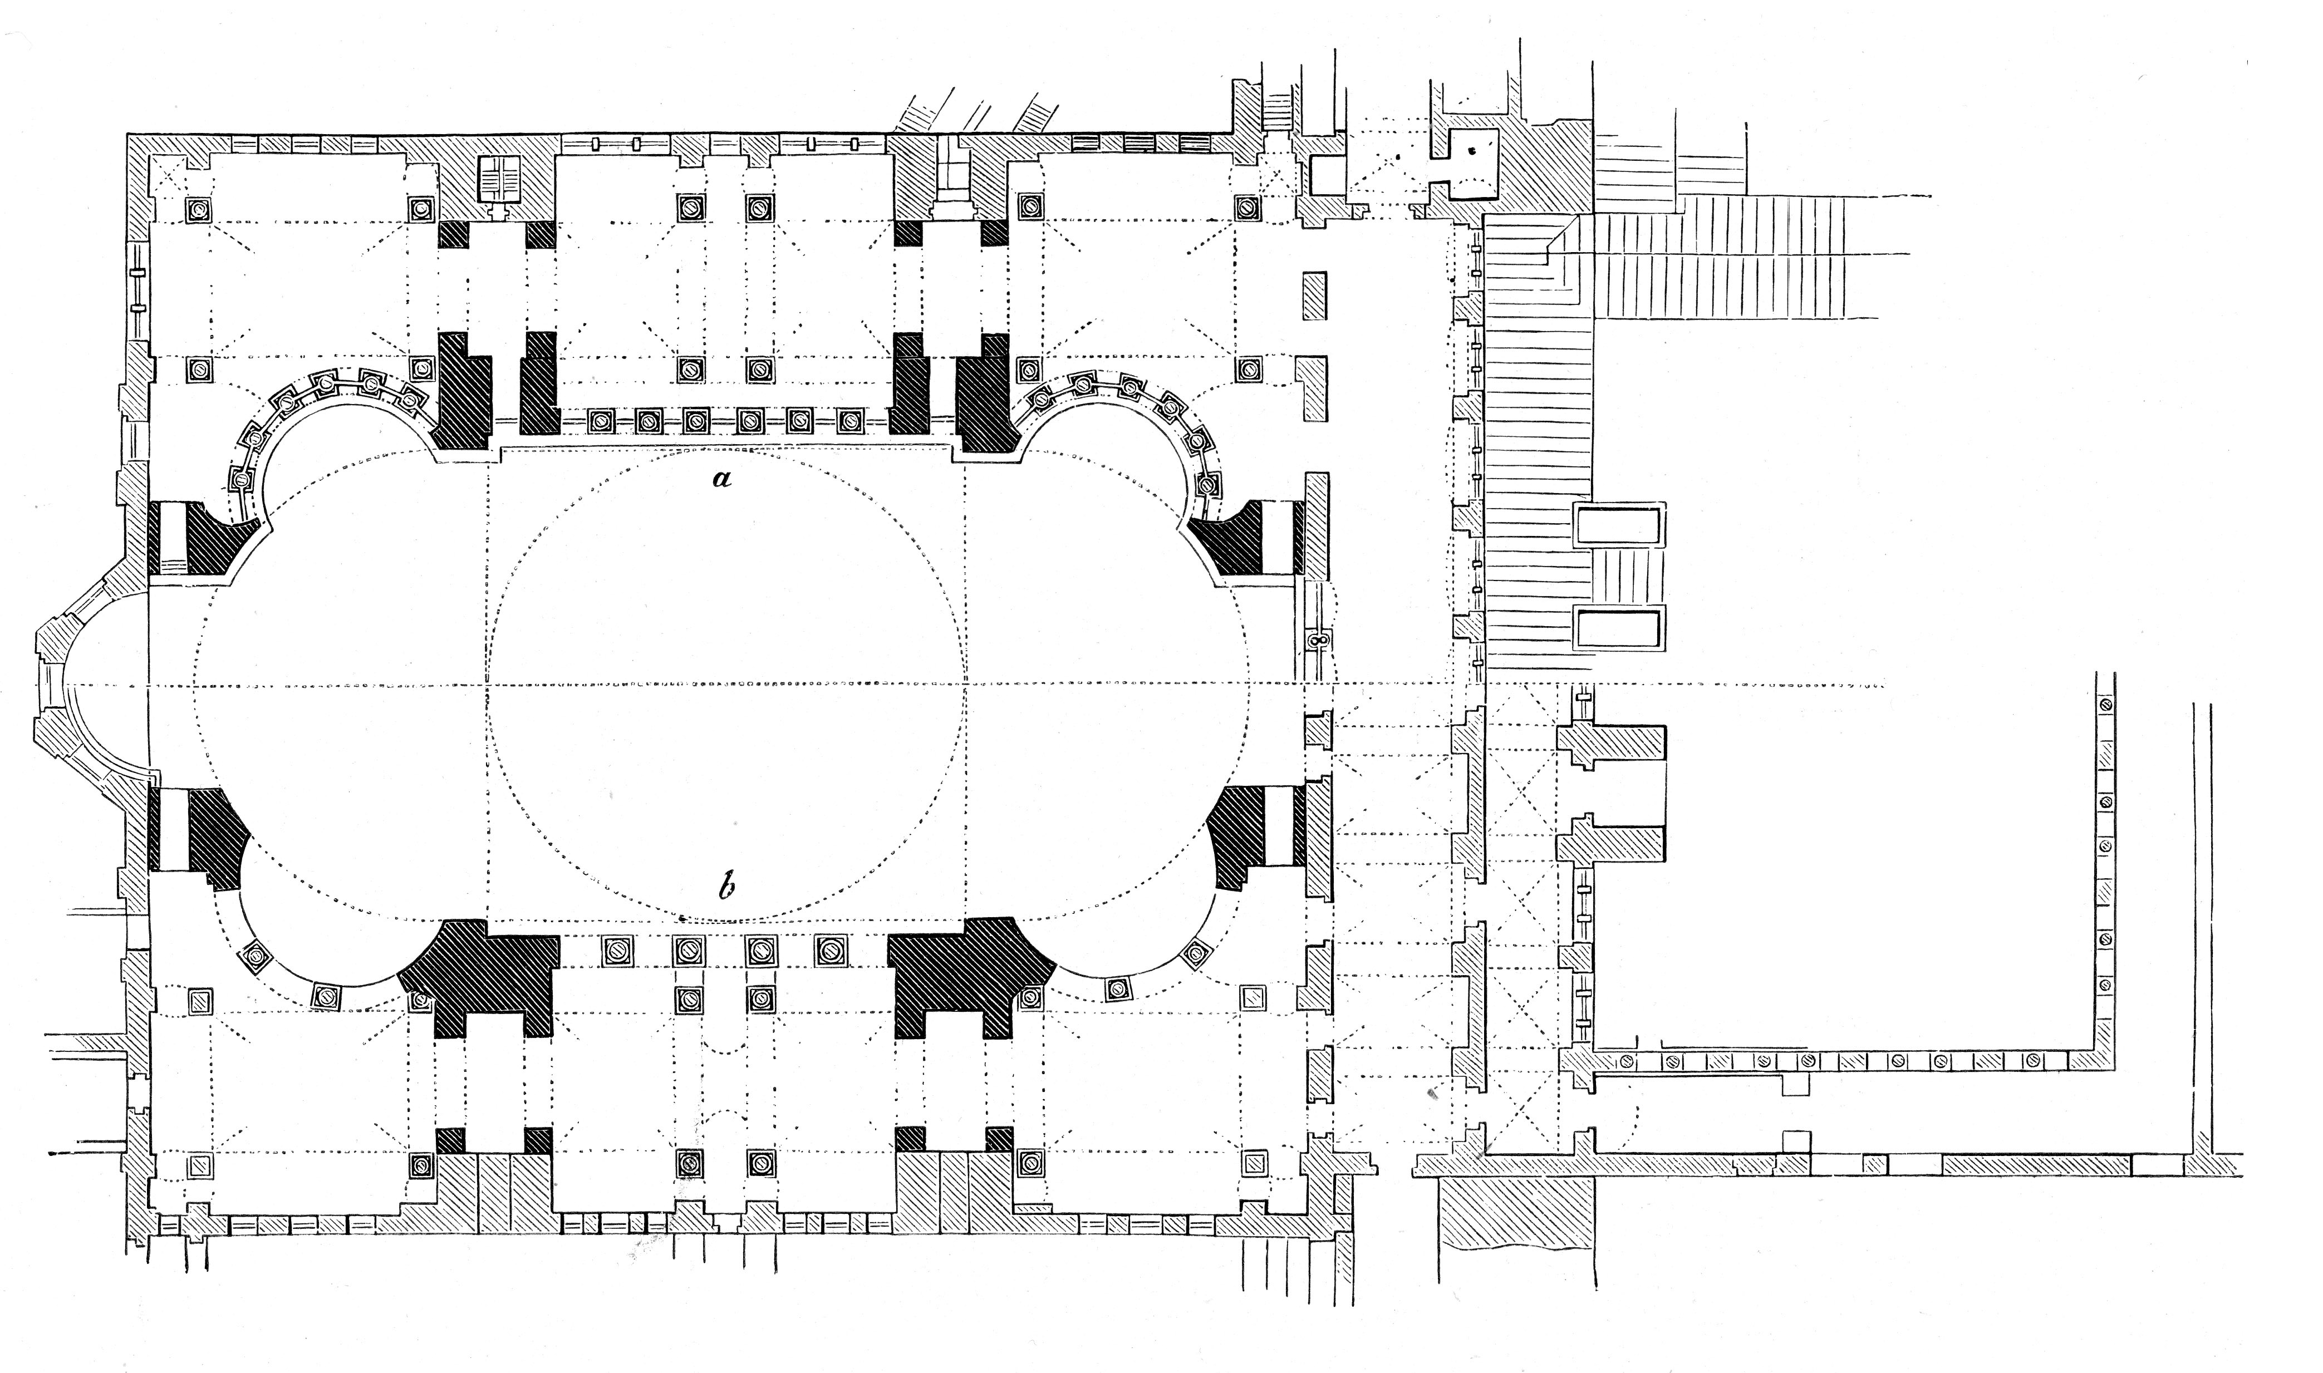
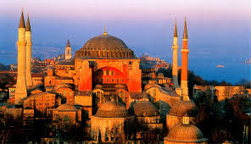
The central church plan, with its dome over the crossing, evolved. The floor plans were shaped after the Greek Cross (equal sized legs, or the Roman cross, the rich mosaic used in Hagia Sophia were copied churches throughout Italy. Minarets ere added to Hagia Sophia after the Turkish conquest. And it has since served as the model for a number of Islamic mosques.

Slide 12
The Middle Ages
AD 400-1000

Slide 13
The Term middle ages generally is applied to the period between classical antiquity and the Renaissance.
Middle Ages

Slide 14

The period from the fifth to the thirteenth centuries was sometimes called the “Dark Ages”
This refers to the supposed lack of intellectual growth during this time period.

Slide 15
The Christian church introduced new religious and ethical concepts and rejected pagan influences.

Slide 16
The Roman empire contributed strong governmental organization and philosophical, literary, scientific, and artistic influence from classical antiquity.

Slide 17
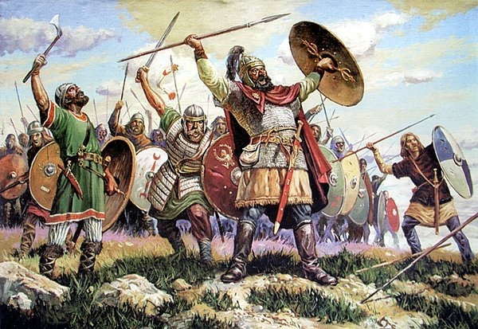
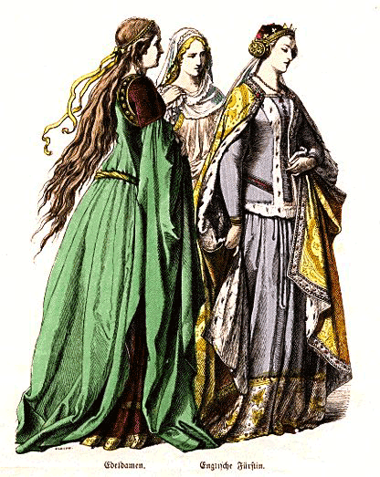
The Germanic tribes contributed ideas of personal freedom and individuality to medieval civilization.

Slide 18

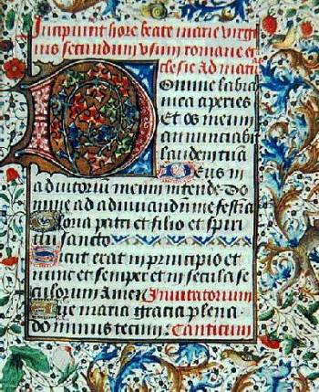
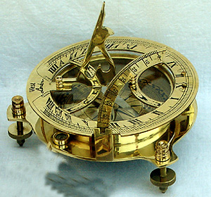

Ideas and concepts brought back by the crusaders from the Eastern cultures also added to the intellectual and artistic growth.

Slide 19
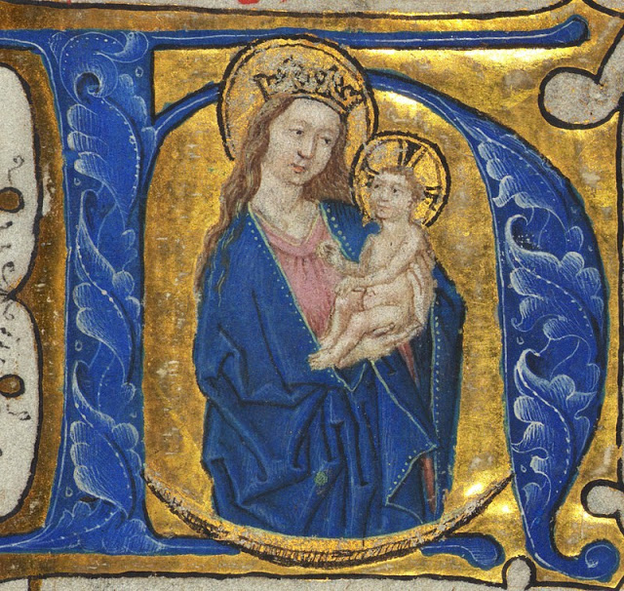
Manuscript Illumination
Manuscript illumination was the chief form of painting over a period of several hundred years.
Illumination is the art of decorating hand lettered manuscripts.
Madonna, 6-7th centuries, Sta Francesca Romana, Rome

Slide 20
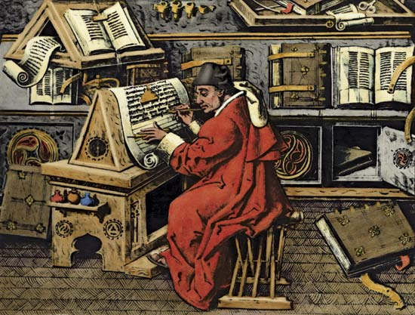
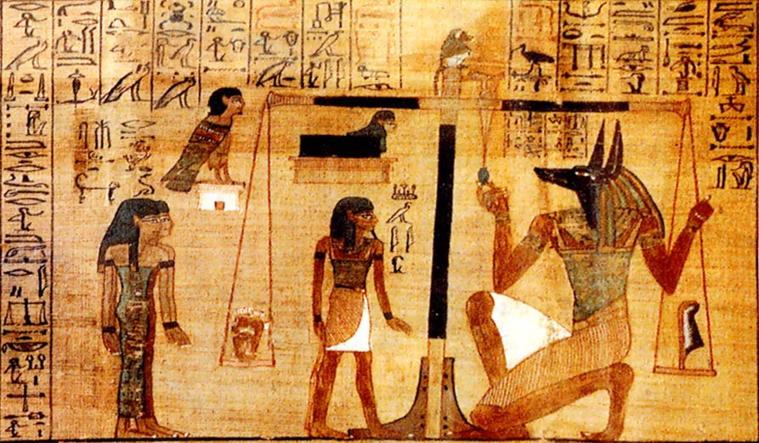
The first known illuminated manuscript is the Egyptian Book of the Dead. The vast majority of western manuscripts were produced in monasteries, which were the center of learning.

Slide 21
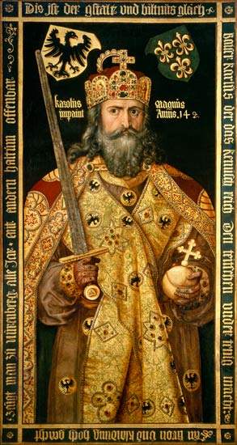
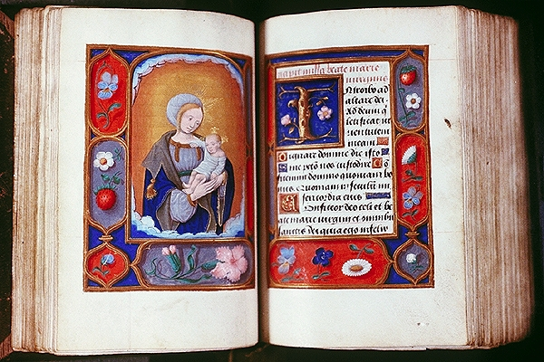
The Emperor Charlemagne, though he was unable to read, was true patron of the art in that he supported the copying of classical manuscripts and encouraged the buildings of churches.

Slide 22
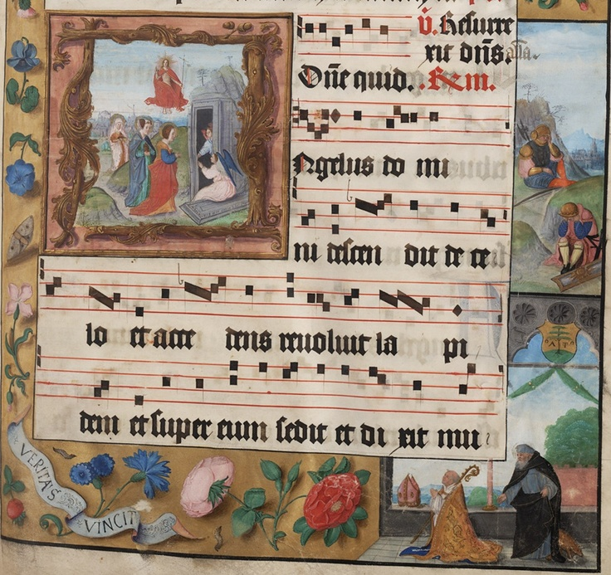
The majority of the books were religious, including bibles, psalm books (psalters), personal prayer and hour books, song book, and antiphonies (responsive reading and song books, often quite large, so they could be seen by many people.

Slide 23
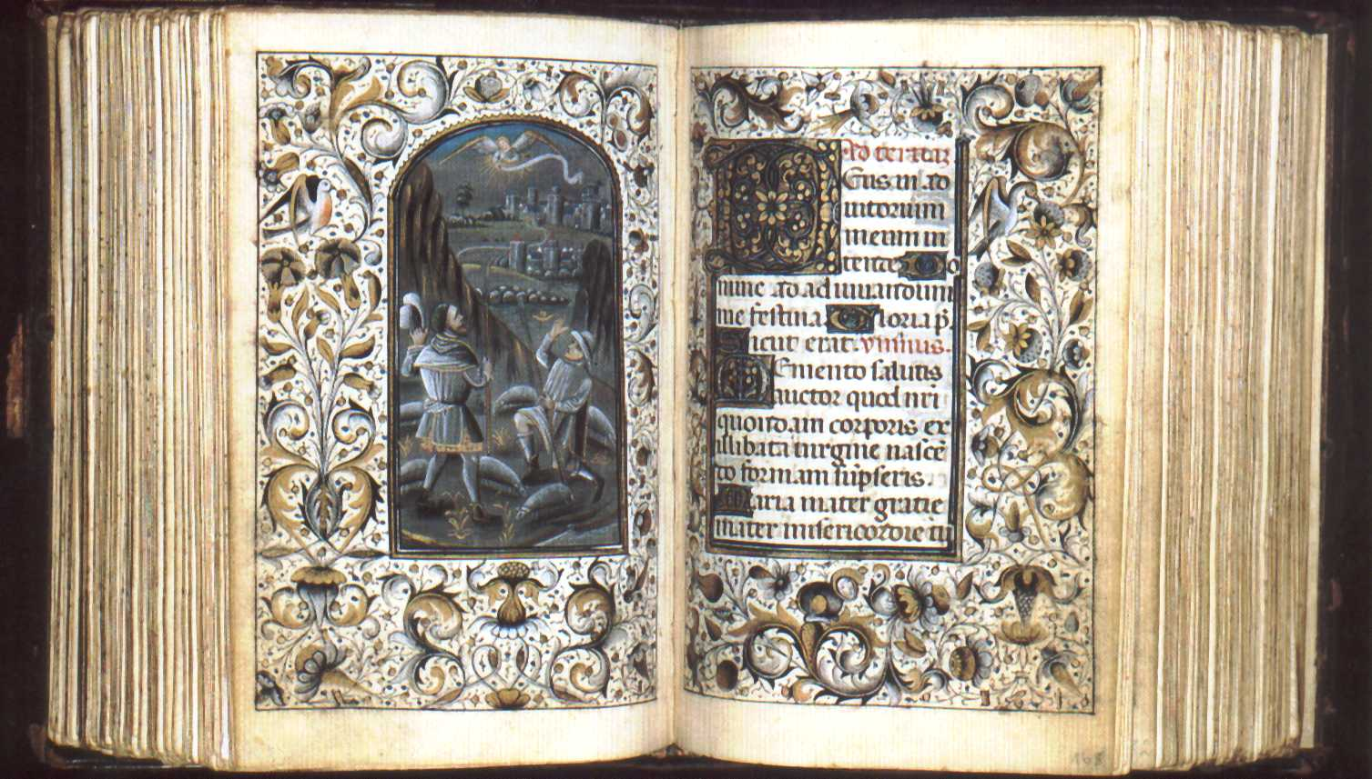
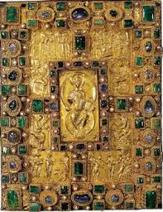
In later years royal patronage encouraged artists to produce books of hours (book containing prayers to be said at certain hours of the day), histories and romances.
The books were painted on vellum or parchment (fine-grained lamb skin, kidskin, or calf skin especially prepared for writing) and often elaborately bound between covers of ivory or gold and enamel embedded with jewels. The text and outlines were done with quill pens in ink. Gold leaf was lavishly used, with the amount of ornament dependent on the price.

Slide 24
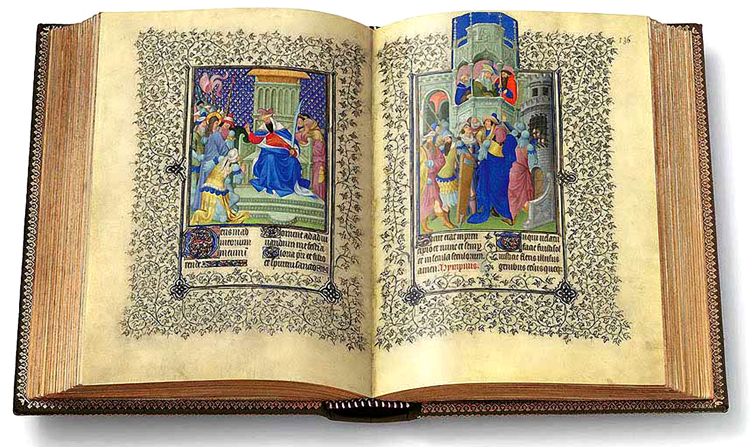
Les Tres Riches Heures de Duc de Berry
Limbourg Brothers 1413-1416
Notes:
Considered to be the finest example of Medieval manuscript illumination of the fifteenth century, Les Tres Riches Heures du Duc de Berry is an exquisite richly decorated Book of Hours - one of the most famous of all International Gothic illuminations - which was commissioned by John, Duke of Berry, around 1413. A Book of Hours was a popular type of devotional prayer book, which included a text for each liturgical hour of the day, plus calendar, as well as prayers, psalms and masses for specific holy days. Painted in gouache on parchment (vellum), The Tres Riches Heures includes 416 pages, 131 of which have large miniatures, while many more are decorated with border illustrations or large historiated initials, as well as 300 ornamented capital letters. Comparable, as a work of fine art painting in miniature, with the likes of the Mona Lisa, this work of art is now in the Musee Conde, Chantilly, France (Ms.65). The creators of this outstanding example of 15th century French religious art were the Flemish Limbourg Brothers, Pol (Paul), Herman (Hennequin) and Jean (Jan or Jannequin) - nephews of Jean Malouel, court painter to the Duke of Burgundy - all three of whom died of plague in 1416.

Slide 25
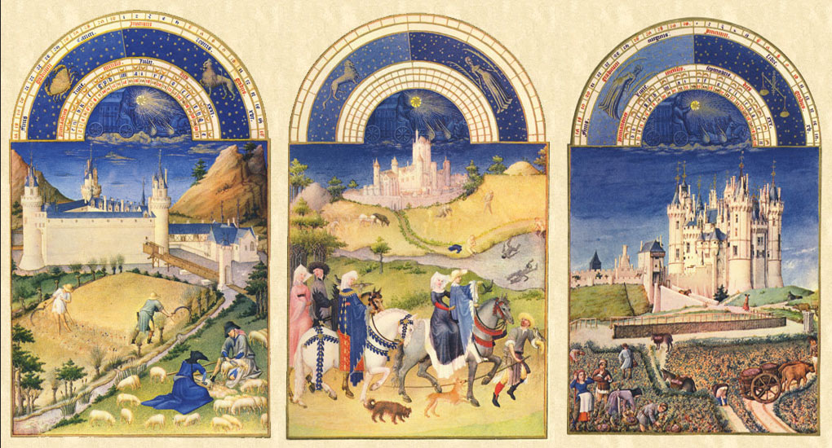
Les Tres Riches Heures de Duc de Berry
Limbourg Brothers 1413-1416

Slide 26
notes
Book of Hours
commissioned by John, Duke of Berry, around 1413.
a popular type of devotional prayer book, which included a text for each liturgical hour of the day, plus calendar, as well as prayers, psalms and masses for specific holy days.
416 pages,
131 of which have large miniatures, while many more are decorated with border illustrations or large historiated initials,
as well as 300 ornamented capital
this work of art is now in the Musee Conde, Chantilly, Franceletters.
Limbourg Brothers, Pol (Paul), Herman (Hennequin) and Jean (Jan or Jannequin) - nephews of Jean Malouel, court painter to the Duke of Burgundy - all three of whom died of plague in 1416.

Slide 27
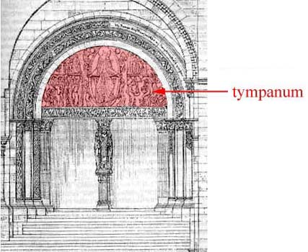
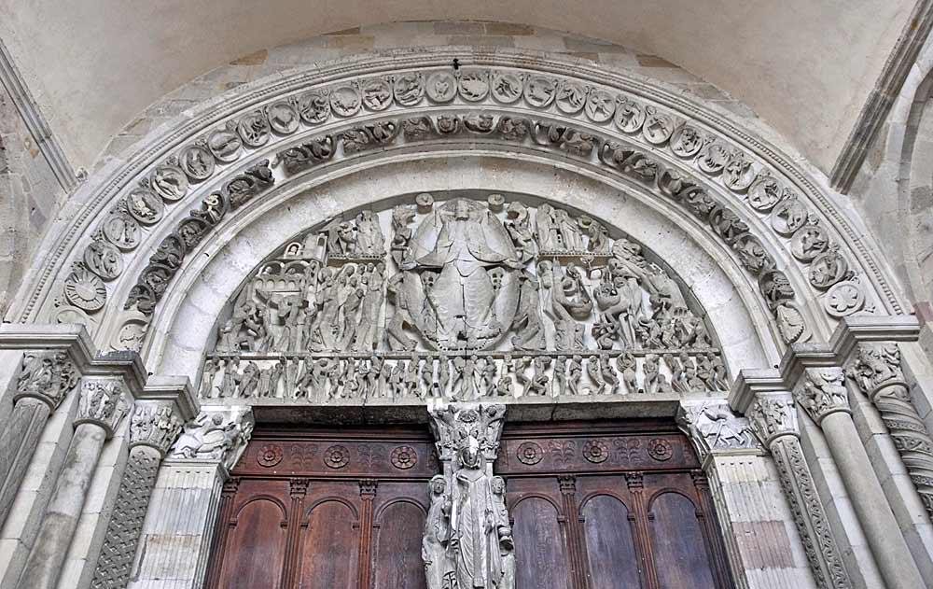
Sculpture
Sculpture played an important part in the decoration of Romanesque and Gothic churches. It was used to decorate column, the door jambs, and the tympanum (curved arch above the entrance to the churches).
Classical sculptures had been all but lost in history, and Romanesque sculpture revived it as a decorative art.

Slide 28
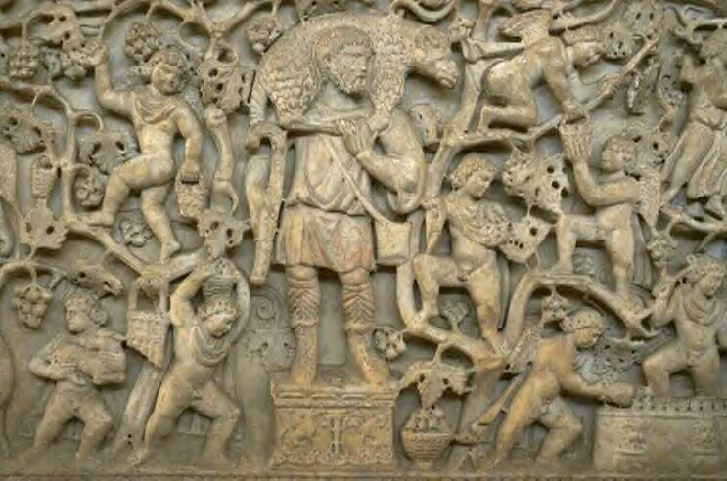
The subjects were largely religious stories and themes such as lives of the saints, the last judgment, or scenes from the life of Christ. Bronze casting was revitalized, and numerous small images of the Madonna and Child or crucifixes were carved of wood, ivory or stone.
Good Shepherd Sarcophagus, from the Catacomb of Praetextatus, Rome,
Late AD 4th century
Marble
sarcophagus
The figure of Christ, as larger and central denotes the importance of Christ.
hierarchy of scale governing the size and importance of the figures.
The Eucharistic wine or vine, is symbolic of the Blood of Christ.
Notes:
The same groping for a new style is seen in the Good Shepherd sarcophagus. Where spiritual and not physical presence was sought.
The figure of Christ, as larger and central denotes the importance of Christ. Once again we have a hierarchy of scale governing the size and importance of the figures.
The Eucharistic wine or vine, is symbolic of the Blood of Christ. The message is symbolic but easily read, through the crucifixion of Christ, the faithful are promised Salvation.

Slide 29
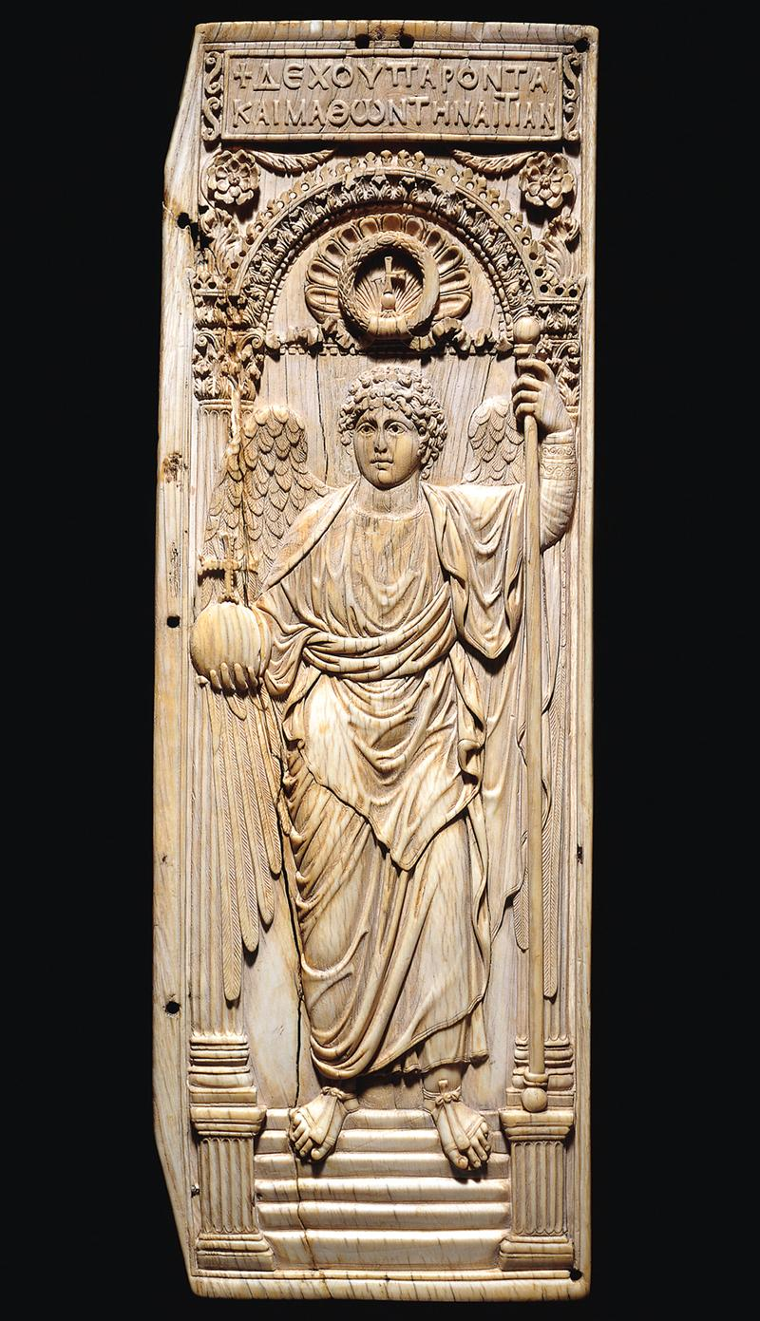
Saint Michael the Archangel early sixth century
Ivory
1' 5" X 5 1/2".
British Museum, London
right leaf of a diptych
The sculptor who carved this ivory panel modeled Saint Michael on a classical winged victory
the archangel seems to float in front of the architecture rather than stand in it

Slide 30
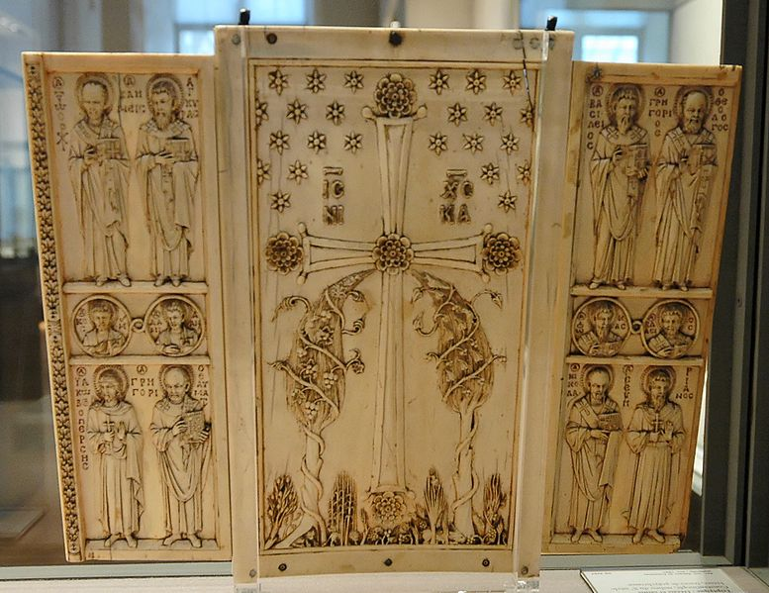
The Harbaville Triptych late 10th century
Byzantium
Ivory but would have been painted
This is thought to be either Romanos II crowned in 959, or possibly Romanos IV, crowned in 1068.
Notes:
The Harbaville Triptych is a Byzantine ivory triptych of the middle of the 10th century with a Deesis and other saints, now in the Louvre. Traces of colouring can still be seen on some figures. It is regarded as the finest, and best-preserved, of the "Romanos group" of ivories from a workshop in Constantinople, probably closely connected with the Imperial Court.
The group takes its name from another ivory in the Cabinet des Médailles of the Bibliothèque nationale de France, Paris showing Christ crowning an Emperor, named as Romanos, and his Empress. This is thought to be either Romanos II crowned in 959, or possibly Romanos IV, crowned in 1068. related works are in Rome, the Vatican, and Moscow, this last another coronation probably datable to 944.^{[1]}
The Harbaville Triptych is considered "by far the finest, for it shows an elegance and delicacy which are absent in the others. All are in the polished, elegant style typical of the Court school."^{[2]} Other groups have also been identified, presumably representing the output of different workshops, perhaps also employed by the Court, but generally of lower quality, or at least refinement.^{[3]} Since much greater numbers of ivories survive than panel paintings from the period, they are very important for the history of Macedonian art.
All sides of the triptych are fully carved, with more saints on the outsides of the side leaves, and an elaborate decorative scheme on the back of the central leaf.

Slide 31
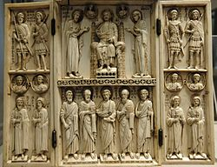

Slide 32
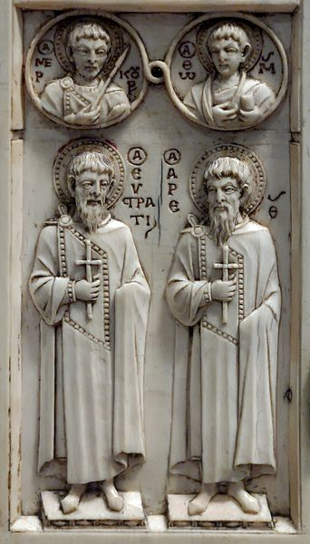
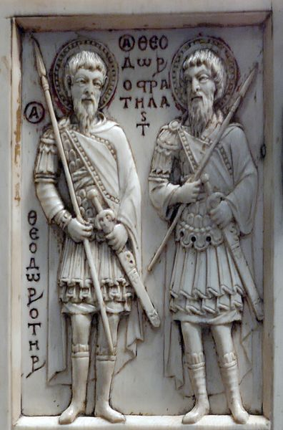
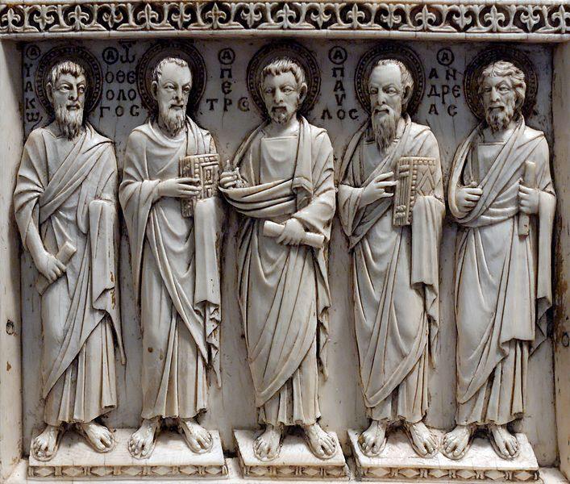
Left leaf, bottom panel: St. Eustratius and St. Arethas. In the roundels, Saint Mercurius and St Thomas the Apostle.
Left leaf, top panel: Saint Theodore the Recruit, Saint Theodore the General
Middle leaf, bottom panel: Apostles James, John, Peter, Paul and Andrew

Slide 33
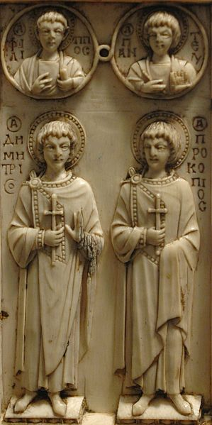
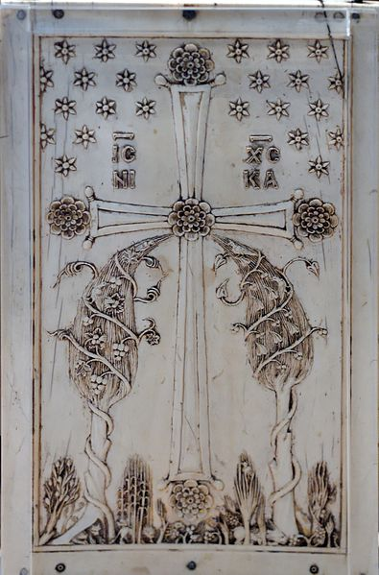
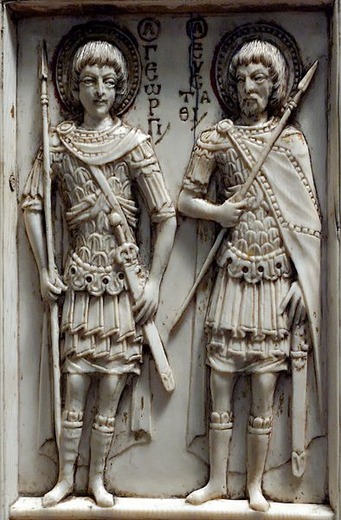
Right leaf, top panel: Saint George and Saint Eustace
Right leaf, bottom panel: Saint Demetrius and Saint Procopius. In the roundels, St. Philip the Apostle and Saint Pantaleimon
Verso of middle leaf: representing the triumphal cross in Paradise, with two trees of life and the inscription "Iesou Christos nika" ("Jesus Christ conquers")

Slide 34
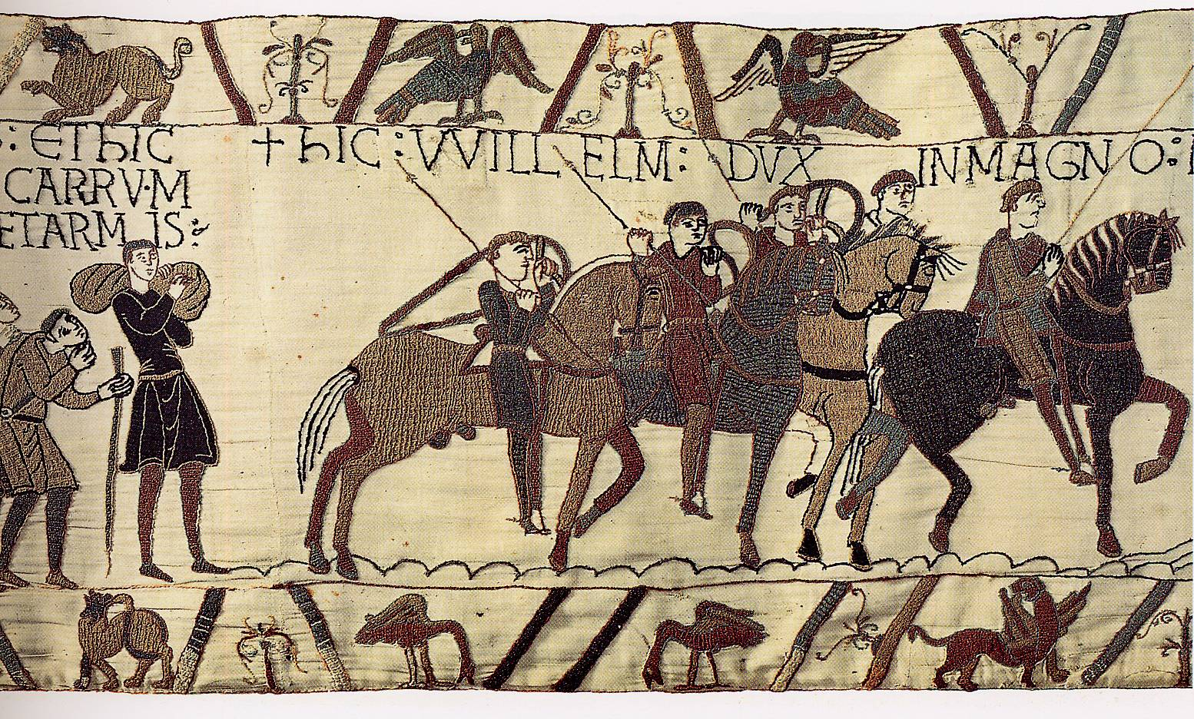
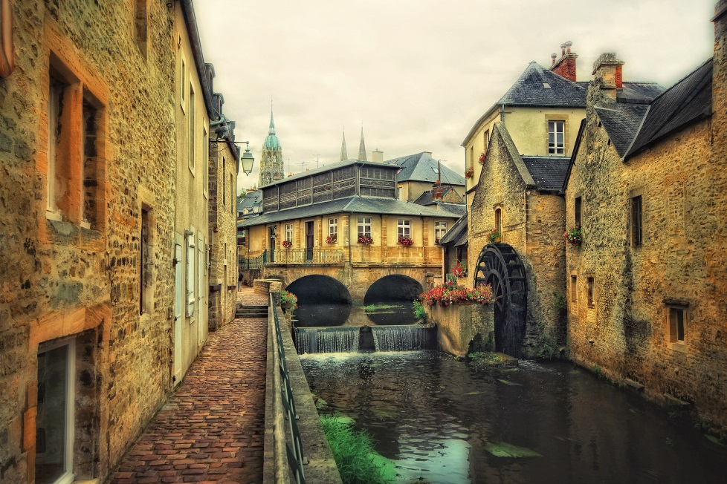
Bayeux Tapestry
1070-1080 wool on linen
The Bayeux tapestry was probably made in southern England (presumable by an English designer and needlewomen). It is the first known work by women artists and is credited to Queen Matilda, the wife of William the conqueror, and the women of her court.
Bishop Odo, the half brother of William the conqueror, commissioned it for his cathedral in Bayeux, France.

Slide 35
History of Norman Conquest 1066, William

Slide 36
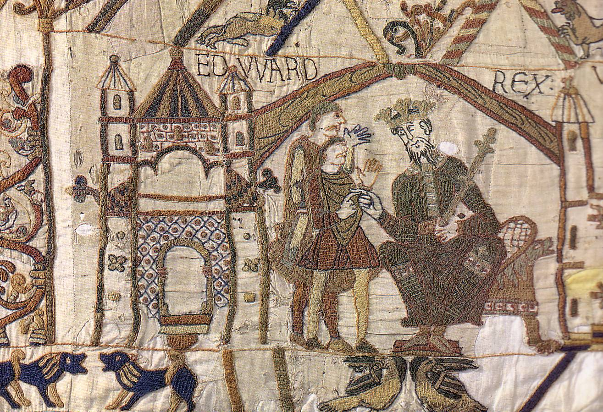
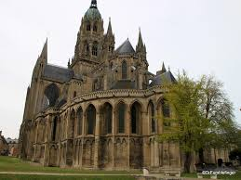
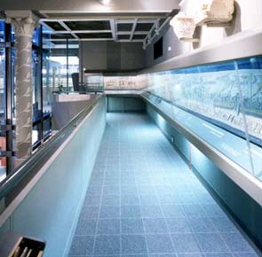
Edward the Confessor
It was embroidered in sections, which were joined together to be viewed when hung clockwise around the nave of the cathedral. For many years it was kept in the treasury of the church, and brought out only on feast day. Today it is in a specially designed room near the cathedral where it can be seen in its full glory.

Slide 37
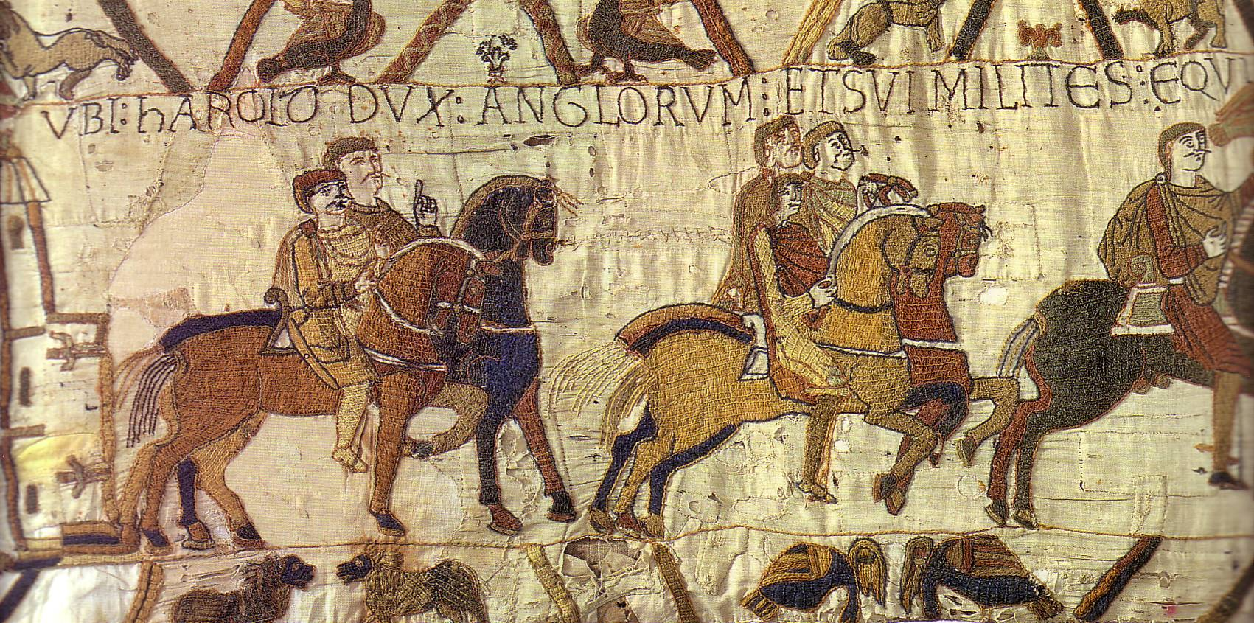
Text: Where Harold [Anglo-Saxon], Duke of the English, and his soldiers ride to Bosham
The tapestry is 230 feet long by 20 inches high and tells its story in a series of vignettes (scenes). It is not truly a tapestry (which is woven, but is linen, embroidered in wool, using only two types of stitches. The rich detail, soft colors (, and imaginative use of space has made it a world renowned treasure. It is reminiscent of many illuminated manuscripts, with a border richly embellished with real and imaginary animals. The interlaced branches of trees, the shorthand use of symbols for water or land and the beautiful horsed warriors and boats all contribute to its beauty.

Slide 38

Ecclesia: The Church

Slide 39

Text: Here Harold sailed the sea, and, with the wind full in his sails, he came to the land of Count Guy

Slide 40


Slide 41

Text: Here Guy Captures Harold

Slide 42

Text: And he took him to Beaurain and held him there

Slide 43

Text: Where Harold and Guy converse

Slide 44

Text: Where Duke William’s messengers came to Guy. Turold

Slide 45

Narrative switches so that it is read right to left
Text: William’s messengers

Slide 46

Text: Here the messengers came to Duke William
(The castle-like structure may stand for Rouen)

Slide 47

Text: Here Guy brought Harold to William, Duke of the Normans

Slide 48


Slide 49

Text: Here Duke William comes to his palace with Harold

Slide 50

Text: Where a Cleric and AElfyva

Slide 51

Text: Here William gave arms to Harold

Slide 52

Text: Here William came to Bayeux, where Harold swore a sacred oath to Duke William

Slide 53

Text: Here Duke Harold returned to English soil and came to King Edward

Slide 54


Slide 55

Edward the Confessor

Slide 56

Text: Here King Edward, in his bed, addresses his faithful followers; and here he has died.

Slide 57

Text: Here they gave Harold the King’s crown

Slide 58

Text: These men wonder at the star.

Slide 59

Text: Here Duke William ordered ships to be built

Slide 60

Text: Here King Harold was slain, and the English fled.

Slide 61
William the Conqueror/ King Harold of England

Slide 62

embroidery using eight different colored wool threads

Slide 63
Gothic and Romanesque
Architecture

Slide 64

Architecture
The middle ages covered a prolonged time period that saw an evolution of architecture form the early Roman basilica with its flat wooden ceiling, through the Romanesque and Gothic churches. Many churches took centuries to build, so that there rarely was one totally unified style within a single church.
The two spires on Chartres Cathedral, for example were built centuries apart, yet the differences in style do not detract from the whole.

Slide 65


Medieval Architecture
Romanesque and Gothic

Slide 66

Romanesque

Slide 67

Romanesque
First universal style in European Architecture since Imperial Rome.
Starts between 6th and 10th centuries and ends in the 12th century.

Slide 68

Romanesque
Characteristics:
  Thick Walls
  Symmetry
  Large Towers
  Round Arches
  Semicircular Protrusions
  Groin Vaults

Slide 69


Groin Vaults

Slide 70
Gothic

Slide 71

Gothic Style
Flourished from 12th century - 16th century
Originated by the French
Much more complex
  Less symmetry
  Higher structures
  Bigger windows
  Higher Spires
Notes:
Forget the association of the word "Gothic" to dark, haunted houses, Wuthering Heights, or ghostly pale people wearing black nail polish and ripped fishnets. The original Gothic style was actually developed to bring sunshine into people's lives, and especially into their churches. To get past the accrued definitions of the centuries, it's best to go back to the very start of the word Gothic, and to the style that bears the name.
The Goths were a so-called barbaric tribe who held power in various regions of Europe, between the collapse of the Roman Empire and the establishment of the Holy Roman Empire (so, from roughly the fifth to the eighth century). They were not renowned for great achievements in architecture. As with many art historical terms, “Gothic” came to be applied to a certain architectural style after the fact.
The style represented giant steps away from the previous, relatively basic building systems that had prevailed. The Gothic grew out of the Romanesque architectural style, when both prosperity and peace allowed for several centuries of cultural development and great building schemes. From roughly 1000 to 1400, several significant cathedrals and churches were built, particularly in Britain and France, offering architects and masons a chance to work out ever more complex problems and daring designs.
The most fundamental element of the Gothic style of architecture is the pointed arch, which was likely borrowed from Islamic architecture that would have been seen in Spain at this time. The pointed arch relieved some of the thrust, and therefore, the stress on other structural elements. It then became possible to reduce the size of the columns or piers that supported the arch.
So, rather than having massive, drum-like columns as in the Romanesque churches, the new columns could be more slender. This slimness was repeated in the upper levels of the nave, so that the gallery and clerestory would not seem to overpower the lower arcade. In fact, the column basically continued all the way to the roof, and became part of the vault.
In the vault, the pointed arch could be seen in three dimensions where the ribbed vaulting met in the center of the ceiling of each bay. This ribbed vaulting is another distinguishing feature of Gothic architecture. However, it should be noted that prototypes for the pointed arches and ribbed vaulting were seen first in late-Romanesque buildings.
The new understanding of architecture and design led to more fantastic examples of vaulting and ornamentation, and the Early Gothic or Lancet style (from the twelfth and thirteenth centuries) developed into the Decorated or Rayonnant Gothic (roughly fourteenth century). The ornate stonework that held the windows–called tracery–became more florid, and other stonework even more exuberant.
The ribbed vaulting became more complicated and was crossed with lierne ribs into complex webs, or the addition of cross ribs, called tierceron. As the decoration developed further, the Perpendicular or International Gothic took over (fifteenth century). Fan vaulting decorated half-conoid shapes extending from the tops of the columnar ribs.
The slender columns and lighter systems of thrust allowed for larger windows and more light. The windows, tracery, carvings, and ribs make up a dizzying display of decoration that one encounters in a Gothic church. In late Gothic buildings, almost every surface is decorated. Although such a building as a whole is ordered and coherent, the profusion of shapes and patterns can make a sense of order difficult to discern at first glance.
After the great flowering of Gothic style, tastes again shifted back to the neat, straight lines and rational geometry of the Classical era. It was in the Renaissance that the name Gothic came to be applied to this medieval style that seemed vulgar to Renaissance sensibilities. It is still the term we use today, though hopefully without the implied insult, which negates the amazing leaps of imagination and engineering that were required to build such edifices.

Slide 72



Characteristics
High Pointed Vaults
Multiple Smaller Towers
Flying Butrusses
Pointed Arches
Notice the skeleton-like structure

Slide 73


Slide 74

High Walls Full of Windows Allows Light to Enter the Interior

Slide 75


Flying Buttresses
Allowed builders to make higher, thinner walls while maintaining support.

Slide 76


Chartres Cathedral
Chartres, France
Notice the lack of symmetry, architectural detail
Dominates the skyline
  Cathedrals served as the center of the community
Notes:
Chartres Cathedral, also called Notre-Dame d’Chartres or the Cathedral of Notre-Dame, Gothic cathedral located in the town of Chartres, northwestern France. Generally ranked as one of the three chief examples of Gothic French architecture (along with Amiens Cathedral and Reims Cathedral), it is noted not only for its architectural innovations but also for its numerous sculptures and its much-celebrated stained glass. The cathedral’s association with the Virgin Mary (the supposed veil of the Virgin is kept in the cathedral treasury) made it the destination of pilgrims in the Middle Ages.
The oldest parts of the cathedral are its crypt and the west portal, or Royal Portal, which are remnants of a Romanesque church that was mostly destroyed by fire in 1194. The present cathedral was constructed on the foundations of the earlier church and consecrated in 1260. It is built of limestone and stands some 112 feet (34 metres) high and is 427 feet (130 metres) long. In many ways, the cathedral’s design resembles those of its contemporaries, especially Laon Cathedral, but it displays innovations with its tall arcades, unusually narrow triforium, and huge clerestory—the massive weight of which required using flying buttresses in an unprecedented manner.
The cathedral contains an immense amount of sculpture, particularly figure sculpture, ranging from large column statues to miniatures. As the purpose of the sculptures was to preach and instruct, they mainly depict scenes and figures from the Old and New Testaments.
Chartres Cathedral contains 176 stained-glass windows, the feature for which it may be best known. Like the sculpture, the stained glass was intended to be educational. The five windows of the choir hemicycle (a semicircular arrangement) relate in various ways to the Virgin Mary. The rose window in the north transept portrays figures from the Old Testament. The south transept, which is representative of the New Testament, has a rose window depicting the Apocalypse.
Several alterations have been made to the cathedral. The northwest tower’s distinctive spire, for example, was added in the early 1500s. Chartres emerged with relatively little damage from the political and religious upheavals of the 16th century and sustained less damage than most cathedrals during the French Revolution (1787–99). After a fire damaged the roof in 1836, a series of restorations were carried out during the 19th century. In 1979 Chartres Cathedral was designated a UNESCO World Heritage site. During the late 20th century preservation efforts concentrated on protecting the cathedral’s stained glass from air pollution damage.

Slide 77

Chartres Cathedral
1140-1220

Slide 78
Chartres Cathedral 1260 AD
Legend has that it is built on a Druid worship site
Held the supposed veil of the virgin Mary.
Roman temple site
Romanesque church (burnt down in 1194)
Rebuilt and added onto in the Gothic style
176 Stained glass windows
112 feet tall
Gothic style used Geometry because God used geometry creating the universe.

Slide 79


Slide 80


Notre Dame Cathedral – 1345 C.E. Paris, France
Construction lasts from 1163 – 1345 C.E.
The Symbol of Paris long before the Eiffel Tower
High point of Gothic Architecture
Notes:
One of the most notable monuments in Paris (and in all of Europe for that matter) is the Notre Dame Cathedral. This Catholic treasure is over 800 years old. It is located on a small island called the Ile de la Cite in the middle of river Seine. The building of the cathedral was completed over the course of 200 years; it was started in 1163 during the reign of King Louis VII and was completed in 1345.
As is the case with most notable historical monuments, The Notre dame Cathedral Paris has its own share of both the glorious and the tragic historical moments that will forever remain indelible in the mind of people everywhere. Among them is the crowning of Henry VI of England right inside the cathedral in 1431. The Cathedral was at one time in a stage of total disrepair and close to the point of being demolished, but was later saved by Napoleon who himself was crowned Emperor in 1804 inside the Cathedral.
After restoring the Cathedral back to its formal beauty and in the midst of World War II, it was rumoured that the German soldiers might destroy the newly installed stained glass. It was therefore removed and only reinstalled again after the war had ended. The steps were taken because of only one particular archeological glass window called the Rose window which is supposed to be the biggest glass window in the world produced in the 13th century.
Discussing the history of the Notre Dame Cathedral Paris would not be complete without discussing the most famous story of the peasant girl, Joan of Arc, who is well documented in the history books of France. She was very brave and claimed that she had visions from God. This poor girl had spiritual and character richness even though she had no material goods. Through her visions and courage, she helped France in the battles against the English troops. While using the wise military tactics of Joan of Arc, the well known heroine, France won many fights against England. She also was a great supporter of the monarchy; she is indirectly the reason why Charles VII was crowned. However, Joan of Arc was captured by the Burundians’, accused of heresy and tragically, she was burned at the stake. But this was not the end of the brave girl. On the 7 July 1456, Joan of Arc was declared innocent and a martyr. In 1909 she was beatified in the famous Notre Dame cathedral in Paris by Pope Pius X.
Notre Dame Cathedral which can also be called “our lady” is still in use today by the Roman Catholic Church for Sunday mass and it is the seat of the Archbishop of Paris. A notable and distinct historical artefact which is very
popular today is the famous bell that has been redesigned to ring automatically. Any visitor to the bell tower should be prepared to climb the 140 steps staircase, if desirous of seeing the historical bell or have a glimpse of the city of Paris.
Also inside the Notre Dame Cathedral, among so many historical artefacts, is the notable 17th century organ with all of its parts still functional. There are also drawings, plans and engravings which showed the old and hidden mysteries of several of the church developments and how the city of Paris came into being.

Slide 81

Notre Dame
http://www.youtube.com/watch?v=O61ng_QqC4I
Notes:
One of the most notable monuments in Paris (and in all of Europe for that matter) is the Notre Dame Cathedral. This Catholic treasure is over 800 years old. It is located on a small island called the Ile de la Cite in the middle of river Seine. The building of the cathedral was completed over the course of 200 years; it was started in 1163 during the reign of King Louis VII and was completed in 1345.
As is the case with most notable historical monuments, The Notre dame Cathedral Paris has its own share of both the glorious and the tragic historical moments that will forever remain indelible in the mind of people everywhere. Among them is the crowning of Henry VI of England right inside the cathedral in 1431. The Cathedral was at one time in a stage of total disrepair and close to the point of being demolished, but was later saved by Napoleon who himself was crowned Emperor in 1804 inside the Cathedral.
After restoring the Cathedral back to its formal beauty and in the midst of World War II, it was rumoured that the German soldiers might destroy the newly installed stained glass. It was therefore removed and only reinstalled again after the war had ended. The steps were taken because of only one particular archeological glass window called the Rose window which is supposed to be the biggest glass window in the world produced in the 13th century.
Discussing the history of the Notre Dame Cathedral Paris would not be complete without discussing the most famous story of the peasant girl, Joan of Arc, who is well documented in the history books of France. She was very brave and claimed that she had visions from God. This poor girl had spiritual and character richness even though she had no material goods. Through her visions and courage, she helped France in the battles against the English troops. While using the wise military tactics of Joan of Arc, the well known heroine, France won many fights against England. She also was a great supporter of the monarchy; she is indirectly the reason why Charles VII was crowned. However, Joan of Arc was captured by the Burundians’, accused of heresy and tragically, she was burned at the stake. But this was not the end of the brave girl. On the 7 July 1456, Joan of Arc was declared innocent and a martyr. In 1909 she was beatified in the famous Notre Dame cathedral in Paris by Pope Pius X.
Notre Dame Cathedral which can also be called “our lady” is still in use today by the Roman Catholic Church for Sunday mass and it is the seat of the Archbishop of Paris. A notable and distinct historical artefact which is very
popular today is the famous bell that has been redesigned to ring automatically. Any visitor to the bell tower should be prepared to climb the 140 steps staircase, if desirous of seeing the historical bell or have a glimpse of the city of Paris.
Also inside the Notre Dame Cathedral, among so many historical artefacts, is the notable 17th century organ with all of its parts still functional. There are also drawings, plans and engravings which showed the old and hidden mysteries of several of the church developments and how the city of Paris came into being.

Slide 82
Notre Dame
Notre Dame du Paris-Our lady of Paris (referring to the Virgin Mary)
2 bell towers and one big one weighing 13 tons
Took 180 years to complete
Rose window is the largest ever built in the 13th century
Main gate tells story of the last judgment.
In front there is point zero marking that marks the center of Paris
Gallery of Kings was destroyed during French Revolution.

Slide 83


Slide 84

Laon Cathedral
Gothic Architecture 12/13th century
Site was started in 800
Notes:
Laon Cathedral (Cathédrale Notre-Dame de Laon) is one of the most important examples of the Gothic architecture of the 12th and 13th centuries, earlier than the cathedrals of Sens and Notre Dame of Paris and ranking with them in importance. It is located in Laon, Picardy, France, and is the seat of the Bishop of Laon. It has been listed among the Monuments Historiques since 1840.
Contents
[hide]
1 Previous cathedrals on the site
2 History
3 References
4 External links
Previous cathedrals on the site[edit]
The current cathedral is built on the site of an earlier edifice commenced under the episcopacy of Gerfrid (774 - 800). That Carolingian cathedral was consecrated on 6 September 800 in the presence of the emperor himself.
The Carolingian building was replaced under Bishop Élinand (1052–1095).^{[1]} The present new building was inaugurated with the second coronation of the future King Philip I. This cathedral was torched during the Easter Insurrection on 25 April 1112. During the revolt Laon's unpopular Bishop Waldric (in French Gaudry) was killed, despite taking the precaution of hiding in a barrel in the cellar of the episcopal palace. The cathedral was not destroyed, however, and after a repair programme lasting two years it was rededicated in 1114 under Bishop Barthélemy de Jur.
History[edit]
The present Laon Cathedral dates from the 12th and early 13th centuries, an early example of the Gothic style that originated in Northern France. The former cathedral was burned out and damaged during the communal insurrection in 1112, then occasioned by the revocation of the commune's charter. The present reconstruction began with a choir in about 1160 and was finished as far as the east side of the transept by 1174. In a second campaign, which started about 1180, the nave was built, and completed after 1205. Then the choir was replaced by the greatly lengthened present choir in 1215.
The building is cruciform, and the choir terminates in a straight wall instead of in an apse. Of the seven planned towers flanking the façades, only five are complete to the height of the base of the spires, two at the west front, with life-size figures of oxen beneath the arcades of their upper portion, two more, one at each end of the transept, and a square central crossing tower that forms a lantern illuminating the crossing.
Nave in four tiers, with clerestories,triforium and tribune under sexpartite vaulting
The west front, then with three porches, the centre one surmounted by a fine rose window of 1210, ranks next to that of Notre Dame de Paris in the purity of its Gothic style. Because of the use of white stone in the interior, however, the luminosity is remarkably greater than at Notre-Dame. The cathedral has stained glass of the 13th century and a chancel screen of the 18th century. Although the cathedral suffered some damage during the French Revolution and the Franco-Prussian War of 1870, it escaped both World Wars unharmed.
The famous medieval artist Villard de Honnecourt made detailed drawings of one of the towers of Laon, ca. 1230.
Composer Pierre Dumage was organist of the cathedral in 1710–19.

Slide 85

Chantilly, France
Notes:
In 1386 it was bought by Pierre d’Orgemont, Chancelier de France, who built a new castle that was completed in1394 on the site. In 1484 Chantilly passed to the Montmorency family.
In 1524 remodelling of d’Orgemont’s castle in a French Renaissance style was begun by Anne, Duc de Montmorency and Constable of France under Francis I, Henry II and Charles IX. Work was interrupted by the capture of the Constable at the Battle of Pavia in 1525, but was resumed after his release.
Between 1528 and 1531 Pierre Chambiges completed the reconstruction of the north and west wings and construction of the Galerie des Cerfs which formed one end of a walled garden.
The name derived from the many life-like stags’ heads that adorned it: they were carved in wood with real antlers and all bore on their necks the arms of Montmorency and the families with which they were allied.
In May 1538 a contract was made with Jean Chocquet, a master mason of Senlis, to construct the great terrace between the château and the park. This was an important step towards regularizing an otherwise irregular design.
A new, smaller castle, the Petit Château, was built in 1560 in proto-Baroque style on its own island in the moat but connected to the main château by a bridge.
Although there is no record of the architect, it was probably designed by Jean Bullant, who was in the service of Montmorency between 1550 and 1567 and had worked on his châteaux at Ecouen and Fère-en-Tardenois. Chantilly housed the Constable’s art collection, which included Michelangelo’s two white marble Captives (currently at Paris, Louvre), made for the tomb of Pope Julius II in S Pietro Vincoli, Rome, and many notable antiquities.
On his death at the Battle of Saint-Denis in 1567, Anne de Montmorency was succeeded by his son Henri (1534–1614), who completed his father’s work at Château de Chantilly between 1600 and 1614.
As the centrepiece of the great east terrace Henri erected a statue of his father (destroyed during the French Revolution, but replaced by a bronze equestrian version later).
His son Henri II de Montmorency built a house in the park, the Maison de Sylvie, named after his wife. Chantilly then passed to Louis II, Prince de Condé (1621–1686), the son of Henry II, Prince de Condé, and nephew of Henri II de Montmorency.
Louis, known as the Grand Condé, was a commander of Louis XIV’s armies and retired to the château in 1675 where he devoted much energy to the improvement of the park and garden.
Louis’s son commissioned Jules Hardouin Mansart to rework the façades of the château. Louis-Henri (1692–1740) commissioned the monumental Louis XV-style stables which were built between 1721 and 1735 to the designs of Jean Aubert, and the small Château d’Enghien east of the great terrace.
During the Revolution the château was confiscated, used as a prison and the main building subsequently razed to ground-floor level, while the park was sold off in lots.
The Petit Château and other buildings survived these depredations. On his return from exile in 1814, Prince Louis-Joseph (1736–1818) occupied these and bought back some of the land.
The present château (1875–1882), designed by Honoré Daumet for Henri-Eugène-Philippe-Louis, Duc d’Aumale, was built in French Renaissance Revival style on the foundations of the building largely destroyed in the Revolution, actually the surviving substructure of Pierre d’Orgemont’s 14th-century castle.
The Duc d’Aumale died in 1897, leaving Chantilly and his collection of more than 3000 manuscripts, almost 4000 drawings and 700 paintings to the French nation. The château now houses the Musée Condé and displays important French and Italian Old Master paintings.
The estate's connection with the Montmorency family began in 1484. The first mansion (no longer in existence, now replaced by the Grand Château) was built in 1528–1531 for the Constable Anne de Montmorency by Pierre Chambiges. The Petit Château was also built for him, around 1560, probably by Jean Bullant. In 1632, after the death of Henri II, it passed to the Grand Condé who inherited it through his mother, Charlotte Marguerite de Montmorency.
Several interesting pieces of history are associated with the château during the 17th century. Molière's play, Les Précieuses ridicules, received its first performance here in 1659. Madame de Sévignérelates in her memoirs that when Louis XIV visited in 1671, François Vatel, the maître d'hôtel to the Grand Condé, committed suicide when he feared the fish would be served late.
The original mansion was destroyed in the French Revolution. It was repaired in a modest way by the last Condé, but the entire property was confiscated from the Orléans family between the years 1853 and 1872, during which interval it was owned by Coutts, an English bank. Chantilly was entirely rebuilt in 1875–1881 by Henri d'Orléans, duc d'Aumale (1822–1897) to the designs of Honore Daumet. The new château met with mixed reviews. Boni de Castellane summed up one line of thought: "What is today styled a marvel is one of the saddest specimens of the architecture of our era — one enters at the second floor and descends to the salons". In the end, the Duc d'Aumale bequeathed the property to the Institut de France upon his death in 1897.
Musée Condé[edit]
The art gallery of Chantilly is one of the largest in France
The library
The chapel of the Hearts of the Princes of Condé
The château's art gallery, the Musée Condé, houses one of the finest collections of paintings in France (after the Louvre), with special strength in French paintings and book illuminations of the 15th and 16th centuries.
Works in the art gallery (many of them are in the Tribune Room) include Sassetta's Mystic Marriage of St. Francis, Botticelli's Autumn, Piero di Cosimo's Portrait of Simonetta Vespucci, Raphael'sThree Graces and Madonna of Loreto, Guercino's Pietà, Pierre Mignard's Portrait of Molière as well as four of Antoine Watteau's paintings and Jean-Baptiste-Camille Corot's Le concert champêtre. Other paintings in the collection include works by Fra Angelico, Filippino Lippi, Hans Memling, 260 paintings and drawings by François and Jean Clouet, Veronese, Barocci, Annibale Carracci, Domenichino,Salvator Rosa, Nicolas Poussin, Philippe de Champaigne, Van Dyck, Guido Reni, Jean-Baptiste Greuze, Joshua Reynolds, Eugène Delacroix, Ingres, Géricault.
The library of the Petit Château contains over 1500 manuscripts and 17,500 printed volumes, that is part of the collection of over 700 incunabula, and some 300 medieval manuscripts, including one page of the Registrum Gregorii (c. 983), the Les très riches heures du Duc de Berry, the Ingeborg Psalter and 40 miniatures from Jean Fouquet's Book of Hours of Etienne Chevalier.
Park and Chantilly racecourse[edit]
The main French formal garden, featuring extensive parterres and water features, was laid out principally by André Le Nôtre for the Grand Condé. The park also contains a French landscape garden with a cascade, pavilions, and a rustic ersatz village, the Hameau de Chantilly, which inspired the Hameau de la reine of Marie Antoinette in the Gardens of Versailles.
The estate overlooks the Chantilly Racecourse and the Grandes Écuries (Great Stables) which contains the Living Museum of the Horse. According to legend, Louis Henri, Duc de Bourbon, Prince of Condé believed that he would be reincarnated as a horse after his death. In 1719, he asked the architect, Jean Aubert to build stables suitable to his rank.
Restoration[edit]
The World Monuments Fund included the site in the 1998 World Monuments Watch to call attention to water infiltration and high humidity in the Galerie des Actions de Monsieur le Prince, and again in the 2002 World Monuments Watch due to the precarious condition of the entire estate.^{[1]} Funding for restoration work was provided from various sources, including American Express and the Generali Group.^{[2]} Subsequently, in response to an appeal for the restoration of the château, The Aga Khan donated €40m, accounting for more than half of a €70m needed by the Institut de France to complete the project.^{[3]} In 2008 the World Monuments Fund completed the restoration of the Grande Singerie, a salon with paintings on the walls of monkeys engaged in human activities, once a fashionable salon motif, but with few examples surviving today.^{[4]}
Modern uses[edit]
The château and the Great Stables were featured in the 1985 James Bond movie A View to a Kill, as the home of villainous Max Zorin (played by Christopher Walken) which was being infiltrated by Bond (played for the last time by Roger Moore) in his quest to find out more about Zorin, who had already aroused suspicions of MI6 with various business activities, and ultimately eliminate him.^{[5]}
Pink Floyd performed, on two consecutive nights, at the château during The Division Bell Tour on July 30–31, 1994.
Every two years, in June, the "Nuits de Feu" international fireworks competition is held in the château's garden.
Ronaldo married model and MTV VJ Daniela Cicarelli in the château in 2005. The ceremony reportedly cost €700,000.
Every May, a rowing regatta, the Trophee des Rois, is held in the grounds. French university crews compete in the 750m race for a trophy.

Slide 86
Chantilly
1394
Museum
Royalty
Chateau (Castle)
Elements of Gothic Architecture
Notes:
In 1386 it was bought by Pierre d’Orgemont, Chancelier de France, who built a new castle that was completed in1394 on the site. In 1484 Chantilly passed to the Montmorency family.
In 1524 remodelling of d’Orgemont’s castle in a French Renaissance style was begun by Anne, Duc de Montmorency and Constable of France under Francis I, Henry II and Charles IX. Work was interrupted by the capture of the Constable at the Battle of Pavia in 1525, but was resumed after his release.
Between 1528 and 1531 Pierre Chambiges completed the reconstruction of the north and west wings and construction of the Galerie des Cerfs which formed one end of a walled garden.
The name derived from the many life-like stags’ heads that adorned it: they were carved in wood with real antlers and all bore on their necks the arms of Montmorency and the families with which they were allied.
In May 1538 a contract was made with Jean Chocquet, a master mason of Senlis, to construct the great terrace between the château and the park. This was an important step towards regularizing an otherwise irregular design.
A new, smaller castle, the Petit Château, was built in 1560 in proto-Baroque style on its own island in the moat but connected to the main château by a bridge.
Although there is no record of the architect, it was probably designed by Jean Bullant, who was in the service of Montmorency between 1550 and 1567 and had worked on his châteaux at Ecouen and Fère-en-Tardenois. Chantilly housed the Constable’s art collection, which included Michelangelo’s two white marble Captives (currently at Paris, Louvre), made for the tomb of Pope Julius II in S Pietro Vincoli, Rome, and many notable antiquities.
On his death at the Battle of Saint-Denis in 1567, Anne de Montmorency was succeeded by his son Henri (1534–1614), who completed his father’s work at Château de Chantilly between 1600 and 1614.
As the centrepiece of the great east terrace Henri erected a statue of his father (destroyed during the French Revolution, but replaced by a bronze equestrian version later).
His son Henri II de Montmorency built a house in the park, the Maison de Sylvie, named after his wife. Chantilly then passed to Louis II, Prince de Condé (1621–1686), the son of Henry II, Prince de Condé, and nephew of Henri II de Montmorency.
Louis, known as the Grand Condé, was a commander of Louis XIV’s armies and retired to the château in 1675 where he devoted much energy to the improvement of the park and garden.
Louis’s son commissioned Jules Hardouin Mansart to rework the façades of the château. Louis-Henri (1692–1740) commissioned the monumental Louis XV-style stables which were built between 1721 and 1735 to the designs of Jean Aubert, and the small Château d’Enghien east of the great terrace.
During the Revolution the château was confiscated, used as a prison and the main building subsequently razed to ground-floor level, while the park was sold off in lots.
The Petit Château and other buildings survived these depredations. On his return from exile in 1814, Prince Louis-Joseph (1736–1818) occupied these and bought back some of the land.
The present château (1875–1882), designed by Honoré Daumet for Henri-Eugène-Philippe-Louis, Duc d’Aumale, was built in French Renaissance Revival style on the foundations of the building largely destroyed in the Revolution, actually the surviving substructure of Pierre d’Orgemont’s 14th-century castle.
The Duc d’Aumale died in 1897, leaving Chantilly and his collection of more than 3000 manuscripts, almost 4000 drawings and 700 paintings to the French nation. The château now houses the Musée Condé and displays important French and Italian Old Master paintings.
The estate's connection with the Montmorency family began in 1484. The first mansion (no longer in existence, now replaced by the Grand Château) was built in 1528–1531 for the Constable Anne de Montmorency by Pierre Chambiges. The Petit Château was also built for him, around 1560, probably by Jean Bullant. In 1632, after the death of Henri II, it passed to the Grand Condé who inherited it through his mother, Charlotte Marguerite de Montmorency.
Several interesting pieces of history are associated with the château during the 17th century. Molière's play, Les Précieuses ridicules, received its first performance here in 1659. Madame de Sévignérelates in her memoirs that when Louis XIV visited in 1671, François Vatel, the maître d'hôtel to the Grand Condé, committed suicide when he feared the fish would be served late.
The original mansion was destroyed in the French Revolution. It was repaired in a modest way by the last Condé, but the entire property was confiscated from the Orléans family between the years 1853 and 1872, during which interval it was owned by Coutts, an English bank. Chantilly was entirely rebuilt in 1875–1881 by Henri d'Orléans, duc d'Aumale (1822–1897) to the designs of Honore Daumet. The new château met with mixed reviews. Boni de Castellane summed up one line of thought: "What is today styled a marvel is one of the saddest specimens of the architecture of our era — one enters at the second floor and descends to the salons". In the end, the Duc d'Aumale bequeathed the property to the Institut de France upon his death in 1897.
Musée Condé[edit]
The art gallery of Chantilly is one of the largest in France
The library
The chapel of the Hearts of the Princes of Condé
The château's art gallery, the Musée Condé, houses one of the finest collections of paintings in France (after the Louvre), with special strength in French paintings and book illuminations of the 15th and 16th centuries.
Works in the art gallery (many of them are in the Tribune Room) include Sassetta's Mystic Marriage of St. Francis, Botticelli's Autumn, Piero di Cosimo's Portrait of Simonetta Vespucci, Raphael'sThree Graces and Madonna of Loreto, Guercino's Pietà, Pierre Mignard's Portrait of Molière as well as four of Antoine Watteau's paintings and Jean-Baptiste-Camille Corot's Le concert champêtre. Other paintings in the collection include works by Fra Angelico, Filippino Lippi, Hans Memling, 260 paintings and drawings by François and Jean Clouet, Veronese, Barocci, Annibale Carracci, Domenichino,Salvator Rosa, Nicolas Poussin, Philippe de Champaigne, Van Dyck, Guido Reni, Jean-Baptiste Greuze, Joshua Reynolds, Eugène Delacroix, Ingres, Géricault.
The library of the Petit Château contains over 1500 manuscripts and 17,500 printed volumes, that is part of the collection of over 700 incunabula, and some 300 medieval manuscripts, including one page of the Registrum Gregorii (c. 983), the Les très riches heures du Duc de Berry, the Ingeborg Psalter and 40 miniatures from Jean Fouquet's Book of Hours of Etienne Chevalier.
Park and Chantilly racecourse[edit]
The main French formal garden, featuring extensive parterres and water features, was laid out principally by André Le Nôtre for the Grand Condé. The park also contains a French landscape garden with a cascade, pavilions, and a rustic ersatz village, the Hameau de Chantilly, which inspired the Hameau de la reine of Marie Antoinette in the Gardens of Versailles.
The estate overlooks the Chantilly Racecourse and the Grandes Écuries (Great Stables) which contains the Living Museum of the Horse. According to legend, Louis Henri, Duc de Bourbon, Prince of Condé believed that he would be reincarnated as a horse after his death. In 1719, he asked the architect, Jean Aubert to build stables suitable to his rank.
Restoration[edit]
The World Monuments Fund included the site in the 1998 World Monuments Watch to call attention to water infiltration and high humidity in the Galerie des Actions de Monsieur le Prince, and again in the 2002 World Monuments Watch due to the precarious condition of the entire estate.^{[1]} Funding for restoration work was provided from various sources, including American Express and the Generali Group.^{[2]} Subsequently, in response to an appeal for the restoration of the château, The Aga Khan donated €40m, accounting for more than half of a €70m needed by the Institut de France to complete the project.^{[3]} In 2008 the World Monuments Fund completed the restoration of the Grande Singerie, a salon with paintings on the walls of monkeys engaged in human activities, once a fashionable salon motif, but with few examples surviving today.^{[4]}
Modern uses[edit]
The château and the Great Stables were featured in the 1985 James Bond movie A View to a Kill, as the home of villainous Max Zorin (played by Christopher Walken) which was being infiltrated by Bond (played for the last time by Roger Moore) in his quest to find out more about Zorin, who had already aroused suspicions of MI6 with various business activities, and ultimately eliminate him.^{[5]}
Pink Floyd performed, on two consecutive nights, at the château during The Division Bell Tour on July 30–31, 1994.
Every two years, in June, the "Nuits de Feu" international fireworks competition is held in the château's garden.
Ronaldo married model and MTV VJ Daniela Cicarelli in the château in 2005. The ceremony reportedly cost €700,000.
Every May, a rowing regatta, the Trophee des Rois, is held in the grounds. French university crews compete in the 750m race for a trophy.
In 1386 it was bought by Pierre d’Orgemont, Chancelier de France, who built a new castle that was completed in1394 on the site. In 1484 Chantilly passed to the Montmorency family.
In 1524 remodelling of d’Orgemont’s castle in a French Renaissance style was begun by Anne, Duc de Montmorency and Constable of France under Francis I, Henry II and Charles IX. Work was interrupted by the capture of the Constable at the Battle of Pavia in 1525, but was resumed after his release.
Between 1528 and 1531 Pierre Chambiges completed the reconstruction of the north and west wings and construction of the Galerie des Cerfs which formed one end of a walled garden.
The name derived from the many life-like stags’ heads that adorned it: they were carved in wood with real antlers and all bore on their necks the arms of Montmorency and the families with which they were allied.
In May 1538 a contract was made with Jean Chocquet, a master mason of Senlis, to construct the great terrace between the château and the park. This was an important step towards regularizing an otherwise irregular design.
A new, smaller castle, the Petit Château, was built in 1560 in proto-Baroque style on its own island in the moat but connected to the main château by a bridge.
Although there is no record of the architect, it was probably designed by Jean Bullant, who was in the service of Montmorency between 1550 and 1567 and had worked on his châteaux at Ecouen and Fère-en-Tardenois. Chantilly housed the Constable’s art collection, which included Michelangelo’s two white marble Captives (currently at Paris, Louvre), made for the tomb of Pope Julius II in S Pietro Vincoli, Rome, and many notable antiquities.
On his death at the Battle of Saint-Denis in 1567, Anne de Montmorency was succeeded by his son Henri (1534–1614), who completed his father’s work at Château de Chantilly between 1600 and 1614.
As the centrepiece of the great east terrace Henri erected a statue of his father (destroyed during the French Revolution, but replaced by a bronze equestrian version later).
His son Henri II de Montmorency built a house in the park, the Maison de Sylvie, named after his wife. Chantilly then passed to Louis II, Prince de Condé (1621–1686), the son of Henry II, Prince de Condé, and nephew of Henri II de Montmorency.
Louis, known as the Grand Condé, was a commander of Louis XIV’s armies and retired to the château in 1675 where he devoted much energy to the improvement of the park and garden.
Louis’s son commissioned Jules Hardouin Mansart to rework the façades of the château. Louis-Henri (1692–1740) commissioned the monumental Louis XV-style stables which were built between 1721 and 1735 to the designs of Jean Aubert, and the small Château d’Enghien east of the great terrace.
During the Revolution the château was confiscated, used as a prison and the main building subsequently razed to ground-floor level, while the park was sold off in lots.
The Petit Château and other buildings survived these depredations. On his return from exile in 1814, Prince Louis-Joseph (1736–1818) occupied these and bought back some of the land.
The present château (1875–1882), designed by Honoré Daumet for Henri-Eugène-Philippe-Louis, Duc d’Aumale, was built in French Renaissance Revival style on the foundations of the building largely destroyed in the Revolution, actually the surviving substructure of Pierre d’Orgemont’s 14th-century castle.
The Duc d’Aumale died in 1897, leaving Chantilly and his collection of more than 3000 manuscripts, almost 4000 drawings and 700 paintings to the French nation. The château now houses the Musée Condé and displays important French and Italian Old Master paintings.
The estate's connection with the Montmorency family began in 1484. The first mansion (no longer in existence, now replaced by the Grand Château) was built in 1528–1531 for the Constable Anne de Montmorency by Pierre Chambiges. The Petit Château was also built for him, around 1560, probably by Jean Bullant. In 1632, after the death of Henri II, it passed to the Grand Condé who inherited it through his mother, Charlotte Marguerite de Montmorency.
Several interesting pieces of history are associated with the château during the 17th century. Molière's play, Les Précieuses ridicules, received its first performance here in 1659. Madame de Sévignérelates in her memoirs that when Louis XIV visited in 1671, François Vatel, the maître d'hôtel to the Grand Condé, committed suicide when he feared the fish would be served late.
The original mansion was destroyed in the French Revolution. It was repaired in a modest way by the last Condé, but the entire property was confiscated from the Orléans family between the years 1853 and 1872, during which interval it was owned by Coutts, an English bank. Chantilly was entirely rebuilt in 1875–1881 by Henri d'Orléans, duc d'Aumale (1822–1897) to the designs of Honore Daumet. The new château met with mixed reviews. Boni de Castellane summed up one line of thought: "What is today styled a marvel is one of the saddest specimens of the architecture of our era — one enters at the second floor and descends to the salons". In the end, the Duc d'Aumale bequeathed the property to the Institut de France upon his death in 1897.
Musée Condé[edit]
The art gallery of Chantilly is one of the largest in France
The library
The chapel of the Hearts of the Princes of Condé
The château's art gallery, the Musée Condé, houses one of the finest collections of paintings in France (after the Louvre), with special strength in French paintings and book illuminations of the 15th and 16th centuries.
Works in the art gallery (many of them are in the Tribune Room) include Sassetta's Mystic Marriage of St. Francis, Botticelli's Autumn, Piero di Cosimo's Portrait of Simonetta Vespucci, Raphael'sThree Graces and Madonna of Loreto, Guercino's Pietà, Pierre Mignard's Portrait of Molière as well as four of Antoine Watteau's paintings and Jean-Baptiste-Camille Corot's Le concert champêtre. Other paintings in the collection include works by Fra Angelico, Filippino Lippi, Hans Memling, 260 paintings and drawings by François and Jean Clouet, Veronese, Barocci, Annibale Carracci, Domenichino,Salvator Rosa, Nicolas Poussin, Philippe de Champaigne, Van Dyck, Guido Reni, Jean-Baptiste Greuze, Joshua Reynolds, Eugène Delacroix, Ingres, Géricault.
The library of the Petit Château contains over 1500 manuscripts and 17,500 printed volumes, that is part of the collection of over 700 incunabula, and some 300 medieval manuscripts, including one page of the Registrum Gregorii (c. 983), the Les très riches heures du Duc de Berry, the Ingeborg Psalter and 40 miniatures from Jean Fouquet's Book of Hours of Etienne Chevalier.
Park and Chantilly racecourse[edit]
The main French formal garden, featuring extensive parterres and water features, was laid out principally by André Le Nôtre for the Grand Condé. The park also contains a French landscape garden with a cascade, pavilions, and a rustic ersatz village, the Hameau de Chantilly, which inspired the Hameau de la reine of Marie Antoinette in the Gardens of Versailles.
The estate overlooks the Chantilly Racecourse and the Grandes Écuries (Great Stables) which contains the Living Museum of the Horse. According to legend, Louis Henri, Duc de Bourbon, Prince of Condé believed that he would be reincarnated as a horse after his death. In 1719, he asked the architect, Jean Aubert to build stables suitable to his rank.
Restoration[edit]
The World Monuments Fund included the site in the 1998 World Monuments Watch to call attention to water infiltration and high humidity in the Galerie des Actions de Monsieur le Prince, and again in the 2002 World Monuments Watch due to the precarious condition of the entire estate.^{[1]} Funding for restoration work was provided from various sources, including American Express and the Generali Group.^{[2]} Subsequently, in response to an appeal for the restoration of the château, The Aga Khan donated €40m, accounting for more than half of a €70m needed by the Institut de France to complete the project.^{[3]} In 2008 the World Monuments Fund completed the restoration of the Grande Singerie, a salon with paintings on the walls of monkeys engaged in human activities, once a fashionable salon motif, but with few examples surviving today.^{[4]}
Modern uses[edit]
The château and the Great Stables were featured in the 1985 James Bond movie A View to a Kill, as the home of villainous Max Zorin (played by Christopher Walken) which was being infiltrated by Bond (played for the last time by Roger Moore) in his quest to find out more about Zorin, who had already aroused suspicions of MI6 with various business activities, and ultimately eliminate him.^{[5]}
Pink Floyd performed, on two consecutive nights, at the château during The Division Bell Tour on July 30–31, 1994.
Every two years, in June, the "Nuits de Feu" international fireworks competition is held in the château's garden.
Ronaldo married model and MTV VJ Daniela Cicarelli in the château in 2005. The ceremony reportedly cost €700,000.
Every May, a rowing regatta, the Trophee des Rois, is held in the grounds. French university crews compete in the 750m race for a trophy.

Slide 87

Mont Ste. Michel, France
http://www.youtube.com/watch?v=3zq0axpbPns
http://www.airpano.ru/files/Mont-Saint-Michel-Abbay-France/2-2
Notes:
The island has held strategic fortifications since ancient times, and since the eighth century AD has been the seat of the monastery from which it draws its name. The structural composition of the town exemplifies the feudal society that constructed it. On top God, the abbey and monastery, below this the Great halls, then stores and housing, and at the bottom, outside the walls, fishermen and farmers' housing.
Its unique position of being an island only 600 metres from land made it readily accessible on low tide to the many pilgrims to its abbey Equally, this position made it readily defensible as an incoming tide stranded, or drowned, would be assailants. By capitalising on this natural defence, The Mont remained unconquered during the 100 years war with a small garrison successfully defending The Mont against a full attack by the English in 1433.^{[2]} The reverse benefits of its natural defence was not lost on Louis XI who turned The Mont into a state prison and thereafter the abbey started to be used more regularly as a jail during the Ancien Régime from the sixteenth century.

Slide 88
Monte Ste. Michel Notes
The island has held strategic fortifications since ancient times
The structural composition of the town exemplifies the feudal society that constructed it. On top God, the abbey and monastery, below this the Great halls, then stores and housing, and at the bottom, outside the walls, fishermen and farmers' housing.
Its unique position of being an island only 600 metres from land made it readily accessible on low tide to the many pilgrims to its abbey
Equally, this position made it readily defensible as an incoming tide stranded, or drowned, would be assailants. By capitalising on this natural defence, The Mont remained unconquered during the 100 years war with a small garrison successfully defending The Mont against a full attack by the English in 1433.^{[2]}
The reverse benefits of its natural defense was not lost on Louis XI who turned The Mont into a state prison and thereafter the abbey started to be used more regularly as a jail during the Ancien Régime from the sixteenth century.

Slide 89

Palazzo Pubblico, Sienna
1298-1348
Notes:
The outside of the structure is an example of Italian medieval architecture with Gothic influences. The lower story is stone; the upper crenelatted stories are made of brick. The facade of the palace is curved slightly inwards (concave) to reflect the outwards curve (convex) of the Piazza del Campo, Siena's central square of which the Palace is the focal point. The campanile or bell tower, Torre del Mangia, was built between 1325 and 1344 with its crown designed by the painter, Lippo Memmi. The tower was designed to be taller than the tower in neighboring rival Florence; at the time it was the tallest structure in Italy. It was fitted with a mechanical clock during the mid 14th century. Its design has been used as the basis for several other campaniles including the Dock Tower in Grimsby, England constructed in 1852 and the Joseph Chamberlain Memorial Clock Tower in the edgabston campus of the University of Birmingham (completed in 1908).
The Copenhagen City Hall and Odense City Hall (Denmark) were greatly inspired by Palazzo Pubblico.

Slide 90


Gargoyles and Grotesques

Slide 91


La Gargouille, , was a legendary dragon that lived in the River Seine, which in the 7th Century was ravaging the town and people of Rouen..

Slide 92


It was slain by St Romanus, the Archbishop of Rouen. After the dragon was slain its body was set ablaze, its body was consumed by fire but the head and neck survived and was mounted on a building.

Slide 93

Gargoyle shares a common root with the word "Gargle"; which comes from "gargouille", an French word for "Throat“
Technically an architect calls a waterspout on a building a gargoyle. If a stone carving does not carry water and has a face that resembles a creature, it is technically called a grotesque. The word “gargoyle” is also a derivative from the Latin word, “gurgulio”, which had a double meaning, “throat”, and the “gurgling” sound water makes as it passes through a gargoyle.

Slide 94


A strange beast which combines several different animals is called a chimera.

Slide 95

Chimeras are merely carvings of faces (usually grotesque) or mixes of different types of animal body parts to create a new creature. Some of the more notable chimeras are griffins, centaurs, harpies, and mermaids. Chimeras often served as a warning to people who underestimated the devil.

Slide 96

Notes:
During the 1200's when gargoyles first appeared in Europe, the Roman Catholic Church was actively converting people of other faiths to Christianity. Since most people were not literate, images were very important in communicating ideas and telling the stories of the faith. Many of the religious images that non-Christians were accustomed to were of pagan origin and were of animals or mixtures of animals and humans. Integrating familiar images on churches and cathedrals was thought to encourage the populace to accept the new religion and ease the transition from the old ways and old beliefs.

Slide 97

Notes:
The Gargoyles of Notre Dame:
What do you see when you look up to the top of the great cathedral of Notre Dame? You see monsters, half-man and half-beast. These demon looking creatures carved out of stone are called gargoyles. They are one of the many eerie stone figures that adorn the gutters of the Cathedral of Notre Dame in Paris. Gargoyle comes from a Latin word, meaning gullet or drain. That's what the strange looking creatures are, they're drainpipes. Each grotesque figure has a passageway inside that carries rainwater from the roof and out through the gargoyle's mouth. From the top of the cathedral's towers the gargoyles have a magnificent view of the city.
Gargoyles were used as a representation of evil. It is thought that they were used to scare people into coming to church, reminding them that the end of days is near. It is also thought that their presence assured congregants that evil is kept outside of the church’s walls.[9] However, some medieval clergy viewed gargoyles as a form of idolatry.

Slide 98


Gargoyles Notre Dame

Slide 99


Slide 100

Notes:
Gargoyles and grotesques have always given carvers and sculptors a chance to delight in their creativity and to explore the possibilities in the dance between stone and imagination. Gargoyles freed carvers from the limits imposed by other types of carving, and this was especially true in the Middle Ages. It is certain that stone carvers love creating these pieces, and viewers certainly love seeing them. This may be one of the more compelling reasons they exist.
France has over 100 cathedrals, most built in the middle ages, with Notre Dame being the most famous. In the Middle ages, the populace, for the most part, could not read and write. Churches used visual images to spread the scriptures and reinforce biblical stories. These included; paintings, frescos, stained glass, figures, sculpture and gargoyles. Some believe that gargoyles were inspired directly via a passage in the bible. Others believe that gargoyles and grotesques do not come from the bible, but were inspired by the skeletal remains of prehistoric beasts. Others will argue that they are the expression of man's subconscious fears or, that they may be vestiges of paganism from an age when god would be perceived in trees and river plains. The churches of Europe carried them further into time; maybe to remind the masses that "even if god is at hand, evil is never far away and to act as guardians of their church to keep the evil spirits at bay.

Slide 101

Grotesques
Notes:
The cathedral also served as a "sermon in stone" which could be "read" by an illiterate population. Some gargoyles clearly fill this instructional purpose by illustrating Bible stories such as Eve's reach for the apple and frightening images of eternal torment. Since gargoyles were on the outside of the cathedral and scenes of the Bible and statues of Jesus, Mary and the Saints where common inside the building, this represented God's power to protect the believers. They also represented the struggle between good and evil and symbolized how God was the only protection from evil in a fallen world.
Gargoyles stand guard, warding off unwanted spirits and other creatures and If they're hideous and frightening enough, it was thought they would be especially effective in scaring off all sorts of other threatening creatures. Perhaps it was even believed that some came alive at night protecting people when they were most vulnerable. Better still, the ones with wings could fly and protect the village as well as the church.
Gargoyles crafted during Medieval times became increasingly grotesque in design. Soon they were referred to as “chimeras” because of their representations of creatures that were not of this world - half man, and half bird or beast. These new incarnations were either depicted sitting on their haunches or poised to take flight. They also possessed over exaggerated muzzles or beaks and other odd appendages. They were positioned on a cornice molding so they projected forward and away from the building for a number of feet. In this way the gargoyle was able to spew water far from the building. "Although the demons and monsters so prevalent in cathedral sculpture may seem almost quaint to modern eyes, the men of the Middle Ages did not find them so. In a time when illiteracy was almost a universal condition and belief in a literal, waiting Inferno prevailed, the purpose of most cathedral sculpture was not decorative but instructional. It was intended, to scare its beholders, and there is every reason to believe it did a creditable job, presenting the horrors of torment in living color (of which only faint traces remain today)."

Slide 102



Slide 103


