Slide 1
Ulysses S. Grant
Researched By Jonathan

Slide 2
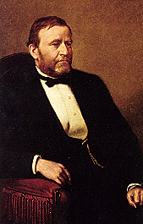
Basic Facts
18th President
Born April 27, 1822
Died July 23, 1885
Years in Office: 1869-1877

Slide 3
Important Information
He has his face on the 50 dollar bill.
He went in office for two terms.

Slide 4
Interesting Facts
He changed his name for Himran Ulysses Grant because he did not want his initials to be H.U.G.
He was a commander in the army.

Slide 5
Any questions or comments?
Thank you!

