Slide 1
Rutherford Birchard Hayes
Researched By Dylan

Slide 2
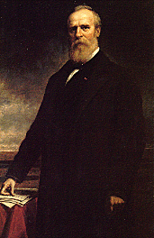
Basic Facts
19th President
Born November 19, 1831
Died September 19, 1881
Years in Office: 1887-1881

Slide 3
Important Information
He was a governor from Ohio.
He signed a bill that let woman lawyers go to the Supreme Court.

Slide 4
Interesting Facts
He was the first president to ever have “The Secret Service” protect him.

Slide 5
Any questions or comments?
Thank you!

