Slide 1
Thomas Jefferson
Researched By Mckenna

Slide 2
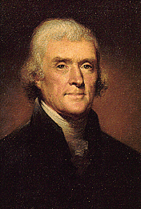
Basic Facts
3rd President
Born August 13, 1743
Died July 4, 1826
Years in Office 1801-1809

Slide 3
Important Information
He wrote most of the Declaration of Independence.
Thomas Jefferson started his own college, The University of Virginia.

Slide 4
Interesting Facts
He had a mocking bird and 2 bear cubs.
His face is on the 2 dollar bill, the nickel and a memorial.

Slide 5
Any questions or comments?
Thank you!

