Slide 1
Calvin Coolidge
Researched by Preston

Slide 2
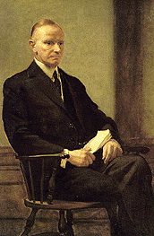
Basic Facts
30th President
Born July 4, 1872
Died January 5, 1933
Years in Office: 1923 -1929

Slide 3
Important Information
He became president when president Harding died.

Slide 4
Interesting Facts
He was born on the fourth of July.

Slide 5
Any questions or comments?
Thank you!

