Slide 1
Dwight D. Eisenhower
Researched By Arden

Slide 2
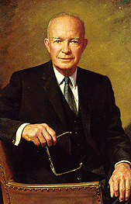
Basic Facts
He was the 34th president.
Born October 14,1890 in Denison, Texas
Died March 28,1960
Years in Office: 1953-1961

Slide 3
Important Information
He was the first president for all 50 states.

Slide 4
Interesting Facts
He was 5 star general.
He played bridge, fishing, golf and painting.
His favorite foods were vegetable soup and steak.

Slide 5
Any questions or comments?
Thank you!

