Slide 1
John F. Kennedy
Researched By Hannah

Slide 2
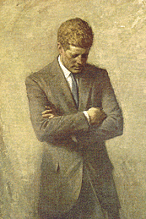
Basic Facts
35th President
Born May 22,1917
Died November 22, 1963
Years in Office: 1961-1963

Slide 3
Important Information
He died when he was President.
In 1957 he was awarded the Pulitzer Prize for a book he wrote.

Slide 4
Interesting Facts
Kennedy’s face is on the 50-cent coin.

Slide 5
Any questions or comments?
Thank you!

