Slide 1
Lyndon Johnson
By Tyson

Slide 2
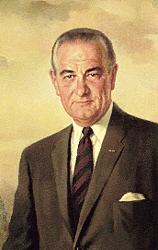
Basic Facts
36th President
Born August 27, 1908 in Stonewall, Texas
Died January 22, 1973 in Johnson City, Texas
Years in Office: 1963-1969

Slide 3
Important Information
He took over when president Kennedy was killed.
He was a senator from Texas.
He put the Civil Rights Act on the law.

Slide 4
Interesting Facts
He liked toasted marshmallows.
He had 2 Beagles named Him and Her.

Slide 5
Any questions or comments?
Thank you!

