Slide 1
Gerald Ford
Researched By Riley

Slide 2
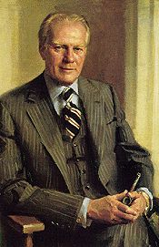
Basic Facts
38th president
Born July 14, 1913
Died December 26, 2006
Years in Office: 1974-1977

Slide 3
Important Information
He was never elected. He was the Vice President, so he became president when Richard Nixon left.

Slide 4
Interesting Facts
He started on the University of Michigan football team.

Slide 5
Any questions or comments?
Thank you!

