Slide 1
James Madison
Researched By David

Slide 2
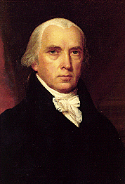
Basic Facts
4th President
Born 1751
Died 1836
Years in Office: 1809-1817

Slide 3
Important Information
He helped create the Constitution.

Slide 4
Interesting Facts
James Madison was on the $5,000 bill which is no longer used.
There were 19 stars on the flag when he left office.
He was the shortest president.
He had a macaw for a pet.

Slide 5
James Madison
Reseaserched by David O’dell

