Slide 1
James Monroe
Researched By Suad

Slide 2
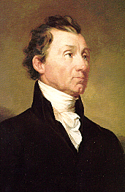
Basic Facts
5th President
Born April 28,1758
Died July 4,1831
Years in Office: 1817-1825

Slide 3
Important Information
He signed the Missouri Compromise, which said that there would no slavery south of Missouri.

Slide 4
Interesting Facts
He died on the 4th of July.

Slide 5
Any questions or comments?
Thank you!

