Slide 1
John Quincy Adams
Researched By Jovan Ghulldu

Slide 2
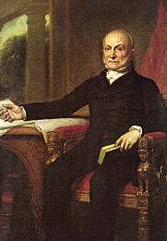
Basic Facts
6th president
Born July 11, 1767
Died February 23, 1848
Years in Office: 1825-1829

Slide 3
Important Information
He was part of congress for 18 years after being president.

Slide 4
Interesting Facts
He was the son of the 2nd president.

Slide 5
Any questions or comments?
Thank you!

