Slide 1
William Henry Harrison
Researched By maysa

Slide 2
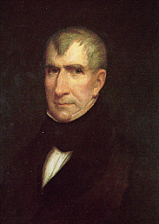
Basic Facts
9th President
Born February 9,1773 in Charles City
Died April 4,1841 in Washington, D.C.
Years in Office: 1841

Slide 3
Important Information
He was only president for one month because he died from pneumonia.

Slide 4
Interesting Facts
He was the first president to die in office.

Slide 5
Any questions or comments?
Thank you!

