Slide 1


WELCOME TO GIFTED CLASS!
What is GIFTED?

Slide 2

What is “Gifted”?
Gifted – One who thinks differently or who has great natural ability or talent. A gifted person thinks outside the box.

Slide 3
Gifted Education Program:
The mission of gifted education is to provide programs and services that meet the unique cognitive, social, and emotional needs of gifted students, preparing them to succeed in a global society.

Slide 4
Other Definitions:
Critical Thinking – the mental process of actively and skillfully using careful thought and judgment to reach an answer or conclusion. Critical thinking is characterized by the careful analysis of arguments, use of objective criteria, and evaluation of data.
Problem Solving uses a number of sequential skills to solve a problem.
Identifying general problem Formulating alternative solutions
Clarifying problem Choosing the best solution
Formulating hypothesis Applying the solution
Formulating appropriate questions Monitoring acceptance of the solution
Generating related ideas Drawing conclusions
Creative Thinking/Thinking Outside the Box – beyond one correct answer, thinking deeper to explore many possible solutions. Creative thinking produces new and original ideas.

Slide 5
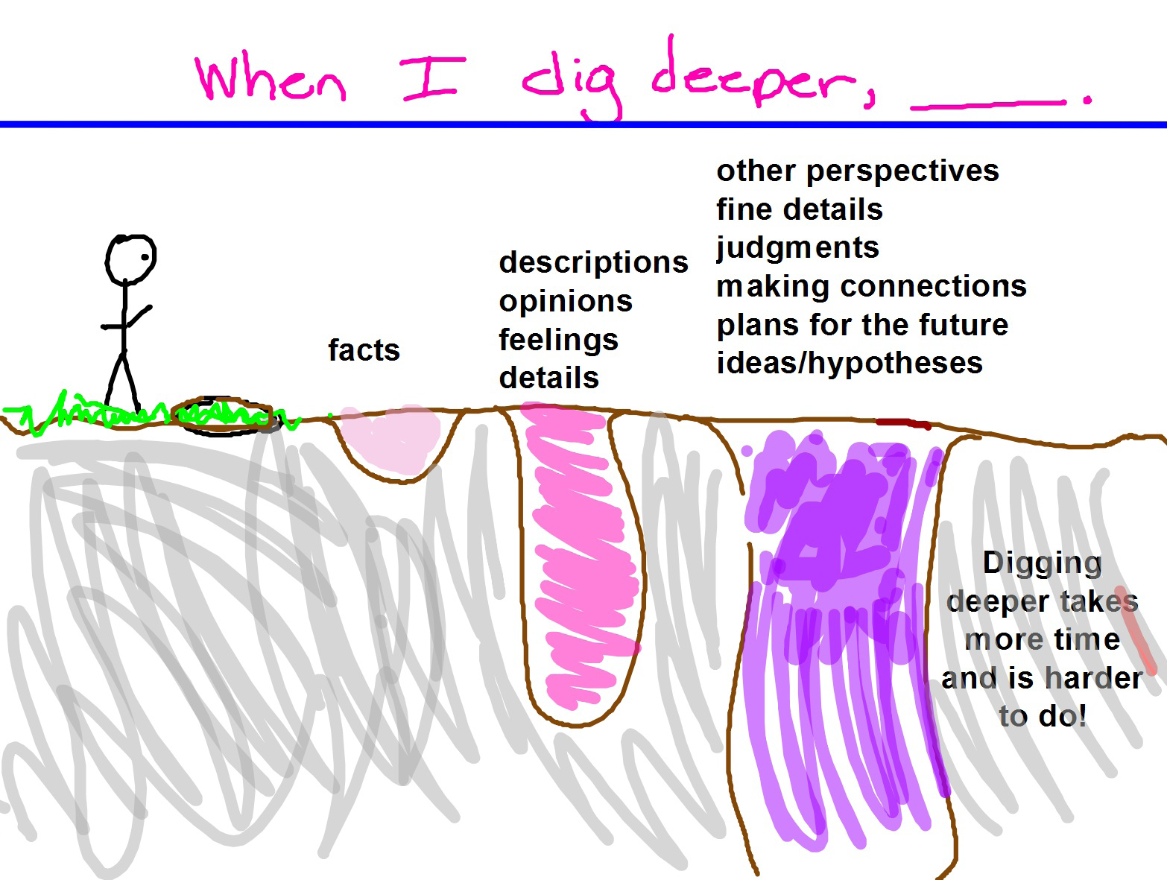
Critical Thinking = Digging Deeper!

Slide 6
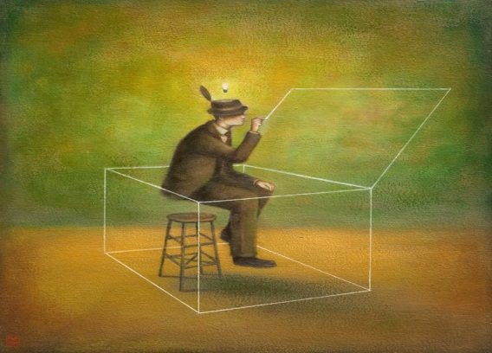
Creative Thinking = Thinking Outside the Box!
("Outside the Box" by Joseph Pelling)
http://www.youtube.com/watch?v=xhCzMCZsKoA&feature=player_detailpage

Slide 7
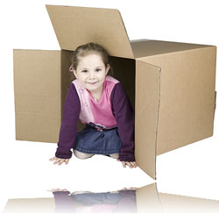
Frameworks for K-12 Gifted Learners
STUDENT OUTCOMES – FRAMEWORK GOALS AND OBJECTIVES
FRAMEWORKS
FOR GIFTED
LEARNERS!
This is how we learn in gifted class!

Slide 8
1. Knowledge
We will learn how to become more global by understanding how to locate facts, build vocabulary, and organize a field of study
We will identify and illustrate basic principals and important details to better understand a topic
We will build knowledge by deeper investigation to study new material

Slide 9

2. Questioning
We will learn how to generate many, varied and unique questions about a topic
We will learn to discriminate between relevant and irrelevant information
We will learn to create a list of questions about a problem to help us dig deeper
We will learn to generate questions to gather specific information or answers
We will learn to create questions from different points of view

Slide 10

3. Research
We will learn how to locate information using tools like a table of contents, index, etc.
We will learn to tell the difference between important and unimportant information
We will learn to gather and record information in a neat and organized way from many different sources. (Books, websites, encyclopedias, etc.)
We will learn to organize and use the information we have gathered, and draw conclusions from what we have learned

Slide 11
4. Critical Thinking,
Creative Thinking &
Problem Solving
We will learn how to identify and investigate a problem from multiple perspectives
We will learn to analyze data and draw conclusions for solutions
We will learn to recognize relevance, reliability and usefulness of data to forecast future outcomes and solutions
We will learn to use and evaluate problem solving methods in solving real world problems

Slide 12

5.Group Learning
We will learn to accept and understand many points of view
We will learn to positively effect the outcome of the group project to achieve goals
We will learn to identify the attributes of good leaders
We will learn to demonstrate good leadership traits
We will learn to assume various leadership roles and participate in different group learning situations

Slide 13

6. Goal Setting
We will learn how to set and achieve personal, academic and career goals
We will learn to identify personal strengths and weaknesses and accept challenges in both areas with an open mind
We will learn to accept responsibility for our own learning and goal setting
We will learn to adhere to deadlines and target dates
We will learn to design and use a plan of action to achieve goals of personal interest

Slide 14
7. Products &
Presentations
We will learn to develop and deliver a variety of products and performances that show what we have learned and deepen understanding
We will learn to develop products to communicate ideas, perspectives, solutions and information
We will learn to create products that synthesize information from a variety of sources
We will learn to plan and revise communication to others in a variety of audiences

Slide 15
Other Important Information:
GIFTED/ENRICHMENT GRADING SCALE
4.0 = “Q” = Quality – WOW! Great Work! Exceeds the requirements;
having a high degree of excellence. I am able to stretch my thinking and
my learning to go above and beyond to “Wow!”
3.0 = “C” = Competent – OK. Good Work. Meets the requirements. Not quite quality or “Wow” work.
2.0 = “W” = Working on it – I am beginning to understand the requirements but I still need help.
1.0 = “NY” = Not Yet - Incomplete or Unacceptable Work. Does not meet the requirements and needs appropriate improvements.
Go for QUALITY work!

Slide 16
SAND LAKE ELEMENTARY SCHOOL
ORANGE COUNTY PUBLIC SCHOOL
GIFTED RULES FOR SUCCESS 2014 - 2015
Ms. Victoria Harman Gifted Resource Teacher (1-4)
BEHAVIOR RULES:
Never give up or say, “I can’t”.
Be respectful to the teacher, other students and to their property.
Raise your hand to speak in whole group. Wait to be called on to speak.
Use self-control at all times. Examples: Walk, use an “inside” voice, keep your hands and feet to yourself.
Be responsible. Come to class prepared with all needed materials. Listen carefully and follow directions. Actively participate with our learning community.
REWARDS:
Centers
Brain Breaks
Free choice in the classroom
Educational game time
D.E.A.R Time! (Drop Everything and Read)
CONSEQUENCES:
When students enter the classroom for their gifted day, they will sign their names on the white board next to “Outstanding” behavior; my expectation is that all students can maintain outstanding behavior for the day.
First Strike: Students will receive a warning; students will erase their name and move it to “Satisfactory”.
Second Strike: Students will move to a time out desk to write a “Behavior Reflection”; students will erase their name and move it to “Need to Think About it” on the Conduct Chart.
Third Strike: Time out for the rest of the day, loss of privileges and parent contact; student will move their name to “Parent Contact” on the Conduct Chart.

Slide 17

WELCOME TO GIFTED CLASS!
Let’s have a fantastic year of learning and exploring together!
Questions?

Slide 18
ACTIVITY: Let’s See if You’ve Been Paying Attention!
GETTING TO KNOW THE FRAMEWORKS!
Each student will work with a partner
You or your partner will choose an envelope from the basket
Plan, design and create a poster to represent the Gifted Framework that you chose. Your poster must be nonlinguistic, and represent what your Framework means to you (Examples: Graphic organizers, Pictures, Pictographs, Flow charts)
Poster goals are: Neat, colorful, creative, “Wow” details, quality representation of your Framework. Ready to be displayed with pride!
Teams will present their poster to the class, explaining what is happening on the poster without naming the Gifted Framework.
The rest of the class tries to guess which Framework your poster represents

