Slide 1
The Seven Deadly Sins
The Seven Heavenly Virtues
Art by Marta Dahlig
Photography by Emma Brabook
Infographics by Kristina Shevory, Wired Magazine

Slide 2
The Seven Deadly Sins
Polish fantasy artist Marta Dahlig spent two years creating this series of images. She combines archetypal colors and symbols to enhance the meaning and destructive power of each sin.

Slide 3
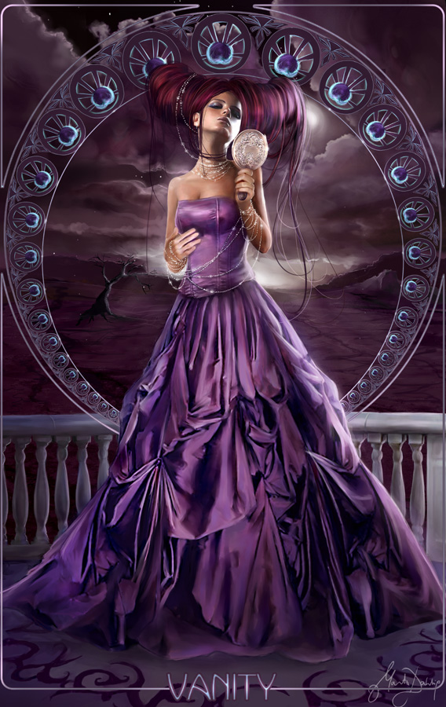
Vanity (Pride)

Slide 4
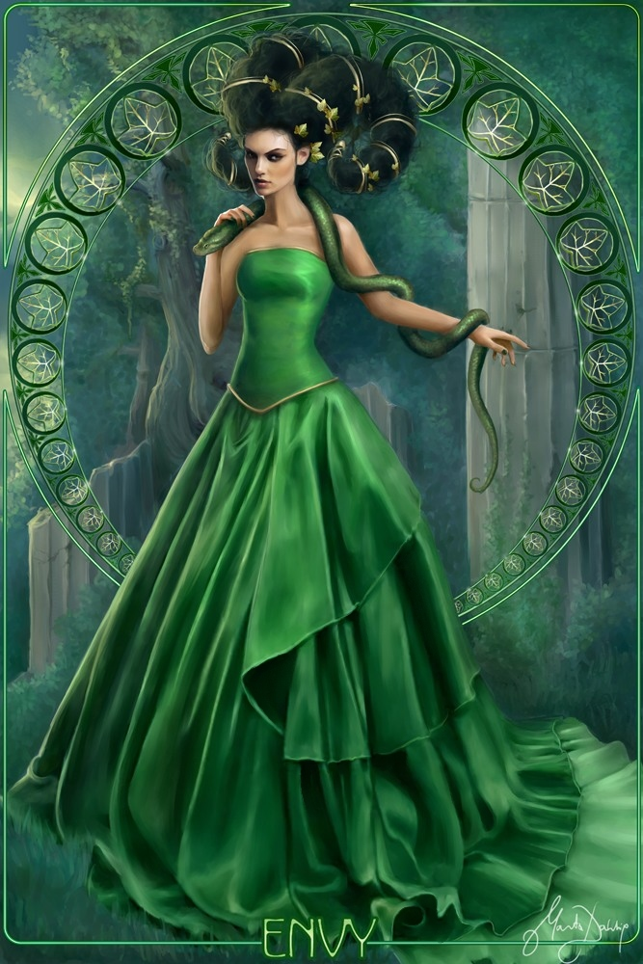
Envy

Slide 5
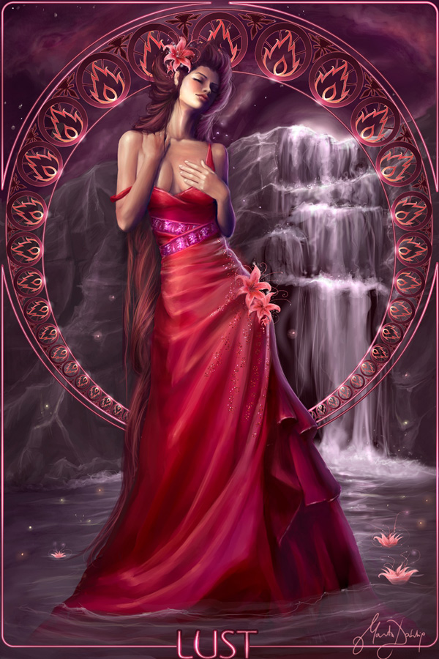
Lust

Slide 6
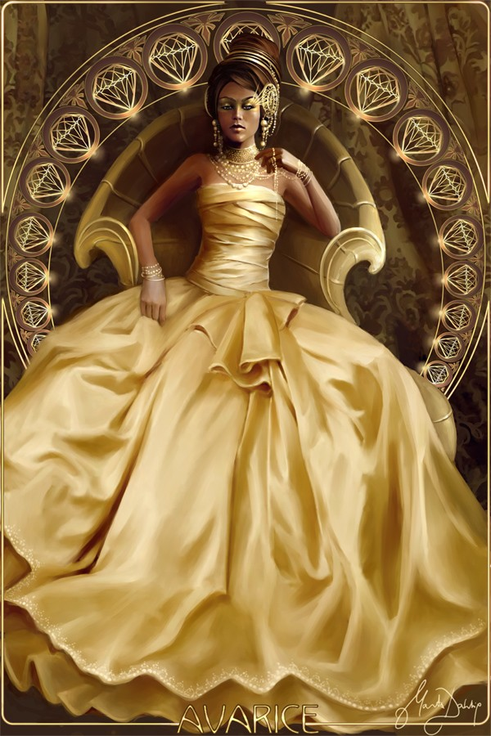
Avarice

Slide 7
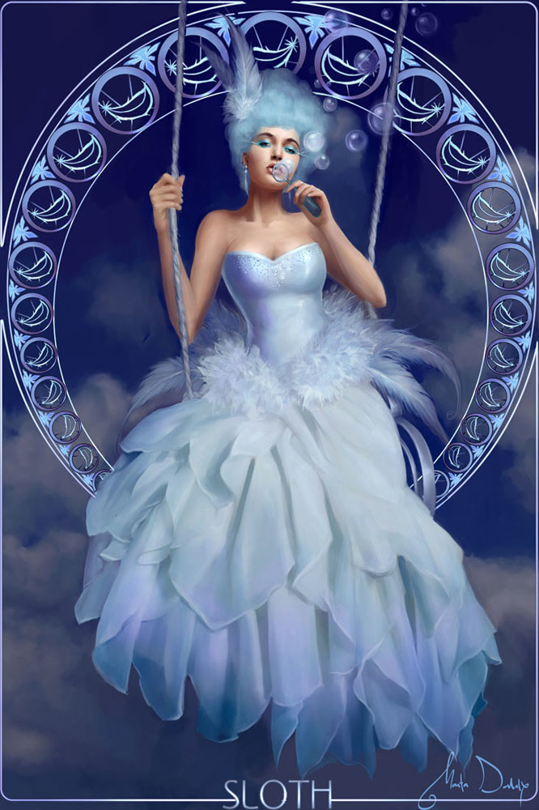
Sloth

Slide 8
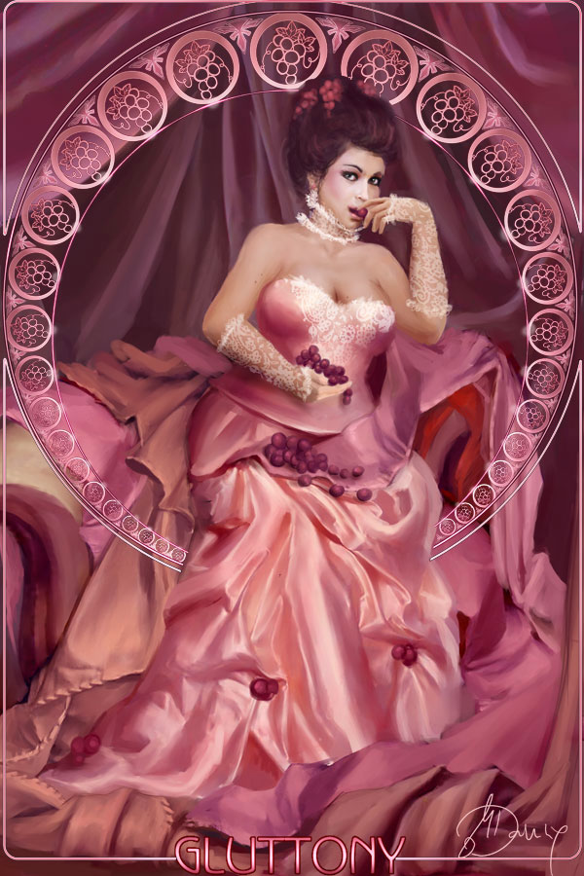
Gluttony

Slide 9
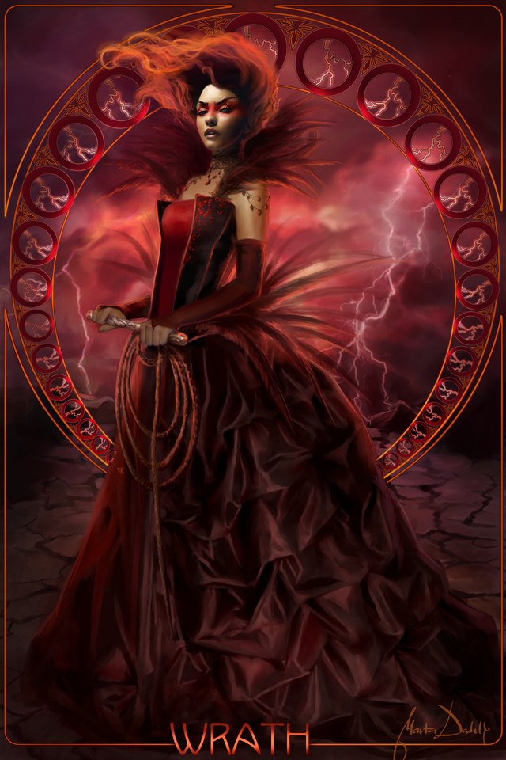
Wrath

Slide 10
The Seven Heavenly Virtues
English photographer Emma Brabook created this series of images for her final major project. Each portrait contains an object that symbolizes that particular virtue and a background color linked to its corresponding sin.

Slide 11

Humility

Slide 12
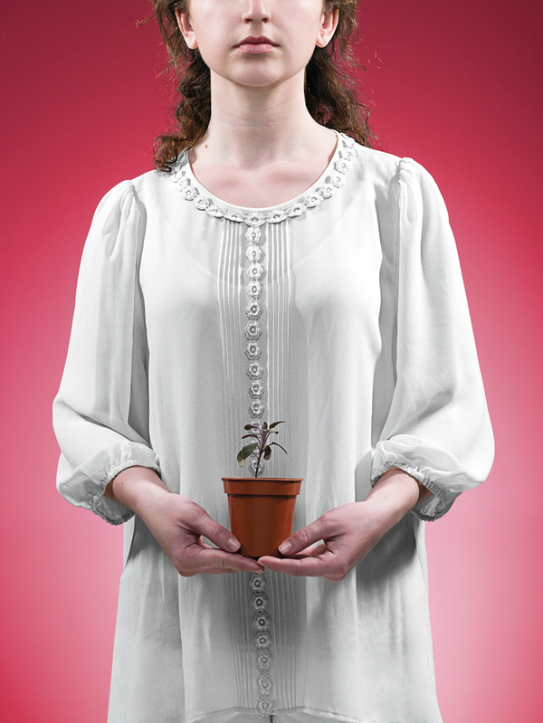
Patience

Slide 13

Temperance

Slide 14
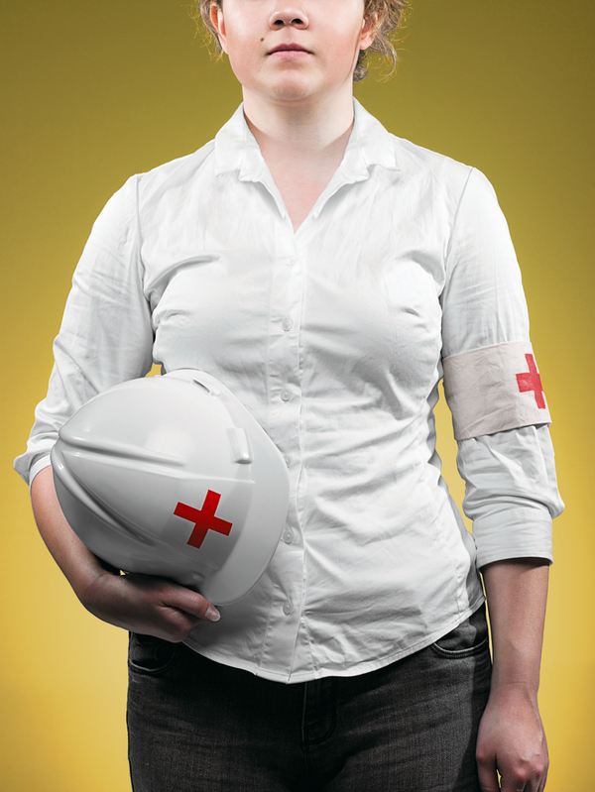
Charity

Slide 15

Kindness

Slide 16

Diligence

Slide 17
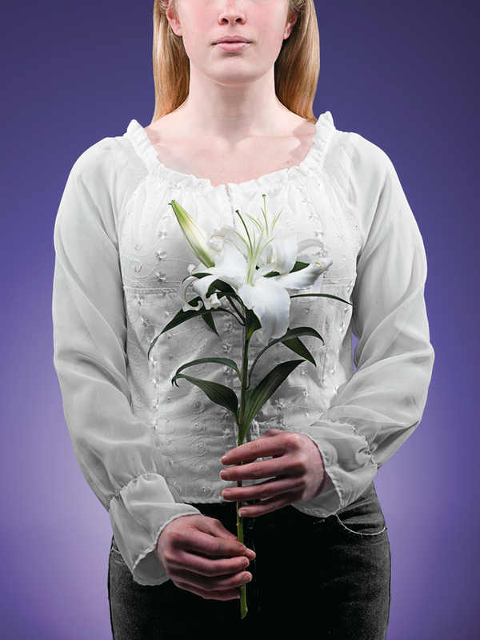
Chastity

Slide 18
American Vice: Mapping the Seven Deadly Sins
In 2009, Wired Magazine and a team at Kansas State University created maps of the Seven Deadly Sins by using statistical data. “Saintly” areas are depicted in gold; “Devilish” areas in maroon. The deeper the color, the more concentrated the virtue—or sin.

Slide 19
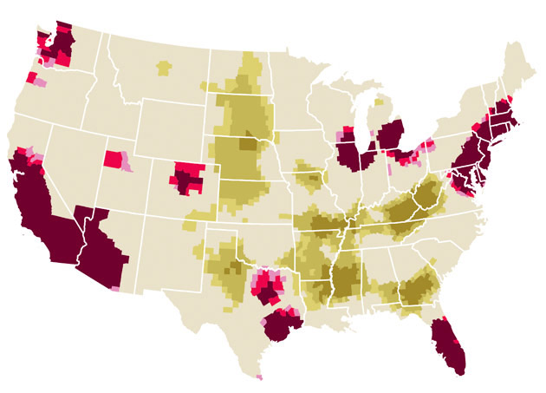
Greed
Average income compared with number of people living below the poverty line.

Slide 20
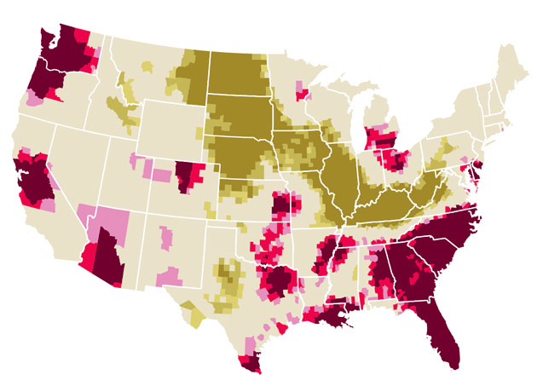
Envy
Total thefts (robbery, burglary, larceny, and grand theft auto) per capita.

Slide 21
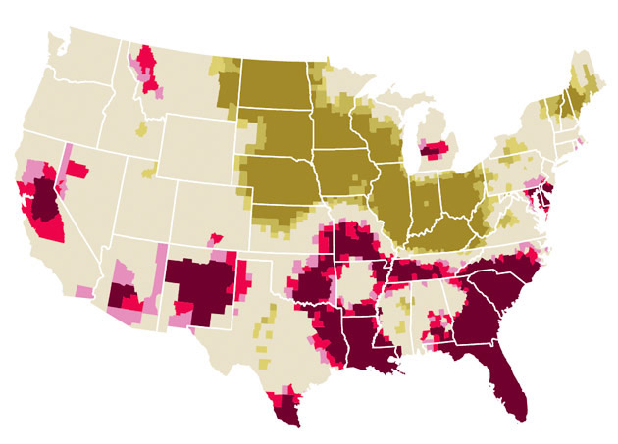
Wrath
Number of violent crimes (murder, assault, and rape) per capita.

Slide 22
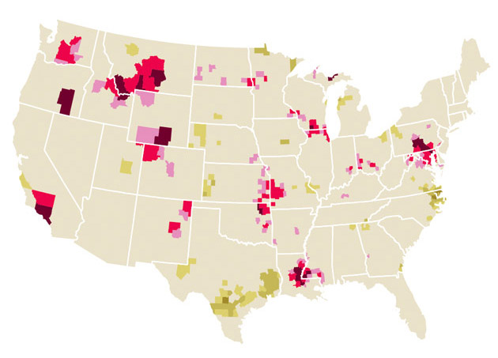
Sloth
Expenditures on art, entertainment, and recreation compared with employment.

Slide 23
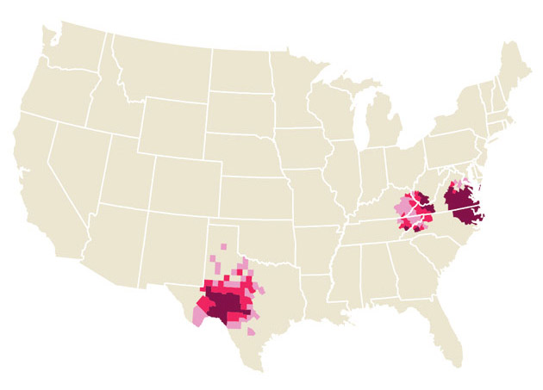
Gluttony
Number of fast-food restaurants per capita.

Slide 24
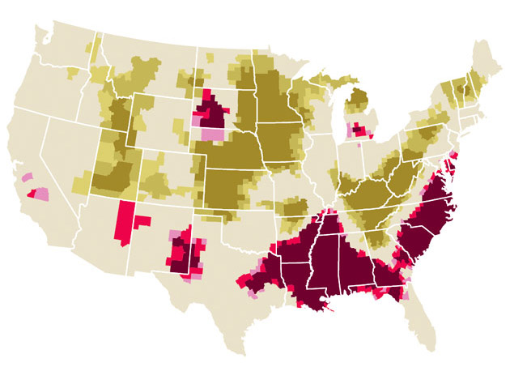
Lust
Number of STD cases reported per capita.

Slide 25
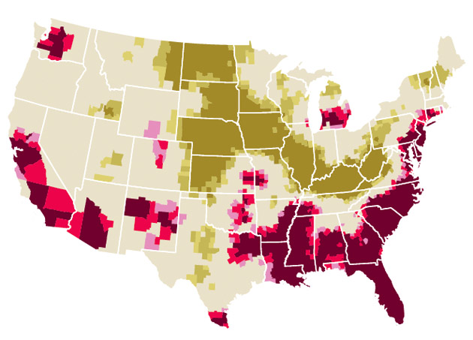
Pride
Aggregate because of the other six offenses—because pride is the root of all sin.

